Slide 1
Improving Programs through Data-Driven Decisions: From Critical Questions to Data Reporting
Colleen Murphy, DaSy at AEM
Missy Coffey, DaSy at AEM
Abby Schachner, DaSy at SRI
2016 Improving Data, Improving Outcomes Conference

Slide 2
Session Agenda
Overview of Session
Intended Outcomes
DaSy Critical Questions
Using CEDS for Organizing Data
Visually Displaying Data
Putting it All Together

Slide 3
Intended Outcomes
Discuss the DaSy Critical Questions and how they can help Part C and Part B/619 programs start the data integration conversation
Demonstrate CEDS tools developed to share data dictionaries, evaluation and research questions, and answer important program and policy questions
Learn reporting methods for visually displaying data

Slide 4
Why Do I Need Data?
  Federal and state reporting
  Additional reporting to
    Highlight gaps and barriers
    Provide evidence of program improvement
    Receive additional funding
    Identify process to outcome relationships
    Improve programs and policies

Slide 5

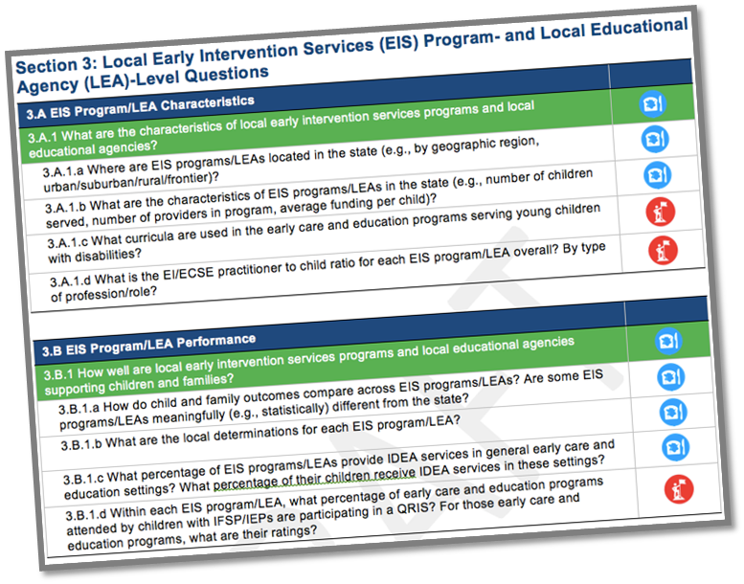
DaSy Critical Questions
Start by identifying your high priority questions
DaSy Critical Questions
Notes:
The Center for Early Childhood IDEA Data Systems (DaSy) compiled a set of Critical Questions that a powerful state data system should be able to answer (or may want to answer) . The answers to these questions serve various functions including: supporting the state agency in effectively administering the program, and meeting accountability requirements for early intervention and early childhood special education, and improving results for children and families through an examination of program features.

Slide 6
DaSy Critical Questions
DaSy Critical Questions:
3 sections of questions
  Child- and family-level
  Practitioner-level
  Local Early Intervention Services (EIS) program/Local education agency (LEA) level
Broad & specific example questions
Essential & aspirational questions
Notes:
The questions are grouped into three sections, which align with the suggested data elements in the DaSy Data System Framework System Design Subcomponent (see SD4). Each section has a set of broad questions, with each broad question followed by more specific example questions.
The broad questions represent critical global questions for state monitoring, evaluation, and program improvement efforts in early intervention and early childhood special education.
The specific example questions illustrate more detailed approaches that will allow the state to address the issues raised in the overall broad questions.
The critical questions include both essential questions, denoted by the [bread and butter] symbol and aspirational questions, denoted by the [mountain climber] symbol.
Essential questions are those that a comprehensive, well-functioning state data system should be able to answer.
Aspirational questions, although valuable to ask and answer, are more complex and require more information or more linkages to other data systems than would be expected even with a good system.

Slide 7
Critical Questions You May Have…
To what extent are children with IFSP/IEPs attending general early care and education programs?
  What percent of children enrolled in EI/ECSE are served in general early care and education programs* (e.g., Early Head Start, Head Start, home visiting, child care, state Pre-K)? How does this compare to the overall population of children birth-5 in the state?
What are the long-term outcomes of children who participate in early intervention/early childhood special education?
  What percent of children who exit EI/ECSE at age expectations do not have an IEP in K-12 (e.g., in kindergarten, in third grade, in grade 12, at graduation, ever)?

Slide 8
Critical Questions You May Have…
What are the characteristics of the practitioners working with children with IFSP/IEPs in general early care and education?
  What are the levels of education and years of experience of the general early care and education practitioners working with children with IFSP/IEPs?
What is the cost of providing early intervention/early childhood special education services to children and families?
  What is the average cost per child for EI/ECSE services statewide? For each EIS program/LEA?

Slide 9
How Critical Questions Can Guide Your Work
Critical questions can
  Be a tool to plan enhancements to a data system
  Help organize analyses to inform program operations, program improvement, and policy and accountability

Slide 10
How to use the critical questions to organize analyses to inform program operations, program improvement, and policy
Identify the questions in this document that are a priority for the state/locality.
Identify which of these questions your state can answer with your data system and which questions currently cannot be answered.
Develop an analysis plan to answer the priority questions that can be answered with your current data system.
Analyze the data.
Apply the results of the analysis to answer your priority questions – and improve services for children and families.
Notes:
Clean up

Slide 11


Using CEDS for Organizing Data

Slide 12


Slide 13


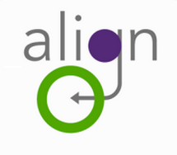
Connecting Questions and Answers

Slide 14


Figure out what data you collect
Use CEDS Align to:
  Get all of your data information in one place
  Compare data collections across agencies or across data systems
  Identify data collection redundancies

Slide 15
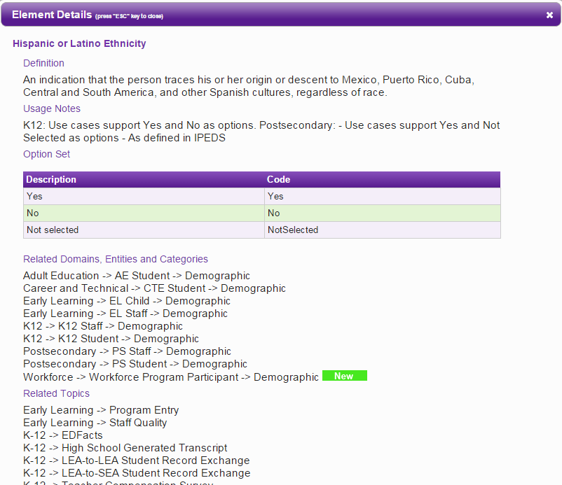
CEDS Elements
Element
Definition
Option set
Domain
Entity
K12
K12 Student

Slide 16
Developing Answers
Way to outline policy analysis
Concise location for:
  Question/problem
  Data elements needed
  Notes about how to conduct the analysis

Slide 17


Using CEDS for Organizing Data
Notes:
Available Connections

Slide 18
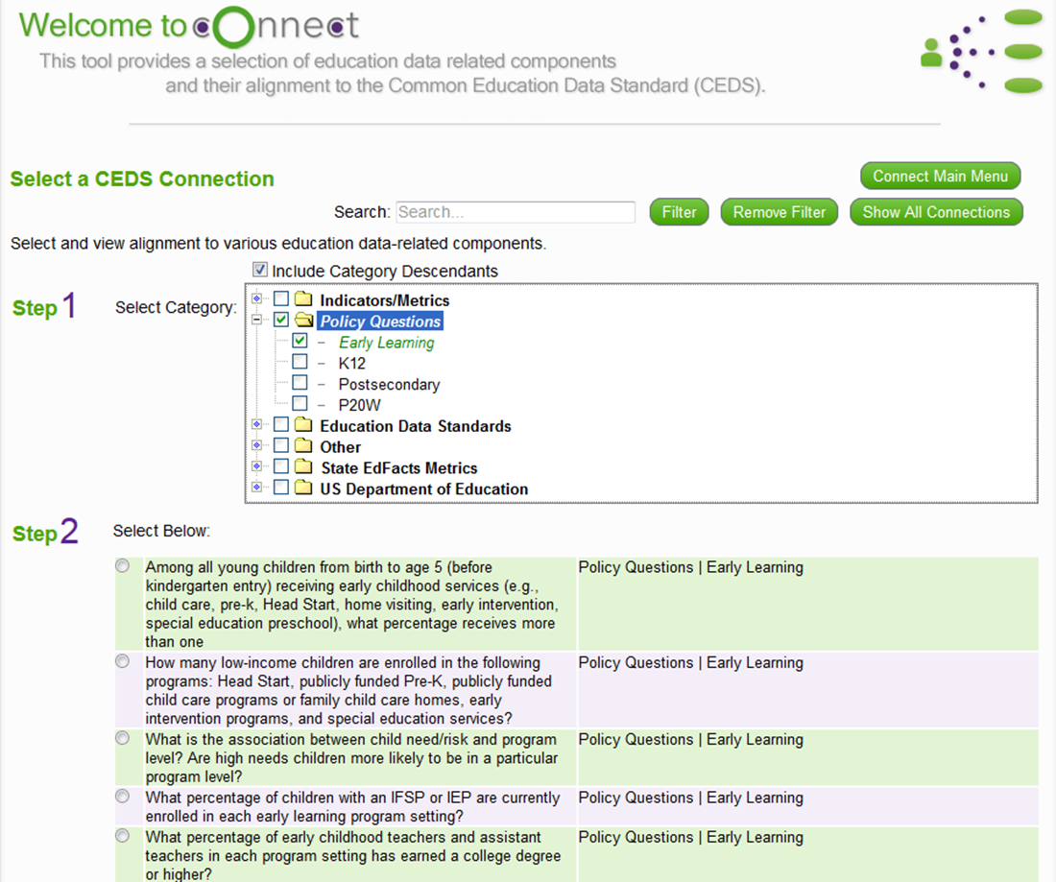
Using CEDS for Organizing Data
Notes:
Available Connections

Slide 19
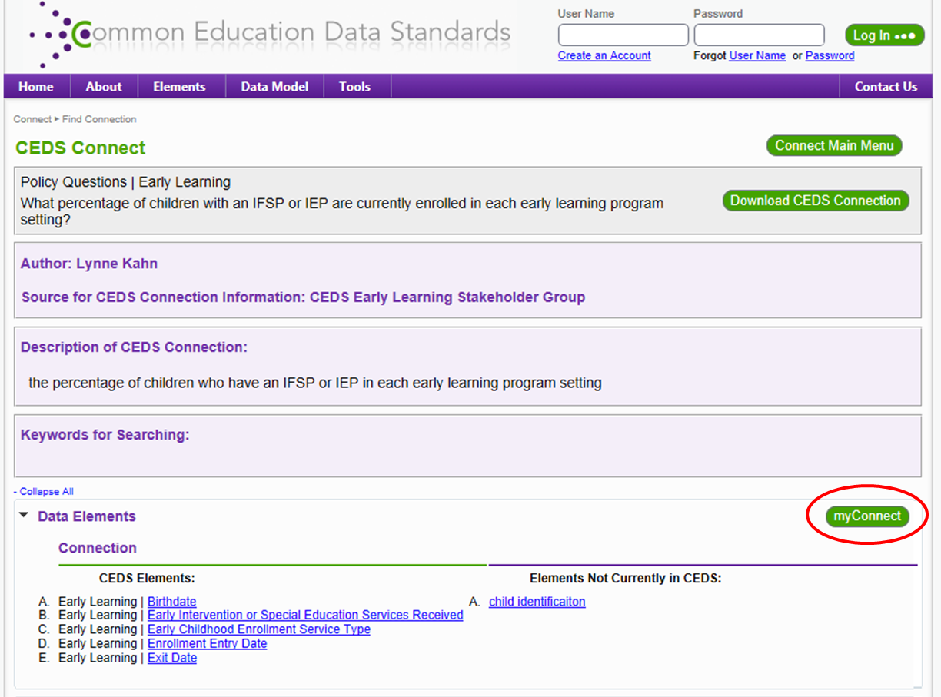
Using CEDS for Organizing Data
Notes:
Available Connections

Slide 20
Using CEDS for Organizing Data
Potential Analysis Recommendations
What percentage of young children who received early intervention or special education preschool and who participated in a highly rated early learning program substantially increased their rate of growth on Outcomes 1 - 3?
  Determine N, the unduplicated number of children receiving EI or ECSE services.
  Select those who participated in another program type.
  Remove children who participated in unrated or low rated programs.
  Remove children without exit ratings.
  Calculate progress category (a-e) for remaining children.
  Apply OSEP formula (c+d)/(a+b+c+d).
Notes:
Available Connections

Slide 21



Connecting Questions and
Answers
myConnect allows you to see a Connection and apply your aligned map to see how to do the analysis using your own data elements

Slide 22


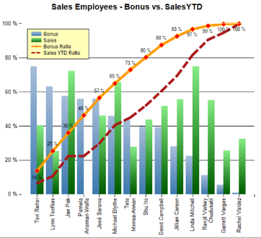
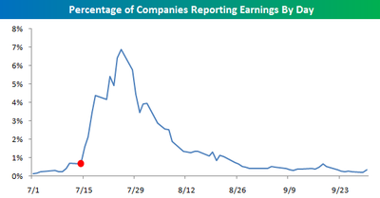
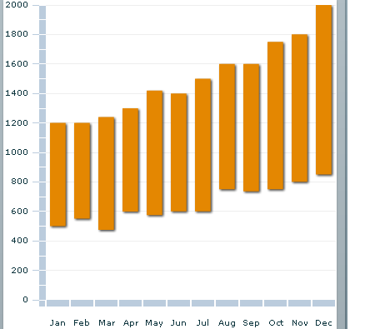


Data Dictionary
Research/Policy
Collaboration / Answers / Resources

Slide 23

Creating Reports to Visually Share Data
Notes:
From the LDU meeting 1 and 2-- Sharon W. and Kerry presented these slides and shared a draft of one of the report templates. It might be good to do the same in this session.

Slide 24
Creating a Standard Report Template
Use common fonts/colors on reports of the same type
Include:
  Disclaimer
  Who to contact with questions
  Page numbers
  If abbreviations, include legend
  Date
  Geographic area
Notes:
Verbally describe what we mean by a report
Pass out draft data reports

Slide 25
Report Content
Identify the critical question(s)
  Are there sub-questions that need to be unpacked?
  Are there multiple questions which can be grouped for the report?
Detail what data was used and how it was analyzed
Highlight the key data points/relationships
Be explicit about key findings
Use effective design and data visualization

Slide 26
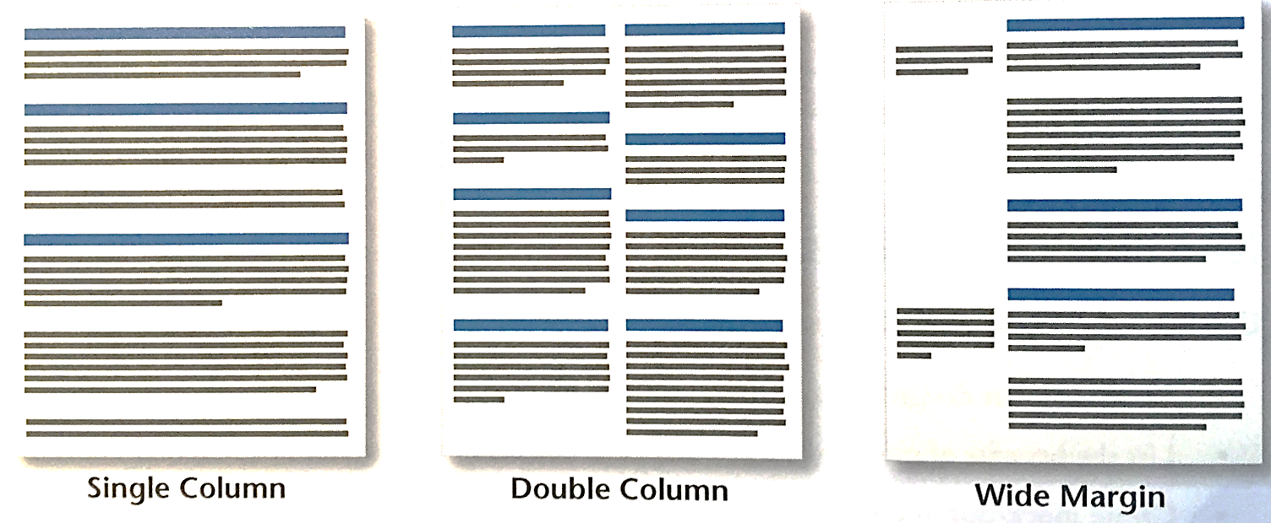
Layout
Determine what headings will be most useful to organize the information before you write
Choose a layout style that includes white space

Slide 27
Layout (Cont.)
Include at least 1 visual every 2 pages (typically data tables and charts)
Integrate visuals with the text they support on the same or facing page

Slide 28
Effective Charts
Emphasize key takeaways with title or “action caption”
Include the n-size and data labels to aid in understanding
Eliminate “chart junk” such as unnecessary gridlines, borders, axis labels, etc.
Use color strategically

Slide 29
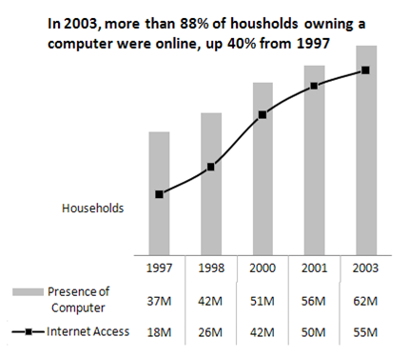
Do make effective use of chart titles

Slide 30
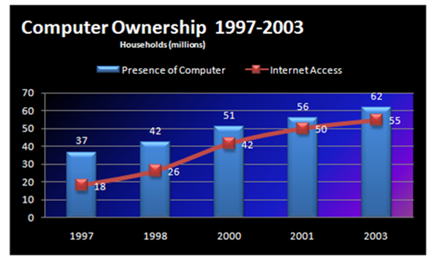
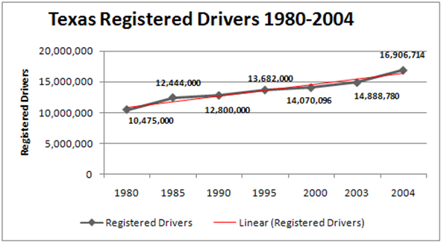
Don’t Do Too Much
Avoid Over-Formatting (background colors, 3D effects, gradients/patterns, clipart) and Chart Junk (unnecessary gridlines, borders, labels)

Slide 31
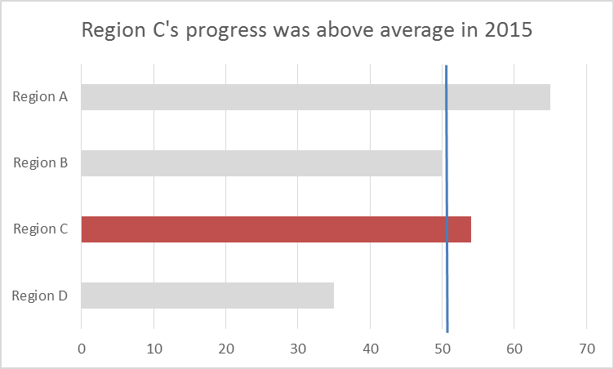
Do use color strategically.

Slide 32
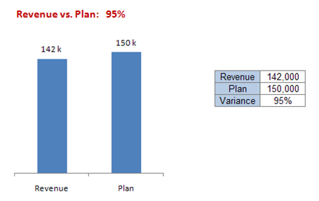
Don’t be afraid not to graph
Ask yourself if there is a benefit to seeing your data graphically.

Slide 33
Effective Data Tables
Include only relevant information
Emphasize key takeaways with title or “action caption”
Use font/color/style consistent with the rest of the report
Separate groups with dividers or colors

Slide 34

Need Data Display Templates & Ideas?
Use the DaSy-NCSI Data Visualization Toolkit
Notes:
I believe the toolkit will be released at the end of July, you could include a link to it in the slides you present at eh conference and plug the session they are doing on it and encourage them to go to the "playground" to try it out

Slide 35
Discussion
Has anyone used the critical questions?
  If so, how and what was useful about the process of identifying your questions?
Has anyone used CEDS?
  If so, how and what benefits did you find?
What sorts of data reports do you have?
  Do your reports include the elements discussed?
  What are the things you want to revise?

Slide 36
For more information
Visit the DaSy website at:
http://dasycenter.org/
Like us on Facebook:
https://www.facebook.com/dasycenter
Follow us on Twitter:
@DaSyCenter
Engage with CEDS at: http://ceds.ed.gov

Slide 37



Thank You!
The contents of this presentation were developed under a grant from the U.S. Department of Education, #H373Z120002. However, those contents do not necessarily represent the policy of the U.S. Department of Education, and you should not assume endorsement by the Federal Government. Project Officers, Meredith Miceli and Richelle Davis.

