Slide 1
Building a Culture of Data Use
Kathy Hebbeler
Donna Spiker
Improving Data, Improving Outcomes Conference
August 2016

Slide 2

Federal
Policies
State
Systems
Local/Regional System
Leadership
Fiscal Policies Professional Development
Use of Data, etc.,
Practices
Interactions of providers with children and families
Good outcomes for children and families
Notes:
We are going to be talking about data use today but before we want to set the stage with some systems concepts. The focus of our service delivery system is good outcomes for children and families. The most direct influence on outcomes is what happens between a provider and a child and the family. By provider, I mean teacher, early interventionist, therapist – anyone working directly with children and families. We call what the provider is doing “practices.” Good practice – good outcomes. Poor practices – not such good outcomes. Pretty straightforward relationship. This is at the core.
What is not so obvious is that whether or not that provider is using good practices depends on multiple influences, some of which influence that provider directly and some indirectly. The most direct influence on the provider is the local program and local system in which the provider operates. Examples of influence include leadership at the local level, fiscal policies, opportunities for professional development, use of data, and many more. But the local level does not operate in a vacuum either. What happens at the local level is influenced by the state system. Some of these influences might be enormous – such as funding and others are less so. Similarly, both the state and local level are influenced by the federal policies and procedures.
So let’s start today with being aware that how providers interact with families is the result of multiple layers of influence.

Slide 3
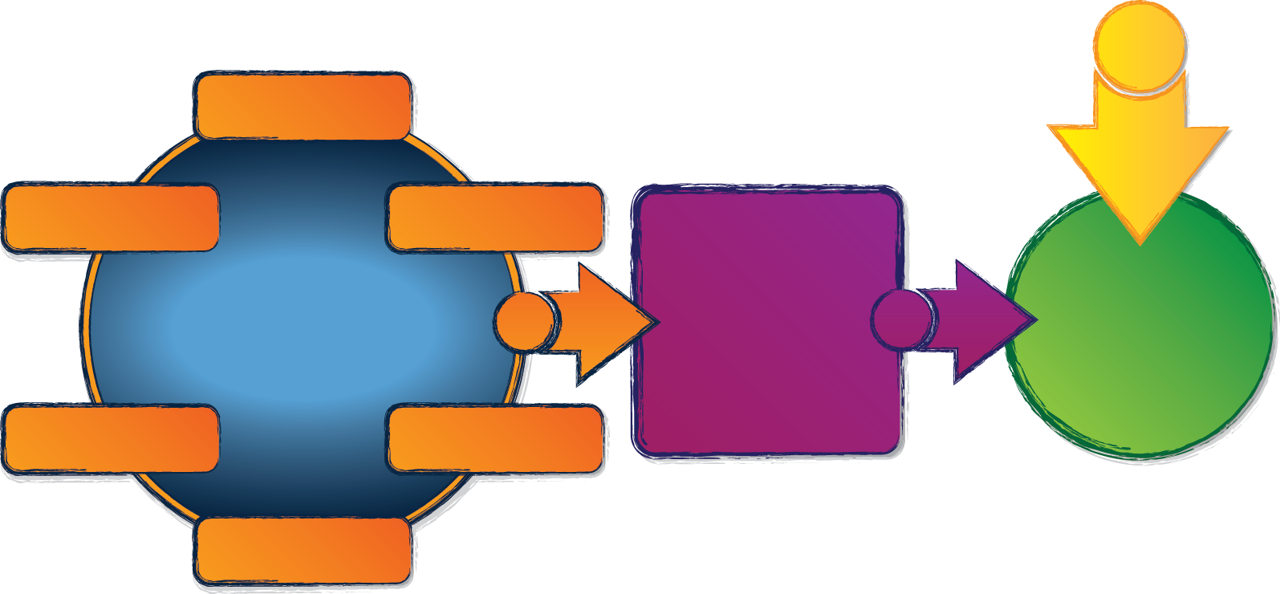

Good State System Good Practice Good Outcomes
Governance
Result
Quality
Standards
Finance
Implementation
of
Effective Practices
Good outcomes for children with disabilities and their families
Building
High-Quality
Systems
Accountability & Quality Improvement
Personnel / Workforce
Data
System
For more information about the ECTA System Framework, visit: http://ectacenter.org/sysframe/
Notes:
Central to systems thinking is the notion of multiple perspectives. This is an abbreviated or simplified view of what we just looked at – this is your view. The local system is missing in this picture and is embedded behind the orange arrow. What view does is show the components of a high quality state system. This is your sphere of influence. In case any of you don’t recognize this, this is an overview of the ECTA System Framework

Slide 4

Thinking about Systems
Has multiple components
The components interact
All of the components are important
  Personnel standards
  Good fiscal policy
Systems are constantly changing – and they are hard to change.
X
New coordinators who are wondering what the job entails: Check out the System Framework
Notes:
Some things to remember about a system. It has multiple parts or pieces and those pieces interact. Furthermore, each is important to the functioning of the system. So we are not going to argue that any one component of the system is more important than other component. Each of them has to be functioning to support the other.
By the way, if you are a new coordinator, find some dedicated time to become familiar with the System’s Framework. It is a great introduction to understanding what a state system for early intervention or early childhood special education.

Slide 5
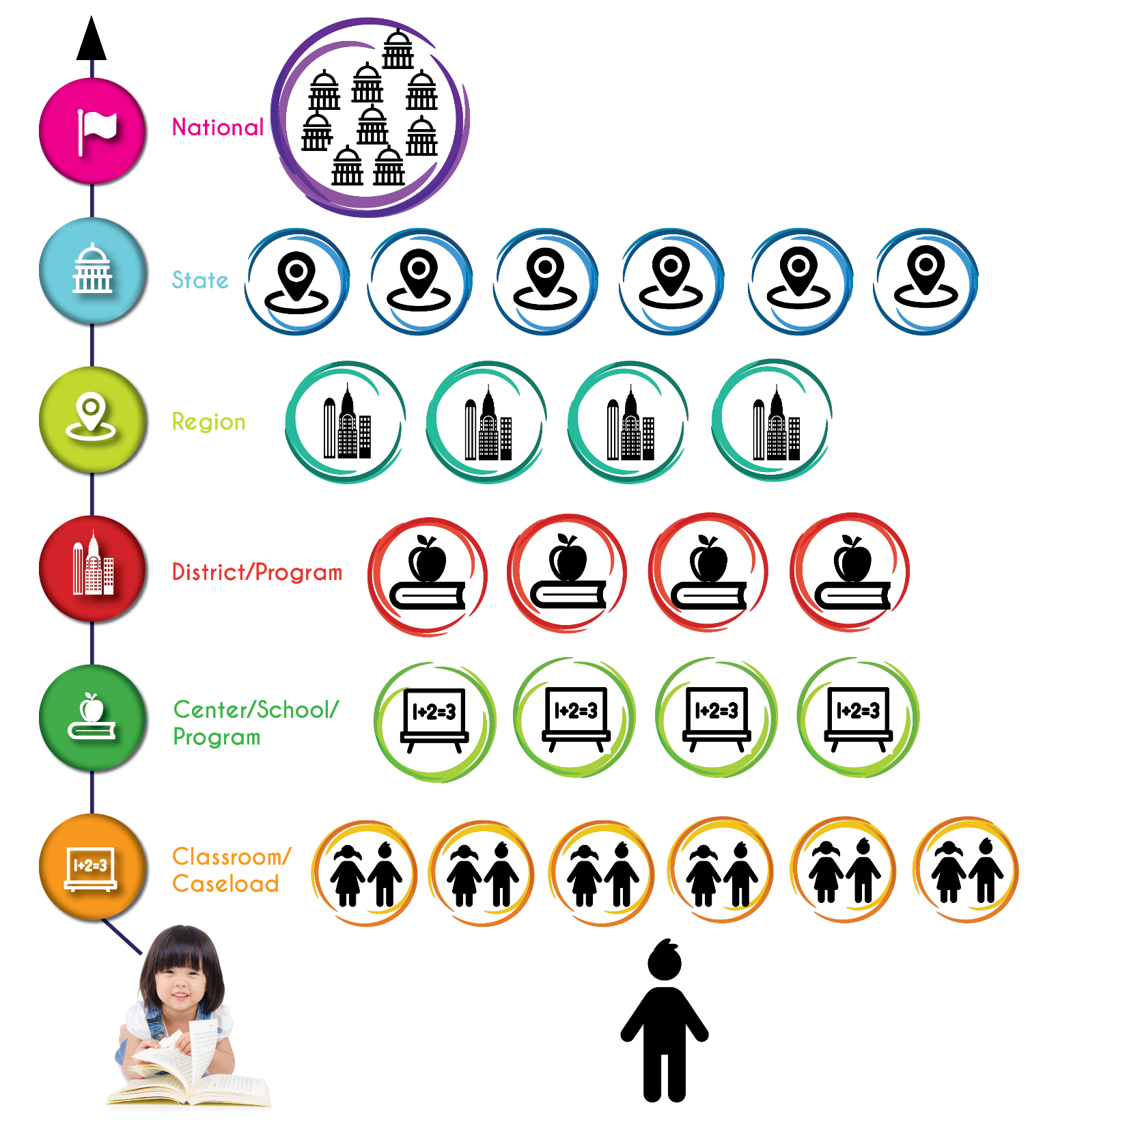
Notes:
Let’s take another look at the multiple levels in how services get delivered to young children with disabilities and their families. Let’s start with the provider level. At the heart of EI and ECSE is the relationship with the child and that child’s family - but the provider is not responsible for just one child. He or she is responsible for many (and some times, we think way too many). Providers are located within a local program or school that is overseen by a principal or director. That person is responsible for many classrooms. And that school is located in a district where someone is responsible for many schools or centers or sites. And there might be a regional level in here. And finally we get to the state level, where most of you operate. The state has responsibilities for many localities. And then finally we get to the national or federal level, where policies are being made that impact each of the states.
We know the number of levels in this configuration varies across states – but all of the configurations have some variations on multiple levels. Each level is a multiple nested within a multiple – and this becomes important for data use.

Slide 6

What do all these people have in common?
All of them make decisions
Their decisions reflect their unique perspective in the system.
Their decisions impact others in the system.
Notes:
Whatever the number of levels your system has, each of the levels has people who work at that level. What do all of these people have in common. They all make decisions. Their decisions reflect their unique perspective in the system – and their decisions impact others in the system.
Big decisions, little decisions – some decisions with big consequences. Some of the little decisions don’t mean much as single decisions but have an impact when taken together. Eg. Preschool teacher who consistently makes good instructional decisions or an early interventionist who has the knowledge base to support a really support the family in helping their child develop and learn.
I might also add that many of you are impacted by the decisions of others and some of them like your state legislature are outside of your system. We will come back to them later.

Slide 7
Propositions
Good decisions are better than bad decisions
Your decisions combined with others’ decisions are critical to whether children and families achieve good outcomes.
People are more likely to make good decisions when they have good information…and that requires good data.
Notes:
Having identified our decision makers, I want to lay out some propositions for you..
Good decisions are better than bad decisions.
Your decisions combined with other’s decisions are critical to whether children and families achieve good outcomes. Some decisions make the state system. better. Some make the local system better. Especially in the EI and ECSE systems, up and down the line, people are incredibly devoted to children and family. Really good people who want to do the right thing. But for a whole host of reasons they might not always make good decisions.
People are more likely to make good decisions when they have good information and that requires good data.

Slide 8

Vision for Data Use
Every person who has influence within the system
Has timely access to relevant, complete, and accurate information
Uses that information to improve policy, systems, programs, or practice
Notes:
What do we want with regard to data? Pretty simple actually, we want to build system where every person who has influence within the system had timely access to relevant and accurate information, and uses that information to improve policy and practice. We want everyone to have the data they need to make good decisions.

Slide 9
Examples of data-informed decisions
Decision:
To address a serious problem identified with data.
Preschool suspensions
Decision:
To take something that is okay and work make it better.
Use of recommended practices
Timelines
Notes:
Sometime data identifies significant problems in our systems. One example would be preschool suspensions – this is a problem we would not even know existed without data. Timelines are another example. The data on timeline show could show instances where things are substantially off of when they should be happening. Data also uncover smaller issues. We don’t to always talk about problems because it sounds negative. In some ways, everything short of providing children and families with high quality services is a problem – I just want to acknowledge that some problems are much more significant than others. Maybe local practitioners are doing some things that are okay but not completely consistent with recommended practices. Data identify the problem. Whatever the problem, data can be used to identify it and track how a program, a district, or a state is doing on addressing the problem.

Slide 10

If this vision was achieved…
There are no problems that go unnoticed because no one knows that they are there.
There are no opportunities for improvement that are lost because no one knew that something needed to get better.
Notes:
Just because you don’t see it does not mean it does not exist. It just means no one is likely to do anything about it.

Slide 11
Continuous Quality Improvement (CQI)
Process of identifying, describing, and analyzing strengths and problems, and then implementing, learning from and revising solutions.
Relies on an organizational culture that supports continuous learning (Culture of data use)
Requires sustained and committed leadership.
Not time limited.
Notes:
I want to talk about something that is closely linked to our vision for data use and that is the notion of Continuous Quality Improvement. CQI comes from business, is being used in health care, and also applied more to the delivery of services in general. There are various adaptations with various vocabulary and buzz terms and graphics. We want to share some key concepts from CQI because they are so central to data use. CQI is a process of identifying, describing and analyzing strengths and problems, and then implement, learning from and revising solutions. It requires an organizational culture that supports continuous learning – that would be a culture of data use. It requires sustained and committed leadership – that is where you come in – and, finally, it is not time limited. It is not a project or an initiative. It is a way of doing business, day in and day out.

Slide 12

Creating conditions that support quality
Quality depends more on system design, consistent long term direction, leadership and follow up – than on individual motivation.
Assumes individuals want to do their best when given appropriate support.
Look at data and eliminate inappropriate variation.
Notes:
CQI approaches improvement with some underlying assumptions. A fundamental working assumption is that system needs to create the conditions for quality. Quality depends on system design, long term direction, leadership and follow up. Not about bad employees. We know in this field most people are really dedicated to doing right by children and families. The system needs to create the conditions that will allow them to do that.
Variation in the system is not a bad thing. We look at data with lots of variation. There is tremendous variability in the population of children with disabilities. Services are individualized. The big question is when is it ok that the data show things are different – and when is it not? More on that in a minute…

Slide 13
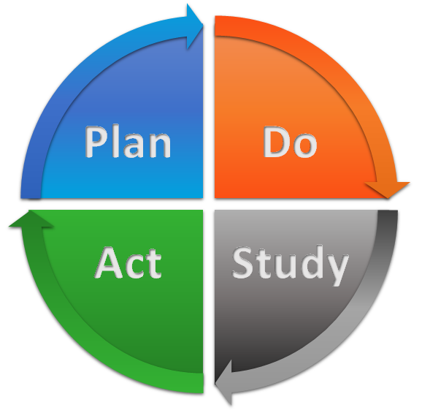
Notes:
I want to talk a little bit about the Plan-Do-Study-Act cycle which is central to using data for continuous quality improvement. I would guess that many of your are familiar with some variation on the PDSA cycle –You have examined your data and yes there is something that needs to be addressed. So what do you do?

Slide 14
Plan an improvement – and determine how you will know if the improvement is effective
  State level
  Program level
  Child and family
Notes:
The nice thing about this process from a CQI perspective is process is exactly the same whether it is a provider examining the effectiveness of a particular intervention, a director planning a new curriculum in the center, or a state implementing new plan for professional development.
This process is what the Part C programs have been doing with SSIP over the last several years. We hope the 619 programs are also engaging in this kind of process either through the state SSIP or outside of it.
A classic and by now common example of how this would work would be a state looking at child outcomes data. There are 3 districts or local programs in your state with especially low child outcomes data. Is it the data? Is it a practice issue? Let’s say the data are pointing to a practice issue in which case you need to work with the program and plan an improvement.

Slide 15

Do it -
Implement the improvement
Collect the data
Do we need these data on an ongoing basis?
Notes:
Now you implement the improvement. You also implement a data collection plan so you will have data that will speak to the success (or not) of the improvement.
I want to introduce just a tiny tangent here because of an issue that is so fundamental to SSIP and any other program improvement question. – That issue is what data do we collect, and where do we put it. More specifically, what do we want in the state data system?
For those of you working on evaluating your SSIP, this is an really important question. If the data address something that needs to be examined regularly, then it belongs in a data system as part of ongoing collection. If it is a one time or intermittent thing, still collect but it does not need to be in the state data system.
What are the things a director needs to see every week? Every month? Every year?
What things are too resource intensive to collect regularly?
Regardless of where you decide to store the data, it is likely you will want to collect it more than once. Anything you improve today, can slip back tomorrow. Systems are in constant changing.

Slide 16
Study
Analyze the data
Interpret
Reflect
Notes:
Ok. Now the next step is study. Now we are moving heavily into data use. Analysis and interpretation is one of the more challenging parts of CQI because the data don’t talk. For the process to be successful, people need attach meaning to the numbers, people who understand the context. This is a good time to bring in the multiple perspectives of stakeholders. One might need more data, or to look at the data in different ways.

Slide 17
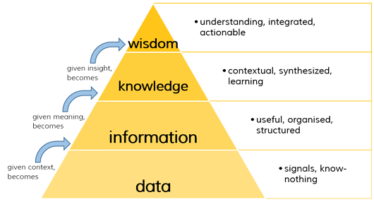
(http://libraryguides.lehigh.edu/TRACseminar/understandinginformation)
Notes:
Let’s talk about interpreting data. This is the information pyramid. There are many variations on this pyramid…and because we can always use another pyramid in special education, we thought we would throw in this slide. Note that data are at the bottom of this pyramid.

Slide 18
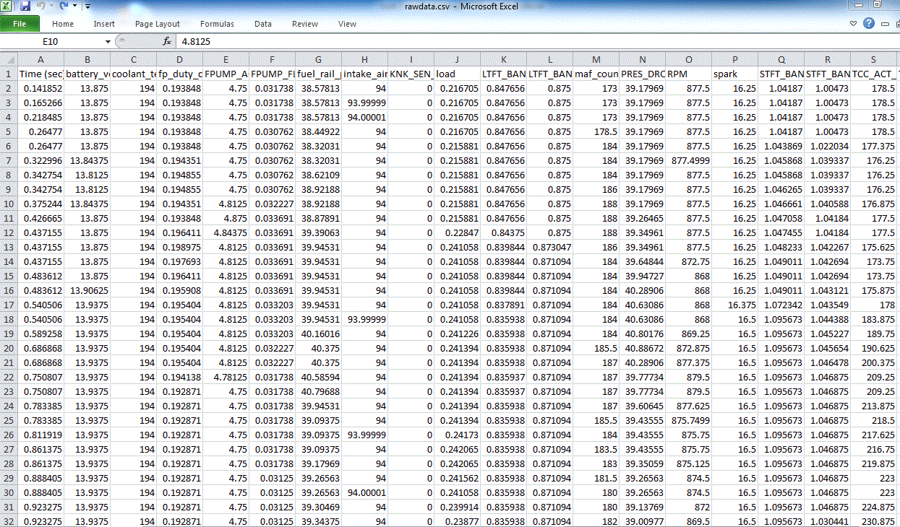
Notes:
This is data. Not too exciting in this form but oh so critical. If what is in the data file is not correct, then there is no CQI, no good decision making, no program improvement. All that time being spent on good data collection procedures, data entry, edit checks, and so on is really important.

Slide 19
DaSy Critical Questions
http://dasycenter.sri.com/downloads/DaSy_papers/DaSy_Critical_Questions_FINAL_20151023v2.pdf
DaSy/NCSI Data Visualization Tool Kit
http://dasycenter.org/data-visualization-toolkit/
Notes:
Data get transformed into information. Lots of thinking is required to get even from data to information – what do you want to ask of your data? What reports do you need? How do you want to analyze and display the information?
DaSy has several resources that can help you with this. Critical questions. Data Visualization.

Slide 20
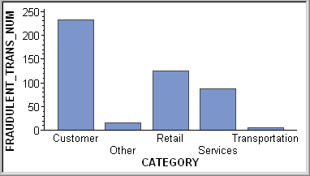
Notes:
Now let’s talk about moving from information to knowledge. This is information. All of us can read this. You can see some high bars and some low bars – but does this mean anything to you? This is more meaningful than raw data but we can’t make sense of this without context. Here is another aside. Remember that sometimes when you are sharing data with stakeholders, depending on who they are and what they already know, your information looks like this to them. If you want stakeholders to participate in reviewing information, be very aware of how much context you need to give them so the information has meaning.

Slide 21
Moving from Information to Knowledge
Putting meaning on the numbers
  Requires understanding what is going on
  Requires knowledge and understanding of context
Notes:
What does it take to turn information into knowledge?

Slide 22
https://www.sri.com/work/publications/national-early-intervention-longitudinal-study-neils-final-report
Notes:
Now I will show you a graph that you can understand. This graph is from the National Early Intervention Longitudinal Study. This was an OSEP funded study that Donna and I worked on about 15 years ago. The study followed a nationally representative sample of over 3300 children from the time they entered early intervention until spring of kindergarten. This is one of the graphs from that study. In kindergarten, 35% of the former EI recipients no longer had a disability or delay and so did not have an IEP. Another 11% were still considered to have a disability but did not have an IEP and 54% had an IEP.
What do these numbers say to you? Surprised that only a little over half had an IEP? We serve around 2% of the population in EI and these are children who are 1.5 to 2 standard deviations below what is expected for their age. We thought it was kind of remarkable that only 54% had IEPs in Kindergarten.
But here is the flip side. There were concerns in the field that in fact there were former EI recipients that need help but weren’t getting it because they did not meet the special education eligibility criteria and that it was only a matter of time before there need became significant enough for them to qualify for special education. So it is interesting to know that they don’t have an IEP but how are they doing.

Slide 23
Notes:
To get at this issue, we asked the children’s kindergarten teachers to tell us how they were doing and we use the same items that had been used with a national study of kindergarten children. So here are 3 items and here is how the general population of kindergarten kids does on those items. Now let’s look at how the group of EI recipients who had no disability in kindergarten were doing. How about the children who had a disability but no IEP? A little lower but still pretty close. And the former IE recipients who had an IEP? For them it is a different story. There are many more literacy skill items, there are math items, there are social emotional and behavior items and the pattern is pretty much the same story for every one of them.
I want to make a couple of points about how information becomes knowledge. First, did you experience how what you brought to these data allowed you to make sense of them. Second, I want to point out that it was our knowledge of special education that drove us to include these measures of achievement to begin with. We knew receipt of special education is an imperfect measure of what a child knows and can do. We also knew the conventional wisdom about kids not meeting eligibility criteria but not doing well. We didn’t want to be looking at the kindergarten data without any information on how the kids were doing. Third, it was also our understanding of context that helped us determine how we needed to look at the data. I want to show you one last bar. This is the data for all of the EI graduates combined. If you were just to look at this bar compared to the top bar, the story is just former EI recipents in Kindergarten are not doing as well as the general population. If we had not disaggregated the data by IEP status, we would have missed the whole story.
Bottom line: You need to bring what you know to your data analysis and your data interpretation.

Slide 24
Moving from Information to Knowledge
Noticing the unexpected
  The numbers do not talk. Somebody has to see something.
  Means the user has some sense of what things should look like – and what they shouldn’t
  The “jewel” of the anomaly
    “How can that be?”
    “What’s up with that?”
Notes:
I also can’t emphasize enough how important it is to bring some sense of expectation to your graphs and tables. Because having some sense of expectation allows you to notice the unexpected. This is where you need to dig deeper, maybe you have a data quality problem. Maybe something really extraordinary is going on in one of your programs or something is really wrong. The CQI people actually explicitly talk about how every “defect” is to be cherished because it is an opportunity for improvement.

Slide 25
(http://libraryguides.lehigh.edu/TRACseminar/understandinginformation)
Notes:
Finally, moving wisdom. Wisdom is knowing how to take the knowledge and make it actionable. Let’s go back to our NEILS data, If you knew this about the early intervention recipients in your state, what would you do with it? Who would you tell? And why would you tell them?
Wisdom – this information can be used to make a case for the effectiveness of early intervention, this information can be used to generate a dollar figure on how much early intervention saves. The other part of the story is how poorly the kids with the IEPs were doing. That was a lot of variation from the general population? Is that appropriate variation? Is that really the best we can do to prepare these kids for kindergarten. Maybe it is but if you can find a few programs that do much better, maybe it isn’t.
Why is this a pyramid??

Slide 26
Act on what was learned
Possible conclusions and actions:
  Well done → Make sure mechanisms are in place to sustain the improvement. Plan another improvement
  Mostly there → Tweak if needed and continue to monitor. Maybe plan another improvement.
  Not what we wanted → Return to planning and re-think.
Notes:
For Part C folks, this is the evaluation of your SSIP. Note this is not a “one and done.” Not for SSIP – not for any kind of program improvement effort because Systems are dynamic. They are constantly changing.

Slide 27

Key Ingredient for CQI: Leadership
Committed to continuous improvement
Strong, participatory, inclusive
Serve as role models for using data in decision making
Clearly communicate expectations around data use
Recognize that staff time is required to collect, enter, examine and use data.
Notes:
What does it take to move to using CQI? This is about leadership establishing a culture committed to continuous improvement up and down the layers of the system.

Slide 28
Key Ingredient for CQI: Leadership
Allocate resources to technology needed to house and analyze data.
Provide professional development for staff on understanding, analyzing, and using data.
Create an organizational culture that facilitates continuous data use.
  Values learning
  Creates a safe space for shared learning through reflection and interpretation of data.
Notes:
We know the resource issue is a heavy lift. One has to be able to access data to use it. Preaching to the choir here. This is 2016. Staff working in EI and ESCE needed to have the technology to use data.

Slide 29
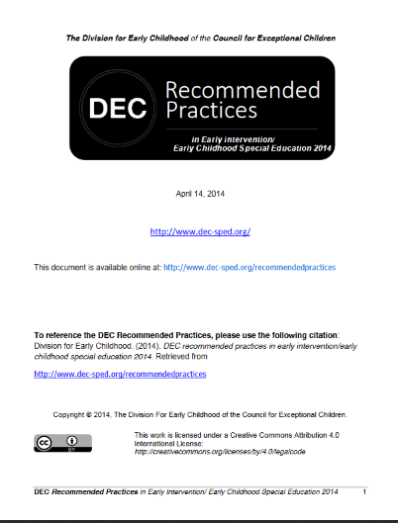
DEC Recommended Practices: Leadership
L12. Leaders collaborate with stakeholders to collect and use data for program management and continuous program improvement and to examine the effectiveness of services and supports in improving child and family outcomes.

Slide 30
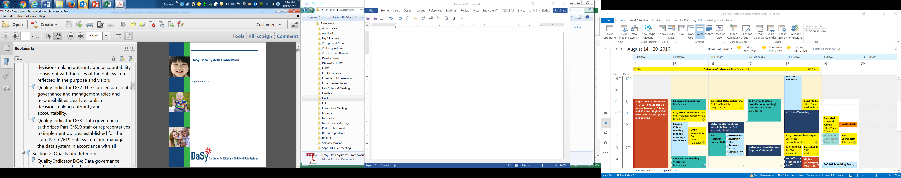
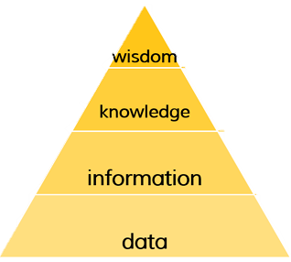
Key Ingredient: Appropriate Data
System is collecting the necessary data elements at the appropriate frequency (See SD4 in DaSy Framework)
Data are of high quality
Notes:
Collecting the right stuff? Can you trust it? Mention SD4, Map data. We know having the right data is a challenge for some of you. Having data you can trust also is a challenge. As you heard Lisa say earlier, this is not just about the child outcomes data. It is about finding and using some of those other data elements that are the influences on your child outcomes data.
Many of you are working with ECTA on child outcomes data quality…if you are not please contact ECTA.
DaSy and IDC can help with data quality issues.

Slide 31
Key Ingredient: Appropriate Technology
The technology (hardware, software) to collect, transmit, store, and analyze the data
Users have ready access to analyzed data
  Timely and useful data displays
Notes:
What Bob talked about and what I just mentioned with leadership. Leadership is critical to getting the appropriate technology in place. Without the technology, you can’t get from data to information

Slide 32
Notes:
When you think about access to information, think about the data users and decision makers at the various levels in your state. They need different kinds of data, presented in different ways that correspond to their sphere of influence. What a teacher needs is different from what a center director needs. What a regional TA provider or supervisor needs is different from what you need. Moving to a culture of continuous improvement requires making sure people have the information they need to make the best decisions they can make.

Slide 33
Key Ingredient: Human Capacity
Extent to which staff understand:
  What appropriate data are
  How to analyze the data
  How to make meaning from the data
    Knowledge and skills to interpret data (in general)
    Knowledge of the context to make sense of EI and ECSE data
  How to use the data in meaningful ways to improve the quality of their work.
Notes:
Using data requires building staff skills about data. What are appropriate data, how to analyze the data…. These are the upper 3 layers of our pyramid and it is a capacity that needs to be built.

Slide 34
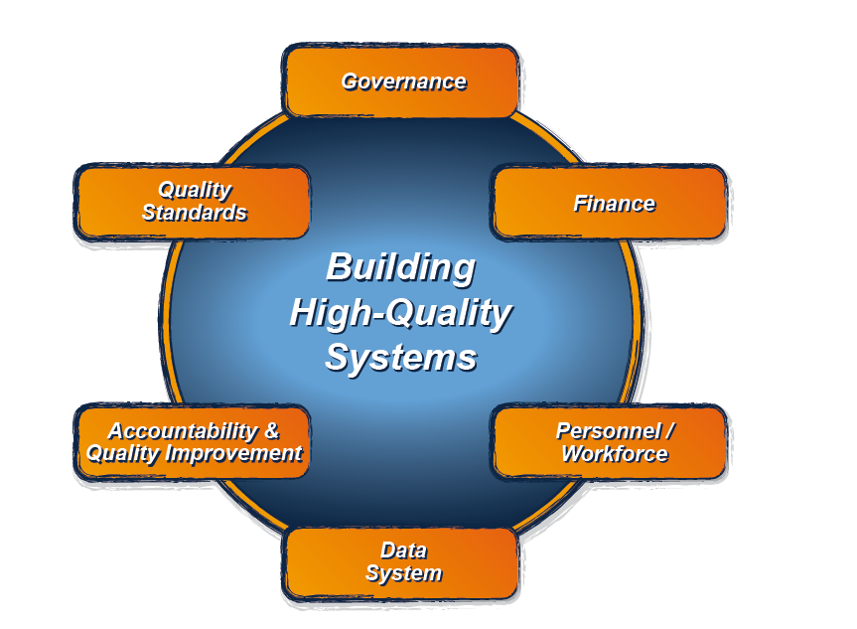
Data System is one component of the state system
This component is addressed in the DaSy Data System Framework
For more information about the Data System Framework, visit:
http://dasycenter.org/resources/dasy-framework/
Notes:
Notice that data system is part of a larger system. Data system, most specifically, the data itself is integral to the functioning of the other parts of the system because it is data that is needed for continuous improvement across the other components.
And this applies at all levels – federal, state, regional, program, classroom, case load – and the individual child

Slide 35

Where to start to move to CQI
All states have started
All states collect some data
  many of you collect a lot of data
Some of you collect all or most of the data elements you need
  some don’t

Slide 36
Where to start to move to CQI
In some of your states, staff at state and local level have ready access to the data they need
  not the case in all states.
Some of you can link data sets to examine some important issues
  Most of you cannot

Slide 37
Think big if you can
Where do you start?
Wherever it makes sense for your state…
Do you have the resources and the stakeholder support (especially the stakeholders who control the resources) to make a significant change in a short time?
Notes:
Giant goals – redesign of the data system in conjunction with some major redesign in other system components.
Moderate system goals are some of the things are topic cohorts are working on: electronic IFSPs, Improving the quality of the child outcomes data, linking Part C and 619 data
At least half of you are engaging in systemic improvement through the SSIP? Think about what you are doing through a CQI lens. Don’t think of the SSIP as an initiative or a project – it is the beginning of an ongoing effort to continuously improve quality in your system.

Slide 38
Start small if you need to
If not, start incrementally.
Pick a small goal that will allow your state to move toward using data CQI
  Add a few data elements
  Get a few reports produced quarterly for state use
  Get a few reports out to the locals.
Notes:
And then go back and pick another goal.

Slide 39
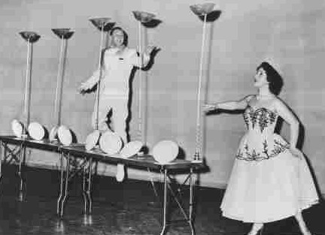
Notes:
These spinning plates are like PDSAs in SSIP. You will have a few PDSA cycles going.

Slide 40

Notes:
If your SSIP looks like this, you might want to think about cutting back a bit.

Slide 41
Provider-child-family
Local system
State system
Notes:
And speaking of spinning, the goal is to build well-oiled machine with a working data engine powered by data where each level of the system is high quality and the state and local infrastructures provide good supports to the folks on the ground who are doing the important work.

Slide 42
Special Thanks to…. (in order of appearance)
Tony Chambers
Ovella "Ms.Peaches" Lott
Lisa Backer
Bob Morris
Ann Freiburg and Rita Wahl
Chelsea Guillen
Notes:
Can you give our data stars a big round of applause?

Slide 43
And to the Production Team
Staff at the Center for Technology in Education, Johns Hopkins University
Denise Mauzy
Bruce Bull

Slide 44
The TA Centers are here to help you.
Please contact us.

Slide 45

Please complete your conference evaluation when you get home!!!
We do use data to inform our decision-making.
Notes:
Some of us had the opportunity to attend an international early intervention conference at the beginning of the summer. And it was quite an experience to learn about the where other countries are in setting up there service delivery system. I was talking to people from some of the developing countries and thinking that is where the US was in the 50s or 60s. So I think it is really appropriate in this 30th anniversary year to celebrate how far we have come as a country – and also to think about what the next 30 years will bring. We sincerely hope that using data to drive program improvement will be part of the evolution of our systems.

Slide 46

If you want to build a ship, don’t drum up the people to gather wood, divide the work, and give orders. Teach them to yearn for the vast and endless sea.
Antoine De Saint-Exupery
Notes:
I want to end with a quote that I really like.
So we hope all of you go home yearning for the vast and endless sea of good outcomes for all children and families….and we hope you have learned some things and been inspired to build the boat that will get us there. Thank you for attending the conference. Safe travels everyone. We wish you a good trip home.

Slide 47
Visit the DaSy website at:
http://dasycenter.org/
Like us on Facebook:
https://www.facebook.com/dasycenter
Follow us on Twitter:
@DaSyCenter

Slide 48



The contents of this presentation were developed under a grant from the U.S. Department of Education, #H373Z120002. However, those contents do not necessarily represent the policy of the U.S. Department of Education, and you should not assume endorsement by the Federal Government. Project Officers, Meredith Miceli and Richelle Davis.

