Slide 1
The Power and Challenges of Early Childhood Integrated Data Systems: Implications for Researchers
Kathleen Hebbeler
Lauren Barton
Suzanne Raber
The DaSy Center at SRI International

Slide 2

What we will cover
The potential of state data for research
The challenges associated with using state data
How researchers can access state data

Slide 3

A small sample of critical questions...
Who is served in state Pre-K?
What services are provided in early intervention?
What is the quality of programs serving 4 year olds?
What is the extent of turnover among early care and education providers?
What are the short- and long-term outcomes for children who participated in one or more early care and education programs?
Notes:
Do they make a difference?
Not a one time question.
State data allows asking question repeatedly for each cohort of children in programs

Slide 4

High quality state data systems can provide valid and reliable information for…
Accountability
  Are state programs improving outcomes?
Program improvement
  What are strengths and weaknesses and how can the state improve effectiveness?
Knowledge development
  What constitutes an effective program?
  What are effective practices?
Notes:
When implemented effectively, ECIDS is a powerful thing that provides critical information needed for all collaborative partners (ECE agency/policy makers & researchers)

Slide 5

The gold mine
There are a multitude of questions that can be answered with state data sets.
“Administrative data”
  Collected by the state usually for program operations or required reporting
  Repeatedly collected
Administrative data sets = veritable gold mine for researchers.
Data from an ECIDS or SLDS are even more valuable but even data from a single program hold nuggets.

Slide 6

Mutually beneficial arrangement
Many state early care and education state agencies do not have the analytic expertise to make full use of the data for policy and program improvement.
  Data collected, and used for program operations or required reporting
Most researchers do not have access to data sets with 50,000 preschoolers.

Slide 7

What does it take for a researcher to “mine the gold?”

Slide 8

Researcher options
Partnership with state
Independent

Slide 9

In partnership
Work with the state agency staff
  Possibly under contract or for a fee
Contributions of the researcher
  Contribute to formulating key questions
  Plan analyses
  Conduct analyses
  Assist in interpreting data
The agenda for the research is primarily to benefit the state but researcher benefits as well.

Slide 10

Partnership can be more extensive...
Phase | Examples of Decisions
Planning | Planning content of data system, including: Identifying critical data elements Alignment/consistency across ECE agencies
Implementation | Frequency of data collections Process for data entry Nature of data quality checks built into system
Ongoing Use | Decisions about Appropriate users/access Identifying critical questions Analyzing data to address them Interpreting meaning of findings

Slide 11
Researcher is independent
Researcher requests a sub-set of the data through a state-developed process.
State provides the data.
Researcher analyzes the data and publishes the findings.
Questions might be of interest to the state but the researcher drives the agenda for the research.

Slide 12
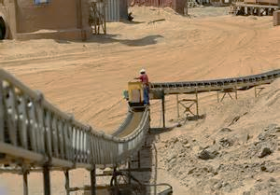
Issues and Challenges

Slide 13
Data quality
These data sets were not designed for research.
These data were not collected for a research project.
  Incomplete data
  Inaccurate data
  Data collections or data entry may be minimally monitored.
Role for researcher: Help state identify and implement procedures to improve data quality.

Slide 14
Nature of the information available
Demographic data on children and families ☑
Dosage (attendance, number of home visits, etc.) ?
Program data
  Workforce ?
  Quality ??
Child outcomes ??
Role for researcher: What data should the state be collecting? (What is collected can change.)

Slide 15
Procedure for accessing the data
(For independents) State needs to have established a procedure for accepting, reviewing, and filling requests for access to data.
  Must include procedures to safeguard personally identifiable information.
State may require findings be communicated back to the state.
(For state partners) Still need procedure for ensuring data security and confidentiality.

Slide 16

Methodological issues
What are the limitations on the conclusions?
Can program effectiveness be demonstrated with administrative data?

Slide 17
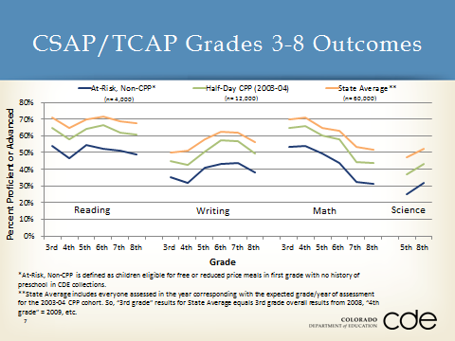
State example: Colorado

Slide 18
State example: Kentucky
Research Question: Do EC special education child outcomes data predict school readiness as measured by kindergarten screener/assessment instruments?
Data Elements | State C/619 Data System | University of KY Data Platform
IEP/IFSP status |  | 
EC Child outcomes |  | 
Child demographics (gender, ethnicity, age, income status) |  | 
School district |  | 
Screening data for children in early child care |  | 
Curriculum/criterion-based assessment data |  | 
Notes:
Also, there are at least 2 other studies: UK graduate students are examining the relationship between teacher self-efficacy and child outcomes and longitudinal trajectories of child progress

Slide 19
Kentucky: Benefits
Can conduct longitudinal studies from early intervention to preschool to elementary school
Can highlight best practices for improved services
Can examine state-wide and local trends
Can examine results for multiple types of programs (state-funded preschool, Head Start, early care)
Notes:
KY is fortunate to have a dataset that includes child-level screening and assessment data at the individual item level for children from early intervention, preschool, and early care. KY has built a system over the past decade that allows for the collection of detailed child information; the challenge has been to locate funding to support staff time to conduct varied and extended analyses to examine the multiple factors that relate to the differential child outcomes across programs.

Slide 20
Kentucky: Challenges
Meeting confidentiality requirements for each state data system
Sharing data between state data systems that typically do not share data
Locating funding to support analyses
Presenting results in ways that support improved policy and practice across multiple stakeholders (providers, families, teachers, administrators)
Notes:
And presumably present results in ways that benefit UK researchers too (e.g., journal articles)

Slide 21
State example: Massachusetts
Research Question (dissertation): To what extent are infants who have been exposed to drugs before birth
  Referred to early intervention (EI) services prior to age 3?
  Recipients of EI Services?
Data Systems:
  Population-based Pregnancy to Early Life Longitudinal Data System
  MA Early Intervention Information System

Slide 22
State example: Massachusetts
Benefits
  Researcher-developed algorithm for population estimates
  Answers to important questions about drug-exposed infants
  A Ph.D.
Challenges
  Obtaining access to state EI data (FERPA, lack of process)
  Data quality (data entry errors in EI data)

Slide 23

Conclusions
State data sets, especially in states that have developed an ECIDS, hold substantial and untapped potential to address important programmatic and policy questions.
Researchers working with state agencies can produce benefits for both parties.
Challenges exist, but are not insurmountable.
  And researchers can help in addressing some of them.

Slide 24

For more information
Visit the DaSy website at:
http://dasycenter.org/
Like us on Facebook:
https://www.facebook.com/dasycenter
Follow us on Twitter:
@DaSyCenter

Slide 25



The contents of this presentation were developed under a grant from the U.S. Department of Education, #H373Z120002. However, those contents do not necessarily represent the policy of the U.S. Department of Education, and you should not assume endorsement by the Federal Government. Project Officers, Meredith Miceli and Richelle Davis.

