Slide 1
Introducing the DaSy Center
FPG Seminar Series
November 18, 2013
Presented by:
Kellen Reid
Martha Diefendorf

Slide 2
The Center for IDEA Early Childhood Data Systems
Notes:
Easy to remember
Especially in a work of acronyms
Early childhood – 0-5
Focus is data on children with disabilities, thus the reference to IDEA

Slide 3
What We Will Cover
What is DaSy
Center Goals
Activities
Needs Assessment
Framework Development
Technical Assistance
Leadership & Coordination

Slide 4
What is DaSy?
A 5-year Center funded by OSEP for $7.5 M
to assist states with improving Part C early intervention and Part B preschool data by:
Building better data systems
Coordinating data systems across early childhood programs
Building longitudinal data systems
Building the capacity of states to use data
Notes:
Size of contract

Slide 5
Who are we?
SRI International
Frank Porter Graham (FPG) Child Development Institute
Applied Engineering Management (AEM)
Westat
Center for Technology in Education (CTE) at Johns Hopkins University (JHU)
Cadre of national experts

Slide 6
How does DaSy fit with other FPG Trohanis TA Projects?
ECTA
(ECO)
RRCP
NCELN
IDC
DaSy
Notes:
Size of the circle reflects the relative amount of funding.
Cross staffing – ensures coordination.

Slide 7
What We Will Cover
What is DaSy
Center Goals
Activities
Needs Assessment
Framework Development
Technical Assistance
Leadership & Coordination

Slide 8
DaSy Center’s Goals
Provide national leadership and coordination around EC data systems
Generate new knowledge and useful products regarding building coordinated EC data systems and including EC in statewide longitudinal data systems
Design and implement a continuum of technical assistance strategies to improve state capacity to collect, analyze, and report high quality data

Slide 9
The Vision
Other EC Program
Data
Other EC Program
Data
K-12 Longitudinal Data
System
Quality
EI/ECSE
Data
Other EC Program
Data
Other EC Program
Data
Coordinated EC Data System

Slide 10
The Time is Right
Recognition of the
The importance of early childhood
Need for good data
Need for coordinated early childhood data systems
Need for longitudinal data systems
Resources for
Building coordinated EC systems (RTT-ELC)
Building state data systems (SLDS, CEDS, PTAC, RTT-ELC)
State and local programs are increasingly aware of the importance of having good data.

Slide 11
…Where DaSy Fits…
More powerful and higher quality data about programs, personnel, services, and children and families
?
?
Improve outcomes for children and families
Improve the quality of Part C and Part B Preschool services and supports
Policy makers, state agency staff, local program staff, and others use data to improve programs
Improved capacity in states to meet IDEA reporting requirements and ask and answer policy and programmatic questions

Slide 12
County: CHILD system
The Need for Integrated Data.
Data helps inform our understanding of the early childhood system
Individuals and families interact with multiple systems and services, so integrated data offers a more complete view of reality [“Big Data”]
Understanding of how systems work and how to better meet existing needs can be informed by integrated data
Service models emphasize long term and collective impact, so data needed across services and over time

Slide 13
Local Example: Child Health
Summary.
Dramatic increase in health insurance coverage for children ages 0-6 in the county: Hooray!
But only 43% of children get all the recommended well-child visits in the first year of life: Oh no!
Data show that 49% of these families were involved with supportive services close to birth, so we can use that connection to reach families: Hooray!
But wait, due to data lags and coordination issues, outreach would happen too late to have an effect: Oh, no!
A preventive approach could be adopted by having dedicated staff at clinics reach out to families…
Result
Medical Home Pilot launched at two health clinics; 86% of families completed scheduled well-child visits, double the rate for children born on Medicaid in Cuyahoga County; one clinic has integrated the model into care with 9 patient advocates serving the needs of families with infants

Slide 14
What We Will Cover
What is DaSy
Center Goals
Activities
Needs Assessment
Framework Development
Technical Assistance
Leadership & Coordination
Notes:
Now we’ll look at the major activities of the Center.
First, I’ll talk about the Needs Assessment survey we conducted in the spring, and Kellen will talk about the development of the framework. Both of these fall under Knowledge development.

Slide 15
Needs Assessment Survey
What we wanted to know to guide our TA:
Current status of Part C and 619 state data systems
Data systems and data elements
Linkages between different state data systems
Data system administration and use of data
Priorities for improving data systems
Areas where states would like TA
15

Slide 16
What methods were used?
Online needs assessment developed by DaSy workgroup
Coordinated with ITCA and ECDC surveys
Sent to Part C and 619 coordinators in all states and jurisdictions
Completed with data managers and others identified by coordinators
16

Slide 17
What were the response rates?
We had an excellent response rate:
For Part C 94% (n= 49 out of 52)
For 619 96% (n= 50 out of 52)
Report focuses on information reported by 50 states, DC, and Puerto Rico // 618
17

Slide 18
Most states have data systems with child-level and workforce data, but fewer have program-level data systems.
 | Part C | 619
Child-level | 94% | 96%
Program-level | 29% | 40%
Workforce: EI providers | 65% | ----
Workforce: special education teachers | ---- | 83%
Workforce: related service providers | ---- | 71%
Workforce: general education teachers | ---- | 71%
18
Notes:
the percentages are the percent of states responding
For child-level – there are no “No’s”, only missing – we know that all states have some child-level data!
There is a lot more detail and information in the report.

Slide 19
Most states have a variety of data elements in their child-level data systems.
Some common data elements | Part C | 619
Child demographics | 94% | 96%
Disability category | 77% | 96%
Eligibility status | 98% | 90%
Child outcomes | 83% | 90%
Service setting | 89% | 87%
ID for program or school | 89% | 81%
Reason for exiting program | 98% | 79%
19

Slide 20
Less than half of states have Part C or 619 program-level data systems.
Only 29% of states have Part C program-level data systems.
Only 41% of states have 619 program-level data systems.
37% have data on program structure (e.g., agency, service model).
33% have information on whether program includes children without disabilities
20
Notes:
Program = administrative entity which receives referrals, provides evaluation services, provides service coordination, and/or provides direct services to children and families.
program-level data means…data on such things as:
a. Program structure (e.g., service model, number of regular and contracted staff, and/or administrative/host agency, etc.)
b. Any measure of the quality of settings in which children receive services (one or more of the following: ITERS, QRIS rating, PAS, accreditation status, etc.)*
c. Program costs
*ITERS = Infant Toddler Environmental Rating Scale
QRIS = Quality Rating and Improvement System
PAS = Program Administration Scale

Slide 21
States vary in the kinds of workforce data they have in state data systems.
Workforce data element | Part C | 619 special ed teachers | 619 related services personnel | 619 regular ed teachers
Demographics | 29% | 67% | 58% | 64%
Employment data | 54% | 77% | 60% | 67%
Education | 46% | 75% | 58% | 64%
Licenses/certifications | 56% | 83% | 69% | 71%
Professional development | 39% | 29% | 29% | 23%
Wages | 10% | 46% | 42% | 46%
21
Notes:
These are what we asked about:
a. Demographics (one or more of the following: race/ethnicity, age, language, gender, etc.)
b. Employment information (one or more of the following: employing agency/school, position title, years of experience, start date, etc.)
c. Education (one or more of the following: degree, field of study, etc.)
d. Licenses/certifications
e. Professional development completed (in-service or other training)
f. Wages

Slide 22
Linkages: What do we mean?
Linking refers to the process of joining or connecting records about one individual or entity in one data system or dataset with those in another data system or dataset using a common identifier or other method
These can be linkages:
Within Part C and within 619
Across Part C and 619
With K12 education
With other early childhood program,
social services, health data
22
Notes:
And some states do not need to talk about linkages because the data are already in the same data system (e.g., When education is the lead for part C; 12 states)

Slide 23
Linkages: Why is this important?
States can answer programmatic and policy questions about:
Children’s outcomes from EI and ECSE participation, e.g.:
Do former EI recipients require special education in kindergarten?
How are ECSE graduates doing in third grade?
Factors associated with good child outcomes, e.g.:
What workforce and program factors, such as personnel qualifications and program quality, have a substantial impact on child outcomes?
Do children served in inclusive programs have better outcomes?
23

Slide 24
In many states, child data elements are in the same system or have been linked.
Child data in same data system or have been linked | Part C | 619
Child data | 87% | 62%
24
Notes:
BUT note that for about 1/3 of states for 619, data on a particular child cannot be linked
Less so for workforce data, and even less so for program-level data
Program data linked
C = 20%
619= 22%
Workforce data linked
C = 45%
619 = 58%

Slide 25
A minority of states can link data elements across data systems within Part C and within 619.
Linkages across data systems | Part C | 619
Child and program/school data | 19% | 31%
Child to classroom | ---- | 19%
Child and workforce data | 40% | 31%
Workforce and program/school data | 17% | 17%
25
Notes:
Challenge for Part B 619 programs to make full use of the child-level data elements:
not all these data elements reside in the same data system or have ever been linked for more than one-third of states.
Remember that many states do not have state-level data systems containing program-level data (65% for C; 56% for 619).

Slide 26
Only about one-third of states have linked data across Part C and 619.
26
Notes:
Remember that there are 12 states with Education as the lead agency for Part C, so we would expect C and 619 data to be in same system or connected.
We compared data from the two surveys, and about one-fourth disagreed about the connections.

Slide 27
There is infrequent use of common identifiers across Part C and 619.
Common identifier for C & 619
Child-level | 21%
Program-level or school-level | 12%
Workforce-level | 6%
27
Notes:
Common identifiers would increase the state’s ability to link data

Slide 28
Linkages with K12 education data are more common for 619 than for Part C.
Linkages with
school age data
Types of education data in same system or have been linked | Part C | 619
K12 special education | 41% | 87%
K12 general education | 14% | 79%
28

Slide 29
For 619,almost half have linkages with state pre-K.
Linkages with other
early childhood data
Types of other EC data | Part C | 619
State pre-K | 12% | 46%
Head Start | 6% | 22%
Early Head Start | 2% | 10%
Child care | 6% | 8%
Home visiting | 8% | 8%
For Part C, few states have linkages with other EC data.
29

Slide 30
Linkages with health data are more common for Part C than for 619.
Types of health data | Part C | 619
Medicaid/SCHIP | 42% | 12%
EHDI | 37% | 8%
Vital records | 21% | 0%
Birth defects registry | 21% | 2%
All-payer claims (insurance) | 13% | 0%
WIC/SNAP | 8% | 6%
Hospital | 6% | 2%
Behavioral health | 4% | 2%
30
Notes:
connections between c and health are strong in many states; health is lead agency in many states (N = )
Highest with Medicaid (42%); and newborn hearing screening (EDHI- Early Hearing Detection & Intervention Program)

Slide 31
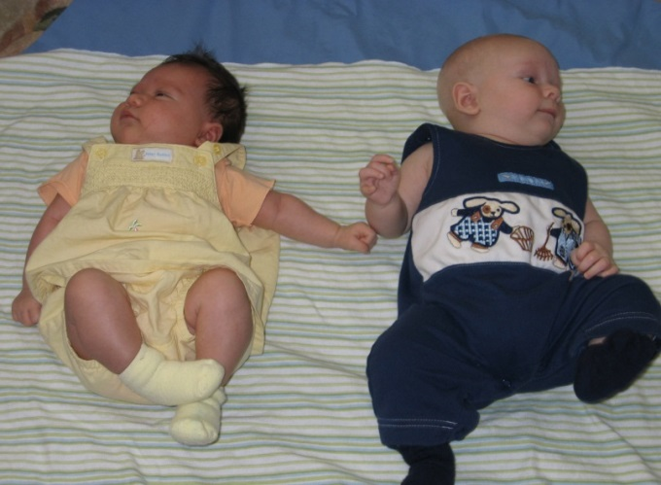
Linkages with social services data are not widespread
Types of social services data | Part C | 619
Child welfare | 21% | 10%
Foster care | 12% | 8%
Temporary Assistance for Needy Families (TANF) | 10% | 14%
Homeless services | 6% | 14%
31
Notes:
CAPTA Child Abuse Prevention and Treatment Act
Requirement to refer children with substantiated cases of abuse and neglect to Part C

Slide 32
Example of DaSy State Interactive Map
32

Slide 33
Priority areas for TA
Area of state priority | Part C | 619
Child and family outcomes | 67% | 63%
Linkages between and across different types of data elements | 58% | 56%
Data use (e.g., analysis, use of program improvement) | 54% | 52%
Data sharing permissions and/or privacy issues | 67% | 48%
APR indicators/618 data | 48% | 63%
Including Part C/619 in broader state data system planning | 52% | 48%
Data quality, verification, audit systems | 50% | 46%
Linkages with social services or health data | 50% | 46%
33
Notes:
DaSy Center staff will be using findings to develop TA plans for the upcoming year. We’re in the middle of TA planning right now.
Only real big difference between the 2 client types is APR indicators – Indicator 6 on where children receive services and whether it is an inclusive program.
Finally, the last results from the survey… are on the next slide.

Slide 34
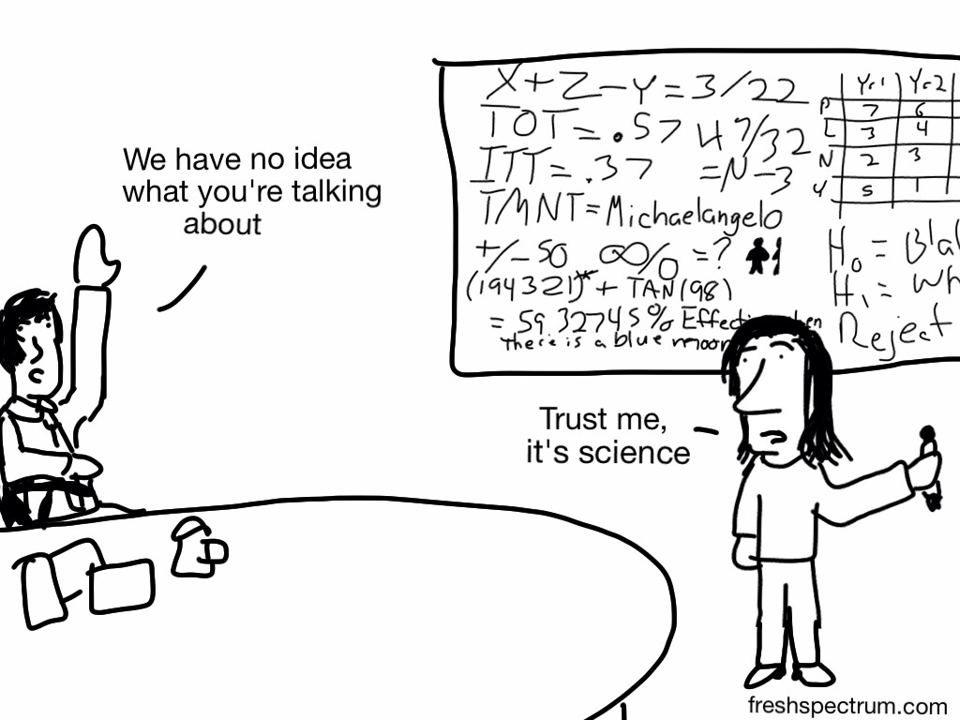

Slide 35
What We Will Cover
What is DaSy
Center Goals
Activities
Needs Assessment
Framework Development
Technical Assistance
Leadership & Coordination

Slide 36
Relationship of ECTA and DaSy Frameworks
ECTA Framework
Finance
Data
Governance
Professional Development
Finance
Monitoring
DaSy Frame-work
Purpose/ Vision
Information Use
Sustainability
Data Governance
Planning & Management
Stakeholder Engagement
System Design
DaSy Frame-work
Purpose/ Vision
Information Use
Sustainability
Data Governance
Planning & Management
Stakeholder Engagement
System Design
Notes:
Also the relationship to the ECIDS framework and SLDS framework

Slide 37
Component Group Responsibilities
Charge to each component group
Outcomes for each component group:
Develop a timeline
Define the component
Review literature related to the component
Identify and define key terms.
Identify the critical sub-components (if any)
Identify a set of quality indicators for the component (or sub-components) and corresponding elements that further define quality.
If relevant, identify states’ options related to the component and the implications (pros and cons) of each of the options.
Articulate what, if anything, is unique about this component for C and 619.
Key terms and definitions (if appropriate) Sub-components,
Set of quality indicators;
“Elements”;
Resources related to the component;
Recommendation on how this component fits in the overall framework.
Notes:
1. Develop a timeline (includes when the component is shared with the partner states)
2. Define the component (use SLDS/ECIDS definition as starting point).
Resources related to the component;
(if appropriate) State’s options related to the component and associated pros and cons;
(as needed) Unique issues for features for Part C and 619;
Recommendation on how this component fits in the overall framework. (single standalone component, should be part of another component, should be a cross-cutting theme, should be split into multiple components or other)

Slide 38
Framework Partner States
Alaska
Arkansas
Connecticut
Georgia
Idaho
Massachusetts
Pennsylvania
38

Slide 39
What We Will Cover
What is DaSy
Center Goals
Activities
Needs Assessment
Framework Development
Technical Assistance
Leadership & Coordination

Slide 40
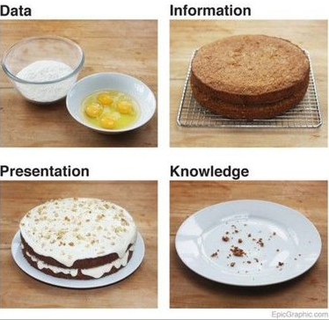
Baking: A metaphor for DaSy’s slice of the “improving outcomes pie”

Slide 41
Activities: TA and Dissemination
Use framework to provide intensive TA to 10 states (phase in, years 2 and 3)
Promote critical data system requirements
Develop national TA network
Provide a continuum of general TA and dissemination activities
Maintain a website
Prepare and disseminate reports, documents, and other materials
Support states in developing data systems to address APR performance and compliance indicators
Notes:
Not sure we need this slide. Slide 39 also has TA activities

Slide 42
What We Will Cover
What is DaSy
Center Goals
Activities
Needs Assessment
Framework Development
Technical Assistance
Leadership & Coordination

Slide 43
Activities: Leadership and Coordination
Establish and maintain stakeholder committee to guide and review the work of the center
Communicate and collaborate with relevant projects
Support communities of practice
Work with TACC on new products
Contribute products to TACC database
Coordinate with NICHY to develop a dissemination strategy
Notes:
“Collaborate with relevant projects” is very important.

Slide 44
Some Key Collaborations
IDC: IDEA Data Center
ECTA: OSEP Early Childhood Technical Assistance Center
ECPC: OSEP Early Childhood Personnel Center
SLDS: State Longitudinal Data System grants support team
CEDS: Common Education Data Standards
ELC TA: Early Learning Challenge TA Consortium
PTAC: Privacy Technical Assistance Center
CEELO: Center on Enhancing Early Learning Outcomes
ECDC: Early Childhood Data Collaborative
RRCP: Regional Resource Center Program

Slide 45
Funding Prospects
Institute of Education Sciences has funding work to integrate data related to young children
US Department of Education Race to the Top funds can be used for longitudinal data systems using integrated data
Various federal funding opportunities exist for studies that could develop and draw on integrated data systems
MacArthur Foundation very interested in use of integrated data

Slide 46
What questions do you have?
Visit DaSy web site: http://dasycenter.org/

