Slide 1
The Center for IDEA Early Childhood Data Systems (DaSy)

Slide 2
About The DaSy Center
A 5-year Center funded by ED’s Office of Special Education Programs (OSEP)
Center meant to assist states with improving IDEA Part C early intervention and Part B section 619 preschool special education data
http://dasycenter.org/
TA Centers Use CEDS to Support States

Slide 3
DaSy Assists States With…
DaSy
Building better data systems
Coordinating data systems across early childhood programs
Connecting to longitudinal data systems
Building capacity to use data
DaSy uses CEDS as a tool to assist states
TA Centers Use CEDS to Support States

Slide 4
Part C APR indicator connections
Created connections for each of the IDEA Early Intervention (EI) Part C state performance plans/annual performance report indicators
11 indicators on topics such as service delivery, settings, and child and family outcomes.
Compliance indicators: 100% of children EI services in a timely manner
Results indicators: Percent of children primarily receiving EI services in community-based or home settings.
TA Centers Use CEDS to Support States

Slide 5
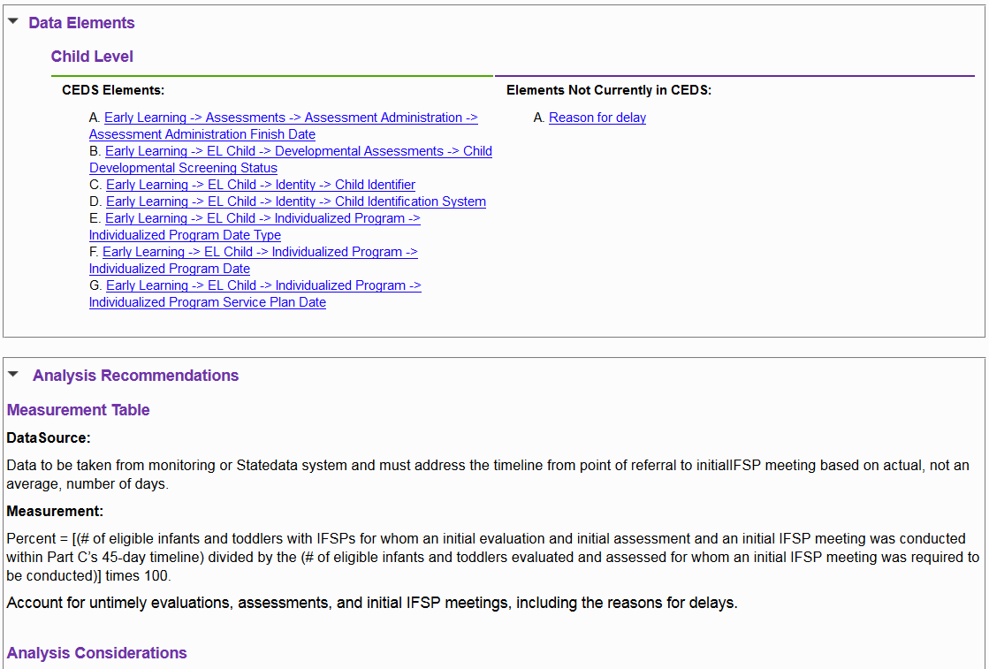
Part C APR indicator connections
CEDS elements
Elements not in CEDS
Analysis recommendations based on OSEP SPP/APR measurement table
TA Centers Use CEDS to Support States

Slide 6
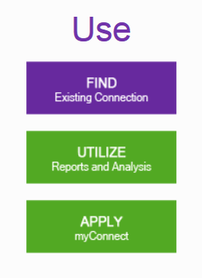
Part C APR indicator connections
If you have used Align to align data dictionary with CEDS, the connections will help:
Maintain consistency and documentation
Explore linkages with other agencies within your state collecting similar data
To locate, use Find existing connection > Disabilities > Part C
TA Centers Use CEDS to Support States

Slide 7
CEDS Connection and Critical Questions
High-quality data systems provide data that can be used to answer important questions
DaSy compiled a list of Critical Questions that an EI/ECSE data system should provide data to answer.
Questions can be used for:
Planning data system enhancements
Informing program operations, program improvement, and policy/accountability
TA Centers Use CEDS to Support States

Slide 8
CEDS Connection and Critical Questions
TA Centers Use CEDS to Support States

Slide 9
CEDS Connection and Critical Questions
DaSy is creating supporting materials to help states answer the questions using their data. This includes:
Data analysis recommendations and steps
Example table shells for organizing data
Example data visualizations for interpreting and sharing data
CEDS connection
TA Centers Use CEDS to Support States

Slide 10
CEDS Connection and Critical Questions
If you have used Align to align data dictionary with CEDS, Connection will help:
Indicate the elements required to answer critical questions and if your data system has them
Guide through analysis
Share analysis and results with other agencies or states
TA Centers Use CEDS to Support States

Slide 11
Find Out More
Visit the DaSy website at: http://dasycenter.org/
Like us on Facebook: https://www.facebook.com/dasycenter
Follow us on Twitter: @DaSyCenter

