Slide 1
Demystifying the “D” Word: Making Data Meaningful for Families
Council for Exceptional Children’s Division for Early Childhood
2016 Annual International Conference, Louisville, KY
October 19, 2016

Slide 2
Presentation Team
Center for IDEA Early Childhood Data Systems (DaSy Center)
Kerry Belodoff
Darla Gundler
Amy Nicholas
Infant Toddler Family Specialist/ Parent Representative & Co-Chair Local Interagency Coordinating Council (LICC) Catawba County, NC
Elizabeth Wise
Photo Source: Google Image Search

Slide 3
IDEA = Individuals with Disabilities Education Act
IDEA Part C = Early intervention (EI; infants and toddlers)
The section of IDEA that applies to infants and toddlers (ages birth to 3) with developmental delays or who have been diagnosed with physical or mental conditions with high probabilities of resulting in developmental delays.
IDEA Part B, Section 619 = Early childhood special education (ECSE; preschool)
The section of IDEA that applies to children ages 3 through 5 with developmental delays and disabilities.
3
Photo Source: Google Image Search

Slide 4
Who’s in the room?
Parents of children who are or who have received EI or ECSE
Service providers (e.g., teachers, therapists, service coordinators)
Local-level EI or ECSE administrators/program leaders
State-level EI or ECSE administrators/program leaders
Researchers
Technical assistance providers
Others

Slide 5
Comfort Level with Data
1. 2.
3. 4.
Photo Sources: Google Image Search

Slide 6
What is the DaSy Center?
The DaSy Center is a technical assistance center funded by OSEP.
The Center assists states with improving Part C and Section 619 data by:
Building better data systems
Linking data across early childhood programs
Connecting to statewide data systems that monitor children over time
Using data to improve services for children and families
Strengthening relationships with stakeholders
6

Slide 7
Review of Session
Role of Families in EI/ECSE Data Conversations
Purpose and Principles of Effective Data Visualization
Using Data Pictures to Facilitate Meaning
A Parent’s Perspective
Photo Source: Google Image Search

Slide 8
CLOSE YOUR EYES
Ignore the thought of numbers for a second. Instead, try to picture the story!
Photo Source: Google Image Search
Notes:
!

Slide 9
Recognize this?
Photo Source: Google Image Search
Notes:
Elizabeth

Slide 10
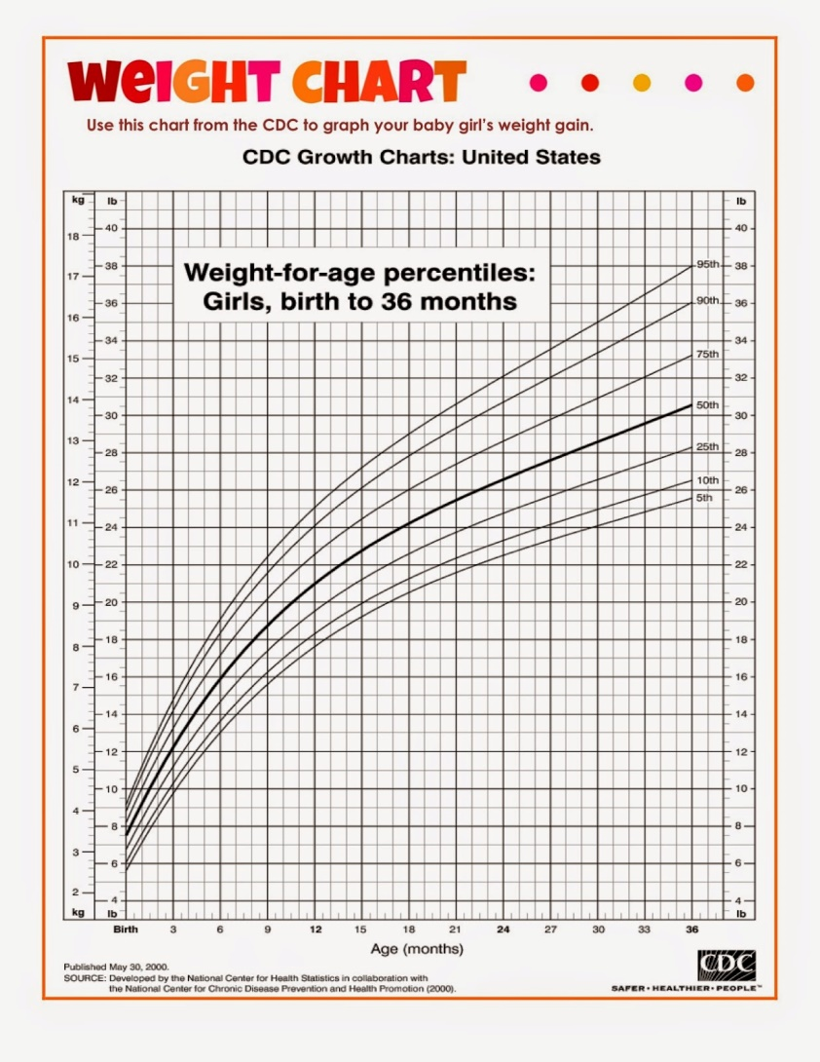
Infant/Toddler Growth Chart

Slide 11
In EI/ECSE, what types of data are we talking about?
Examples:
Demographic (e.g., child gender, race)
Assessment
Provider (e.g., licensure/certification, years of experience)
Services (e.g., Speech-Language Therapy)
Setting (e.g., home, community, gen. ed. classroom)
Child outcomes
Family outcomes (Part C) and parent involvement (Part B)
Hearing and vision screening results
11

Slide 12
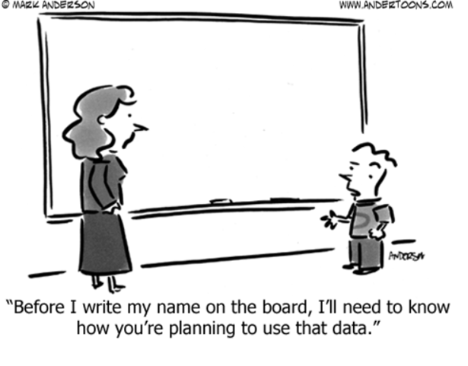
Where do families fit into all of this?
12
Photo Source: Google Image Search

Slide 13
Purpose and Principles of Effective Data Visualization
Photo Source: Google Image Search

Slide 14
What is data visualization?
The representation and presentation of data or information to facilitate understanding.
Photo Source: DaSy Center

Slide 15
What is data visualization?
The representation and presentation of data or information to facilitate understanding.
15

Slide 16
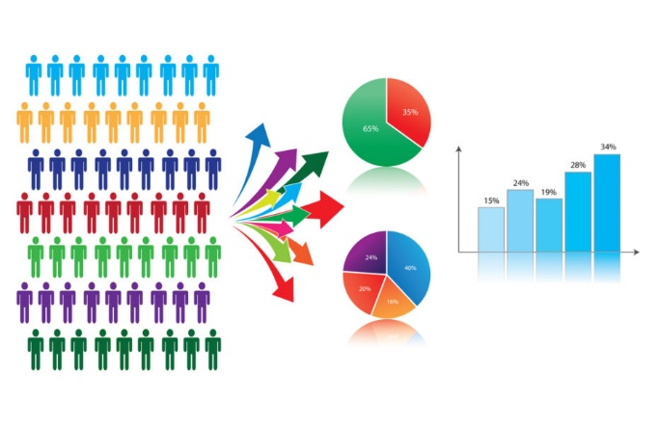
Good data visualization…
Portrays data accurately and clearly
Facilitates understanding
Is engaging and attractive
Is accessible
Promotes data use
Photo Source: Google Image Search

Slide 17
1. Portrays Data Accurately and Clearly
"Many a statistic is false on its face. It gets by only because the magic of numbers brings about a suspension of common sense.“
Good visualization is trustworthy.

Slide 18
2. Facilitates Understanding

Slide 19
Is (Not So) Engaging and Attractive

Slide 20
3. Is Engaging and Attractive

Slide 21
4. Is Accessible
Visualizations are by their very nature images, which can cause issues for some individuals with disabilities (e.g., visual impairments).
Create “alt text” descriptions
Use a color contrast checker
Consider how the data visualization will be presented
With your audience in mind, consider the need for multiple formats beyond “alt text”

Slide 22
5. Promotes Data Use
Bad Example

Slide 23
A picture is worth a 1,000 words!
We will use three data pictures to illustrate the purposes and uses of EI and ECSE data:
Families and professionals working together to help children achieve good outcomes. (CHILD-LEVEL)
Families helping programs improve their services. (LOCAL PROGRAM-LEVEL)
Families showing state policymakers that services make a difference. (STATE-LEVEL)
Photo Source: Google Image Search

Slide 24
Data Picture 1: Families and professionals working together to help children achieve good outcomes.
Photo Source: Google Image Search

Slide 25
What is an outcome?
An outcome is an end result.
Photo Source: DaSy Center

Slide 26
Three Child Outcomes
Children have positive social-emotional skills (including social relationships).
Children acquire and use knowledge and skills (including early language/communication and early literacy).
Children use appropriate behaviors to meet their needs.
Photo Source: DaSy Center

Slide 27
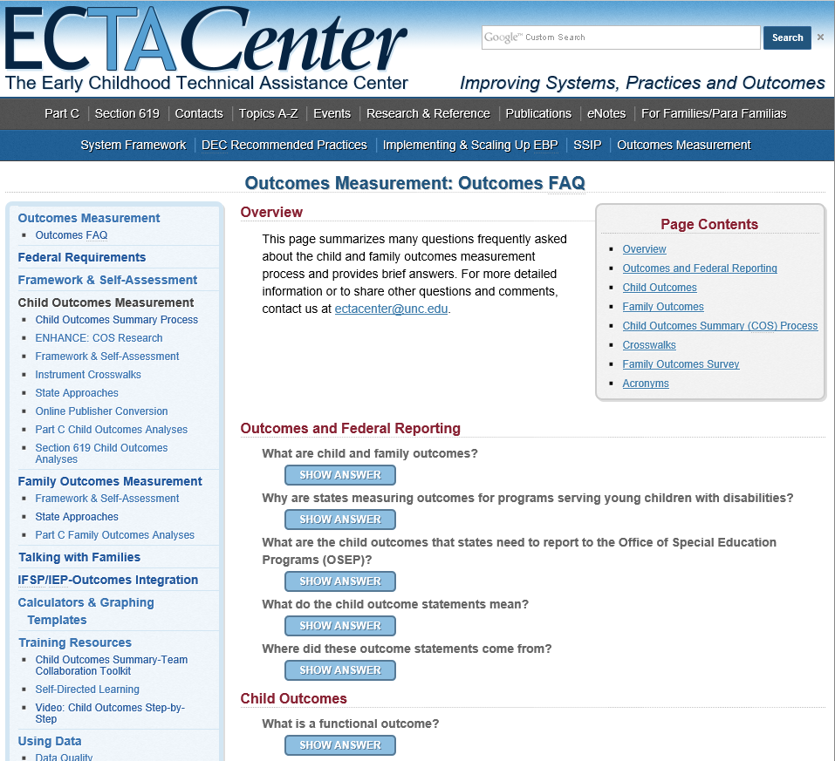
Learn More About Child and Family Outcomes Data
Visit: http://ectacenter.org/ eco/pages/faqs.asp
Important for parents know:
How is your state is collecting outcomes data;
Where you can find those data; and
How those data are being used.

Slide 28
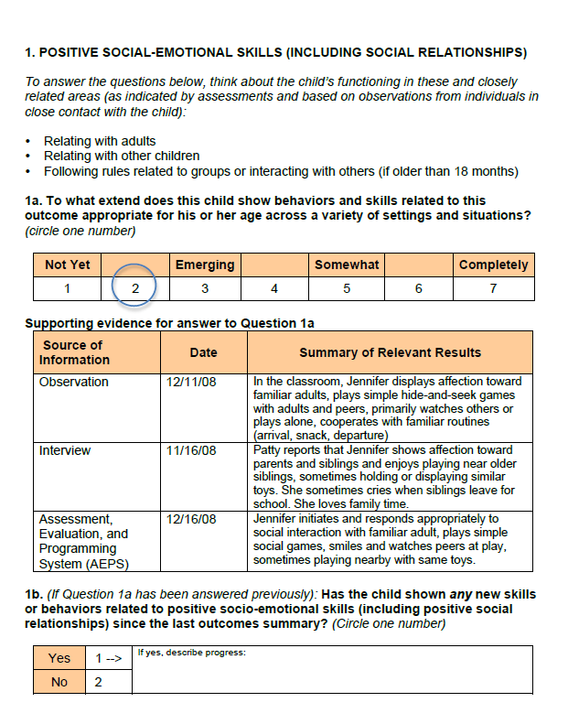
Understanding the Data

Slide 29
Connecting Family Engagement to Child Outcomes
Informing Families About Child Outcomes
Collecting Child Outcomes Data
Reviewing Child Outcomes Data with Families
Explaining outcomes and the measurement process
Including families in the measurement (e.g., assessment) process
Talking with families about outcomes results and family needs

Slide 30
A Family’s Story
Video/Photo Source: DaSy Center

Slide 31
Families Asking Questions About Child-Level Data
When was the data collected? Has anything changed about the child since that time?
How was the data collected? Would there have been issues around the child’s familiarity with the individual collecting the data?
What trends or patterns do the data show?
How do the data look over time? Are the differences or similarities in the data something to take note of?
What strengths or challenges arise from the data?
What does the data tell us about the child’s functioning?
What can you (the family) contribute to better understanding the data, e.g., examples of functioning in daily routines?

Slide 32
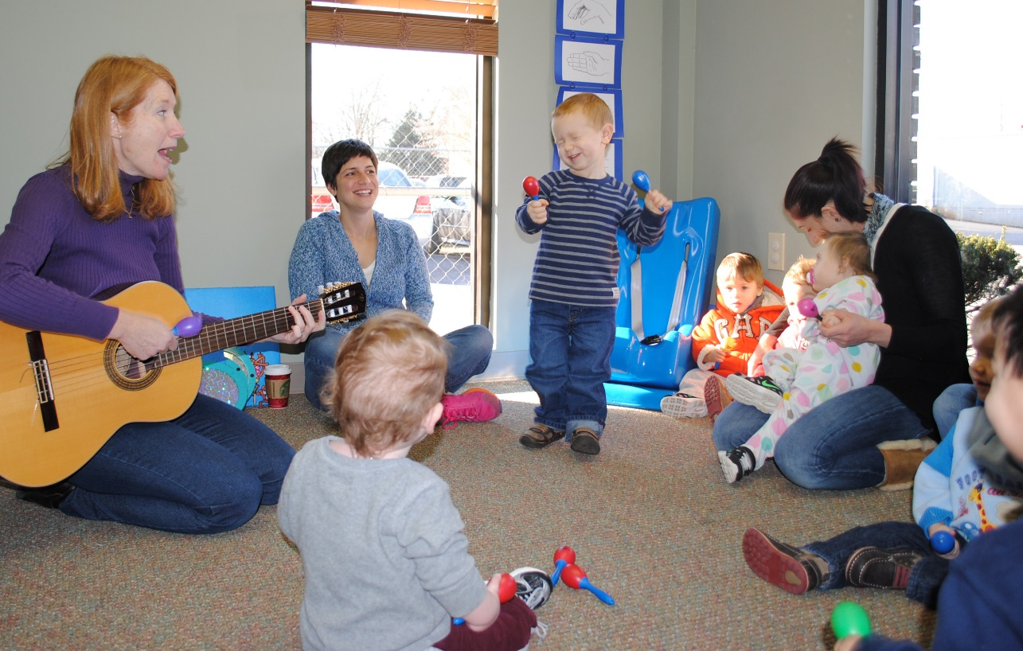
Data Picture 2: Families helping local programs improve their services.
Photo Source: Google Image Search

Slide 33
The Flow of EI/ECSE Data
Local Programs
Collect data in common formats
Share and discuss data with families
Report data to the state
Use data for program improvement
Local Programs
State Agency
Generate reports for federal reporting
Use data for program improvement, including advocating for funding
States
US Department of Education, Office of Special Education
Summarize data to produce a national picture
Report data to Congress to advocate for funding
Federal Government

Slide 34
Uses of EI/ECSE Data at the Local Program Level
To identify strengths and areas of improvement in delivering services.
Are we serving most children in natural environments?
Are we helping families
To look for associations between program level decisions (provider professional development, caseload, etc.) and child and family outcomes.

Slide 35
Local Interagency Coordinating Council (LICC)
A local advisory group that consists of representatives from families, administration, providers, service coordinators, health agencies, and other community programs that works toward the overall goal of enhancing local EI and ECSE supports and services.
Families are critical members of LICCs or anyone can participate in the meetings as guests. Meetings are open to the public.
Photo Source: https://www.tcdsb.org/schools/josyfcardinalslipyj/CSPC/Pages/CSPC-Annual-General-Meeting-and-Elections.aspx

Slide 36
Let’s sneak into an LICC meeting!

Slide 37
Families Asking Questions About Program-Level Data
Program
Practitioner
Child & Family
Photo Source: Google Image Search

Slide 38
Child and Family Questions
How do child and family outcomes differ by child and family characteristics (e.g., disability, demographics)?
What characteristics of services (e.g., type, intensity) are related to better outcomes for children and families?
What is the relationship between the service setting and outcomes?

Slide 39
Practitioner Questions
What are the characteristics of practitioners working in early intervention/early childhood special education (EI/ECSE)?
e.g., demographics, education/experience, turnover rate
What ongoing professional development do early intervention/early childhood special education (EI/ECSE) practitioners receive?

Slide 40
Program Questions
What are the characteristics of our local program(s)?
e.g., number of children served, practitioner-child ratio
What is the cost of providing early intervention/early childhood special education (EI/ECSE) services to children and families?
What are the major funding streams and allocations?
What factors are related to costs?

Slide 41
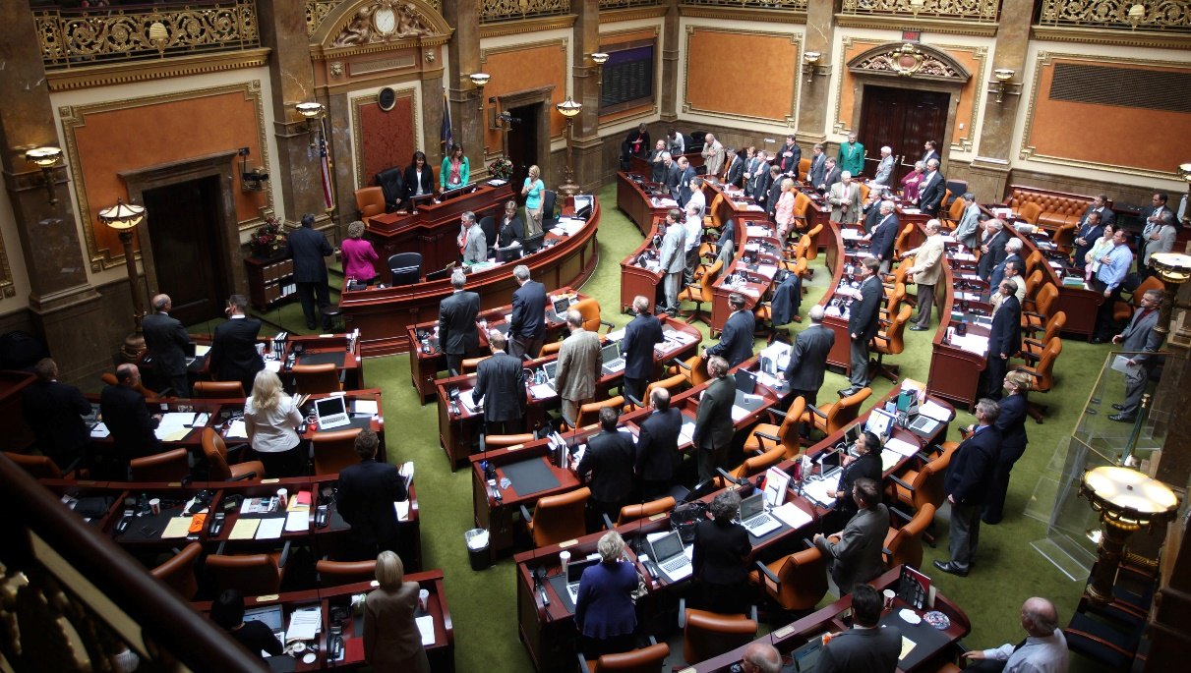
Data Picture 3: Families showing state policymakers that services make a difference.
Photo Source: Google Image Search

Slide 42
Parent Involvement at the State Level
State Interagency Coordinating Council (SICC)
Find your SICC website at: http://ectacenter.org/contact/contactsurl.asp?gc=104
Find your SICC Chairperson at: http://ectacenter.org/contact/iccchair.asp
Contacts with state legislature
Testimonies (written or spoken): Opportunity to influence decision-makers
41

Slide 43
Reporting
State requirements or requests
Federal requirements under IDEA, such as:
Annual Performance Report (APR) = A report that states are required to send to the U.S. Office of Special Education Programs each year demonstrating their performance related to the implementation of IDEA programs.
Find your state’s APR at https://osep.grads360.org

Slide 44
Types of Data: Quality Assurance
Data Types
Uses for the Data
Professional development/training
Program quality ratings
Staff credentials/ competencies
Compliance with regulations
Monitor professional development and technical assistance needs of providers and state staff
Monitor program improvement
43

Slide 45
Types of Data: Program Operations
Data Types
Uses for the Data
Demographics
Fiscal and/or billing
Service delivery
Budgeting
Determining state hiring needs for service providers
Managing day-to-day operations of the program at multiple levels
44

Slide 46
Types of Data: Accountability for Results
Data Types
Uses for the Data
Child outcomes
Family outcomes
Natural/Least Restrictive Environment (LRE)
Show that programs are making a difference for children and families
Monitor state compliance with federal regulations
45

Slide 47
Data Product for Policymakers
Posted with permission from MD State Dept. of Ed. on DaSy website: http://dasycenter.sri.com/downloads/DaSy_papers/Birth_Five_Legislative_Booklet_2016.pdf
46

Slide 48
Families Asking Questions About State-Level Data
What process does the state have in place for ensuring the completeness and accuracy of the data?
What method(s) does the state use for gathering data from locals? Is it effective and efficient?
Do the data show trends that are useful in determining the root cause(s) of any performance issue?
Do locals have adequate numbers of qualified personnel? If not, why not?
Does the state provide training and technical assistance to meet the needs of the local staff in relation to the data (e.g., social-emotional evidence-based practices related to Child Outcome #2)?
47

Slide 49
A Parent’s Perspective

Slide 50
Be an Accurate Guide

Slide 52
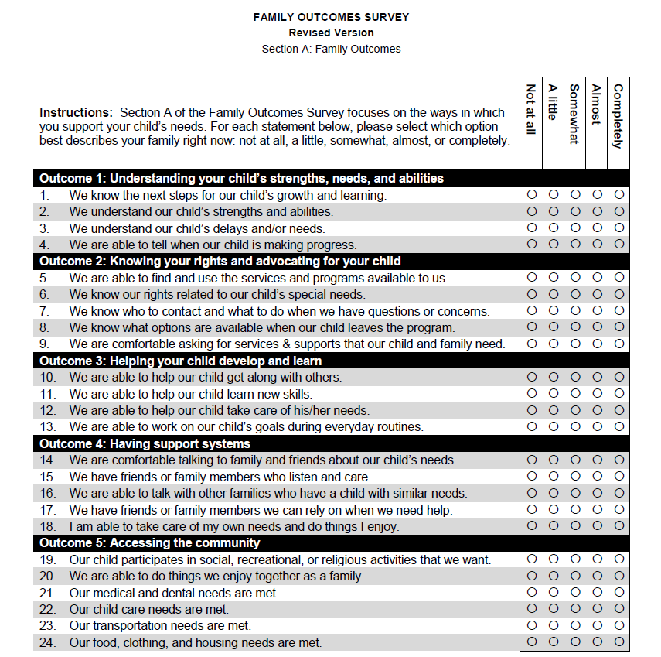
Shape Your Role
What is the family’s role in data collection, e.g., completing the family outcomes survey?

Slide 53
What if….
School districts developed and shared “inclusion report cards?”

Slide 54
FOR ILLUSTRATION PURPOSES OF TYPES OF DATA-NOT BASED ON ACTUAL DATA.
THIS GRAPIC DISPLAYS # OF STUDENTS WITH ALL DISABILIITIES AND DEVELOPMENTAL DELAYS BY PERCENTAGE OF TIME SPENT IN THE REGULAR CLASSROOM, AND SUBSET OF INTELECUAL DISABILITY/DEVELOPMENTAL DELAY.

Slide 55
SCHOOL [NAME] [TOTAL SCHOOL POPULATION # HERE]
AGE/ GRADE | TOTAL # STUDENTS WITH DISABILITIES | TOTAL # GENERAL ED CLASSROOMS 80% OF DAY | # WITH INTELLECTUAL DISABILITIES IN GENERAL ED 80% OF DAY | TOTAL # ASSIGNED TO SEPARATE CLASSROOM | # WITH INTELECTUAL DISABILITIES IN SEPARATE CLASSROOM | TOTAL # IN GENERAL ED 40-79% OF DAY | # WITH INTELLECTUAL DISABILITIES IN GENERAL ED 40-79% OF DAY | TOTAL # IN GENERAL ED < 40% OF DAY | # WITH INTELLECTUAL DISABILITIES IN GENERAL ED < 40% OF DAY
TOTAL

Slide 56
Unmarried
College Graduate
2 Children
NC Partners in Policymaking Graduate 2016
Annual Earnings <$18,000
Daycare Assistance
Self-Employed
Parent Co- Chair LICC
Medicaid Recipient
Home owner
Received Food Stamps
Infant Toddler Family Specialist Certified
Student pursuing additional Certificates
Car paid for

Slide 57
Sensory Seeker
Physically Active
Loves Bugs
Likes to eat chips
Temper Tantrum
Hyper-focused
Detail Oriented
Can not sit still
Above Average IQ

Slide 58
Catawba County, NC’s Local Interagency Coordinating Council (LICC)
Community members and parents working together for children with special needs.

Slide 59
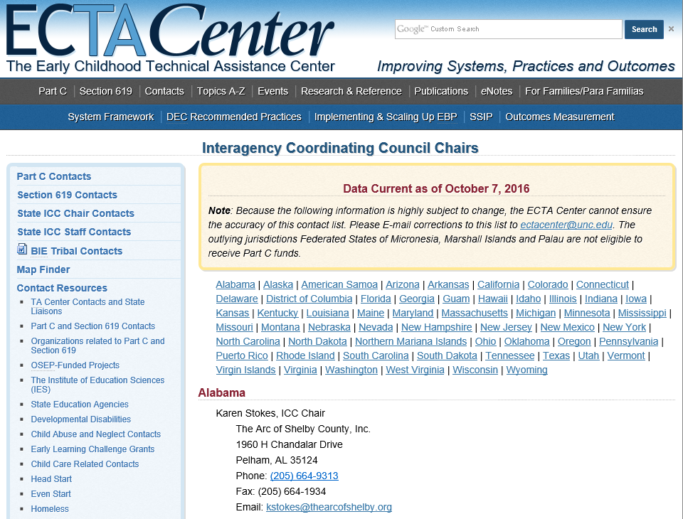
Find Your LICC
Ask your State Interagency Coordinating Council (SICC) Chairperson.
Find that person by visiting:
http://ectacenter.org/contact/iccchair.asp

Slide 60
How many people learned something new from this session?
Image source: Google image search

Slide 61
Key Resource: DaSy-NCSI Data Visualization Toolkit
http://dasycenter.org/data-visualization-toolkit/

Slide 62
Other Resources
DaSy Center website
For Families Page
Data Visualization Toolkit
A Family Guide to Participating in the Child Outcomes Measurement Process
Serving on Groups That Make Decisions: A Guide for Families

Slide 63
The contents of this presentation were developed under a grant from the U.S. Department of Education, # H373Z120002. However, those contents do not necessarily represent the policy of the U.S. Department of Education, and you should not assume endorsement by the Federal Government. Project Officers, Meredith Miceli and Richelle Davis.

