Slide 1
How to Involve Families in the Child Outcome Summary (COS) Process
Debi Donelan, MSSA Early Support for Infants and Toddlers
Katrina Martin, Ph.D. SRI International/DaSy/ECTA Center
May 6, 2016
Notes:
1

Slide 2
Objectives
Objectives:
Discuss why family involvement throughout the COS process is important.
Explore ways to engage families as partners in assessment.
Learn about resources that promote collaboration with families.
Notes:
2

Slide 4
Notes:
Debi 1:38-1:40
How do you include family input in the COS rating selection? https://www.polleverywhere.com/multiple_choice_polls/OoyGuvGamau5qdX

Slide 5
Supporting Multiple Needs

Slide 6
Why team for the COS process?
Obtaining a complete picture of the child’s functioning requires people who:
Spend time with the child in different settings, situations, and everyday routines, and
Have different perspectives about the child’s functioning based on their particular expertise in observing skills and behaviors.
Notes:
6

Slide 7
Who should be on the team?
Family Resources Coordinator
Child’s family
Early Intervention Specialist
Other therapists or related service providers
Other caregivers (child care, extended family, etc.)
Notes:
7

Slide 8
Preparing the Family
Before the meeting:
Explain the COS process to the family.
Share written materials describing the process.
Review what the family can expect.
Check for understanding and answer questions.
Notes:
8

Slide 9
Washington Resource- COS Brochure
http://www.del.wa.gov/development/esit/training.aspx
Notes:
9

Slide 10
Notes:
Debi 1:47-1:49
How are you using the Washington COS brochure with families? https://www.polleverywhere.com/multiple_choice_polls/SLaeAT2vmKHhgOW

Slide 11
National Resource- PACER Family Guide
PACER Center/ECTA Center (2013): http://www.pacer.org/publications/earlyChildhood.asp
Notes:
11

Slide 12
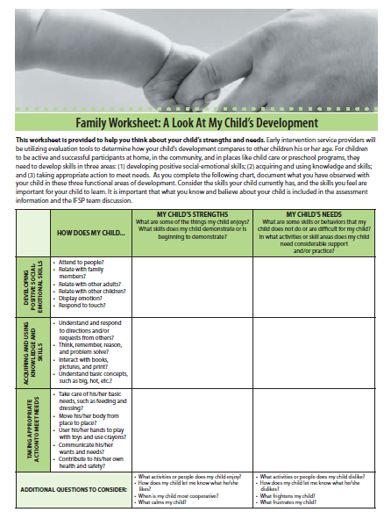
National Resource- Maryland Family Worksheet
Family Worksheet, page 13 of “A Family Guide to Understanding the Individualized Family Service Plan (IFSP)”
http://msde.maryland.gov/MSDE/divisions/earlyinterv/infant_toddlers/resources.html
Notes:
Katrina
1:51-1:55
12

Slide 13
Effective Teaming Practices
All members participate.
It is not necessary that all team members be knowledgeable in all 5 areas
There is no expectation that families understand the rating scale of typical child development
Diverse perspectives and different opinions are encouraged.
Acronyms and jargon are minimized.
Professional terms are explained.
Notes:
13

Slide 14
Effective Teaming Practices
Use appropriate eye contact.
Listen empathically with responsive body language and appropriate facial expressions.
Allow speakers to reflect on and finish their thoughts before moving on.
Summarize, paraphrase, or ask for descriptive examples to check understanding.
Ask follow-up questions to get additional information, as needed.
Notes:
14

Slide 15
Quality COS Teaming Practices (1)
Plan ahead to have the information needed for the discussion.
Notes:
15

Slide 16
Quality COS Teaming Practices (2)
Plan ahead to have information needed for the discussion.
Discuss the child’s functioning on each outcome, across settings, and relative to what is age expected.
Notes:
16

Slide 17
Involving families in a conversation about their child’s functioning
Ask questions that allow parents to tell you what they have seen.
“Tell me how Anthony eats”
Avoid questions that can be answered with a yes or no.
“Does Anthony finger feed himself?”
“Is that what you see at home?”
Notes:
17

Slide 18
Rich Discussion: Example Questions to Ask
What skills and behaviors does the child use?
In what settings and situations?
How often is the child using those skills and behaviors?
What supports are needed for the child to use them?
Are these skills and behaviors that we expect of a child this age?
Are there skills or behaviors that we would expect a child this age to use that this child is not yet using?
Notes:
Katrina 2:05-2:07
Being able to reach an accurate rating requires a rich dialogue about what the child is doing in each outcome and talking about what the child is doing relative to what would be expected for a child this age. Examples of questions that might draw out this type of information are:
What skills and behaviors does the child use?
In what settings and situations?
How often is the child using those skills and behaviors? What supports are needed for the child to use them?
Are these skills and behaviors what we expect of a child this age?
Are there skills or behaviors that we would expect a child this age to use that this child is not yet using?
Make sure the team discusses the child’s functioning in depth across settings and situations.
18

Slide 19
Rich Discussion: Addressing the Full Content of Each Outcome
For example, for Positive Social Relationships:
How does the child interact with familiar adults? With unfamiliar adults?
How does the child interact with peers?
How well does the child follow rules and routines when at child care?
How does the child express himself when he is frustrated? Excited? (other emotions)
How does the child handle transitions between activities?
Notes:
19

Slide 20
Rich Discussion: Considering Age Expectations
Discuss how the child’s functioning relates to age expectations.
Draw on child development resources to age-anchor skills.
Consider such factors as
What is expected in the child’s culture, and
Availability and use of assistive technology devices.
Notes:
20

Slide 21
Quality COS Teaming Practices (3)
Plan ahead to have information needed for the discussion.
Discuss the child’s functioning on each outcome, across settings, and relative to what is age expected.
Consider as a team what you have learned about the child in relation to the criteria on the 7-point scale and use the decision tree to help apply the criteria.
Notes:
21

Slide 22
Summary of Functional Performance
Descriptor statements rather than numbers
There is no reason to mention the numbers on the scale during the discussion or ask families to come up with a number
IFSP Process and Resource Guide:
http://www.del.wa.gov/publications/esit/
Notes:
22

Slide 23
Culture and Summary of Functional Performance
The age appropriateness of some behaviors varies across cultures, especially those related to independence and self care.
It is important for working with the child and for completing the Summary of Functional Performance to understand expectations within the child’s culture.
Notes:
23

Slide 24
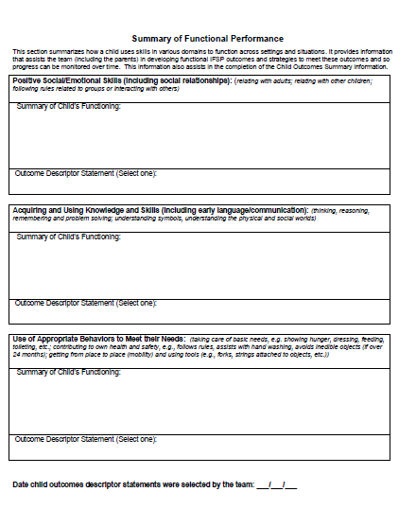
Summary of Functional Performance Example
Example: With regard to positive social relationships, Bella interacts in age-expected ways with adults but is not yet interacting with peers. We are seeing a mix of age-expected and not age-expected skills. Does everyone agree?
Notes:
24

Slide 25
Discussion Questions
How are you currently engaging families in the COS process?
What obstacles have you encountered with regard to involving families in the COS decision-making processes?
Notes:
25

Slide 26
Video
Engaging Families in the COS Process Video
Notes:
26

Slide 27
Discussion Questions
What steps did the providers take to help prepare for the IFSP meeting, including the actions they took to prepare the family?
What unique perspective did each team member bring to the discussion?
Notes:
27

Slide 28
Video
Engaging Families in the COS Process Video
Notes:
28

Slide 29
Discussion Questions
How did the Special Educator transition the discussion of the child’s strengths and needs into the COS rating discussion?
How will you apply what you saw in the video to your current practice to better engage families in the COS process?
How would you adjust your questioning strategies in situations where a parent is not as easily able to describe his/her child’s strengths and needs?
How did the professionals demonstrate that they valued the parent’s contributions to the team discussion?
Notes:
29

Slide 30
Remote Participation
Face-to-face interactions are preferable, but getting all team members together can be difficult
Team discussions can be held with one or more members present remotely (phone or web)
Notes:
30

Slide 31
When Teams Struggle with Consensus
Make sure team members…
Share the same understanding of the three outcomes.
Have the opportunity to thoroughly describe the child’s functioning.
Agree on the age-anchoring of skills.
Revisit/review the definitions or criteria for the ratings being considered.
Notes:
31

Slide 32
Is the COS Rating Subjective?
What does “subjective” mean?
“Relating to the way a person experiences things in his or her own mind based on feelings or opinions rather than facts.” – Merriam-Webster Dictionary
Research shows that consistent application of rating criteria, like those in the COS process, produces valid information.
http://ectacenter.org/eco/pages/enhance.asp
Notes:
32

Slide 33
Final Thoughts

Slide 34
Notes:
Debi 2:59-3:00
How are you feeling about engaging families in the COS process? https://www.polleverywhere.com/free_text_polls/2eMq6am2jJodJRn

Slide 35
Evaluations
Please take a few moments to complete an evaluation.
Thank you!
Notes:
35

Slide 36
Resources
ESIT COS brochure: http://www.del.wa.gov/development/esit/training.aspx
PACER brochure: http://www.pacer.org/publications/earlyChildhood.asp
Maryland form: http://msde.maryland.gov/MSDE/divisions/earlyinterv/infant_toddlers/resources.html
ENHANCE study: http://ectacenter.org/eco/pages/enhance.asp
Videos: http://olms.cte.jhu.edu/olms2/128983
Notes:
36

