Slide 1
Cross-State Learning and Good Data
  Kathy Hebbeler
  SRI International
OSEP Leadership Meeting 2016
Notes:
Hi, my name is Kathy Hebbeler. Donna Spiker and I direct the DaSy Center which is shorthand for the Center for IDEA Early Childhood Data Systems. Thanks for joining us today to hear about how DaSy supports cross state learning. A little later in the presentation you are going to hear from Sharon Walsh who is going to talk to you a new kind of cross state learning opportunity that we at DaSy are especially excited about.

Slide 2

What is DaSy?
A technical assistance (TA) center funded by OSEP to improve Part C and Part B preschool data by helping states:
Build better data systems
Coordinate data systems across early childhood programs
Include Part C and Part B preschool data in longitudinal data systems
Build the capacity to use data
Notes:
Before I talk about cross-state learning, I want to spend a few seconds reminding you what DaSy is. We are a TA Center focused on high quality early childhood data for Part C and 619. We help states with new or enhanced data systems either within the program or linking program data to other data systems. We can help with issues like data quality, data collection, and using data. We can help with APR data and data for SSIP implementation and evaluation.

Slide 3
What does DaSy do?
Data briefs
Individual TA
Website (DaSycenter.org)
Videos
Online learning modules
Webinars
Wondering about the quality of your data system? Check out the DaSy Data System Framework and Self Assessment
Notes:
Like all OSEP funded TA Centers, DaSy supports states in many different ways that you are probably familiar with. We maintain a web site that is full of great resources. Do visit our web site to see these resources.

Slide 4

Cross-state learning opportunities
It’s better together
Notes:
Today, we want to talk with you about some of the ways in which DaSy has and will continue to promote states coming together to learn from each other. Sometimes, it is useful for a state to work one on one with a TA provider. But there also are many common issues facing states where states can learn a lot from each other. [Animation 1] We have seen over and over how much collective knowledge exists across states. [ANIMATION 2] DaSy is working to create meaningful ways for states to come together to share what they know. Let take a look at some ways states are learning from each other.

Slide 5
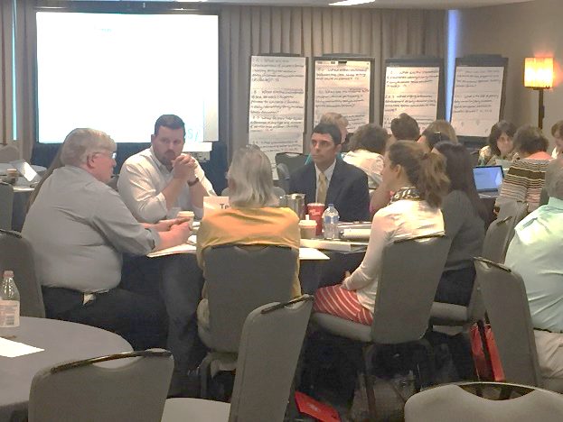
Topical Meetings
5-8 states come together for 1-2 day face to face meeting on a specific topic
May involve states teams
May involve some post meeting follow up
Examples:
  Privacy and Confidentiality
    Watch for a new opportunity in 2016
  C and 619 Participation in ECIDS
  Local Data Use
Notes:
DaSy has supported and will continue to support topical meetings. These meetings involve a small number of states come together to learn from national experts and each other about an important data issue. At our recent meeting on Data Use, for example, teams of state and local staff came together to build their capacity to use data to answer critical policy and programmatic questions.

Slide 6

Learning Communities
Series of facilitated meetings (usually virtual) where small number of states come together around a topic of common interest
Examples:
  Data Visualization Community of Practice
  Early Childhood Integrated Data Systems (ECIDS) Learning Community
Working with other TA Centers on Learning Communities
Child Outcomes Summary Data
Social Emotional Community of Practice
Family Outcomes
Notes:
DaSy also has supported several learning communities. These learning communities bring together states repeatedly to pursue a particular topic in more depth. Most of these meetings are by phone. Our ECIDS Learning Community, for example, consists of Part C and 619 staff that are interested in participating in their state’s effort to build an integrated early childhood data system. This community evolved as a follow up for state participants who attended a topical meeting on the same subject.
Now Sharon Walsh is going to talk with you about a new kind of cross-state learning opportunity that we are especially excited about called “Topic Cohorts.”

Slide 7
Four Topic Cohorts Designed To:
Involve intensive TA work with a state team.
Result in measurable systemic change.
Span duration of many months.
Be guided by:
  State self-assessment using the DaSy Data System Framework and the ECTA Systems Framework
  A written TA agreement.
Be delivered collaboratively, as appropriate.
Involve cross-state learning opportunities and individualized work with the state.
Notes:
ECTA has brought states together, in collaboration with other Centers, around particular topics. These are called topic cohorts. The topic cohorts are provided intensive TA with a small group of states who share a mutual objective (i.e., making progress on the topic) to help them make measureable progress toward their intended outcomes. While the TA involves cross state learning opportunities such as conference calls, webinars, resource documents, and F2F meetings, there is also an individualized component where the state receives intensive individualized TA to support the achievement of their individual goals. The topic cohorts are designed to involve extensive work with a state, result in measurable systemic change, and span a duration of months. The topic cohorts are also guided by a written TA agreement that has been developed jointly by the TA team and the state. This agreement includes a timeline, intended outcomes, and a statement of commitment from the state and the TA providers involved.
The underlying assumption and reason for topic cohorts is that there are commonalities across some states and that bringing states together with a common interest can support them in learning from and sharing with each other to make measurable progress toward a system change goal.

Slide 8
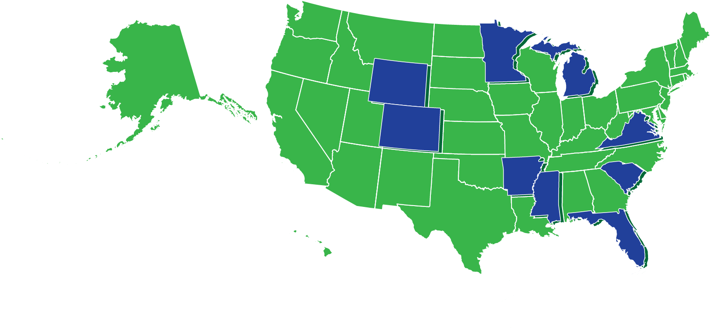



Powerful Data for 619 Topic Cohort
AR, CO, FL, MI, MN, MS, SC, VA, WY
Notes:
Denise

Slide 9
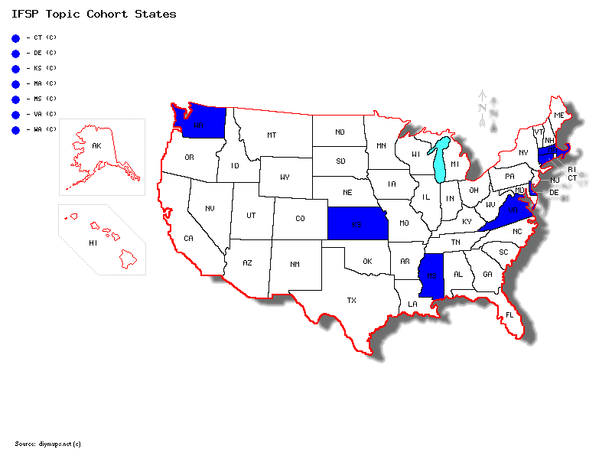

Including the IFSP in your Data System
7 States: CT (C), DE (C), KS (C), MA (C), MS (C), VA (C), WA (C)
Notes:
AMY

Slide 10
Including the IFSP in your Data System Cohort’s Areas of Focus
Identify critical questions involving the use of IFSP data
Develop business requirements for data system enhancements or new data system
Develop or revise state policies related to the IFSP
Enhance reporting capabilities
Revise statewide IFSP form
Explore integrated IFSP/child outcomes and/or family outcomes processes (including with goal of refining existing policies/procedures)
Examine & improve IFSP workflow (including integrated IFSP/child outcomes)
Engage stakeholders

Slide 11
Powerful 619 Data Cohort ‘s Focus
Sharing of data across systems
Integrating data into longitudinal data systems
Data analysis, visualization and reports
(Indicator 6, Indicator 7)
Data quality and integrity
Transition notification/referral processes
Data governance and privacy
Data use
Communication and messaging about 619

Slide 12
Linking Data Between C and 619
New cohort being planned
States have been invited to participate
Kick-off in early February 2016
Topics to be explored:
  Identifying and answering critical policy and program questions
  Establishing data sharing agreements
  Writing business requirements
  Identifying and addressing privacy, confidentiality, and technical aspects
  Other topics of interest to the cohort

Slide 13
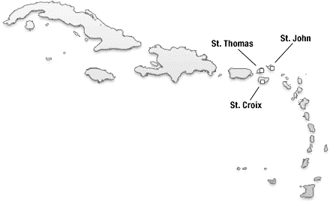
State Participation in DaSy Cross-State Learning Opportunities:
Part C and 619
NH
VT
MA
CT
NJ
DE
Alaska
Virgin Islands
Hawaii
 | Data Visualization CoP | Local Data Use | ECIDS Learning Community | PTAC EC Confidentially Meeting | Child Outcomes Topic Cohort | Child Outcomes Summary Data CoP | Social Emotional Community of Practice | IFSP Topic Cohort | Powerful 619 Topic Cohort | Family Outcomes Learning Community
Part C
619

Slide 14
State Participation in DaSy Cross-State Learning Opportunities: Part C
NH
VT
CT
NJ
DE
Alaska
Virgin Islands
Hawaii
Data Visualization CoP | Local Data Use | ECIDS Learning Community | PTAC EC Confidentially Meeting | Child Outcomes Topic Cohort | Child Outcomes Summary Data CoP | Social Emotional Community of Practice | IFSP Topic Cohort | Family Outcomes Learning Community

Slide 15

State Participation in DaSy Cross-State Learning Opportunities: 619
Alaska
Virgin Islands
Hawaii
Data Visualization CoP | Local Data Use | ECIDS Learning Community | PTAC EC Confidentially Meeting | Child Outcomes Topic Cohort | Child Outcomes Summary Data CoP | Social Emotional Community of Practice | IFSP Topic Cohort | Powerful 619 Topic Cohort | Family Outcomes Learning Community

Slide 16

A great cross-state learning opportunity!
Improving Data, Improving Outcomes Conference
August 15 to 17, 2016
New Orleans, LA
Jointly hosted by DaSy, ECTA, IDC, and NCSI
Mark your calendar
Watch the DaSy web site for how to
suggest topics and presenters
Notes:
Finally, we hope to see you later this summer when you will have the opportunity to hear from many other states about how they are using data to improve their system, practices, and ultimately outcomes for children and families. Start thinking now about something that you would like to share. We know you want to hear what your colleagues are doing and your colleagues are looking forward to learning about what is happening in your state.

Slide 17
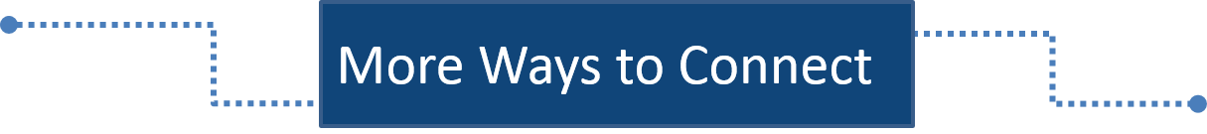



Visit the DaSy website:
DaSy Center Website
Like us on Facebook:
Link to DaSy Center on Facebook
Follow us on Twitter:
Link to DaSyCenter on Twitter
Notes:
Thanks for joining us. Watch our web site and follow us on social media for new ways to share and learn about data.

Slide 18



The contents of this presentation were developed under a grant from the U.S. Department of Education, #H373Z120002. However, those contents do not necessarily represent the policy of the U.S. Department of Education, and you should not assume endorsement by the Federal Government. Project Officers, Meredith Miceli and Richelle Davis.

