Slide 1

IDEA and FERPA Privacy Provisions — Understanding the Basics
CEC Division for Early Childhood's Annual International Conference on Young Children with Special Needs and Their Families
October 9, 2015
Ross Lemke, IDC
Sharon Walsh, DaSy

Slide 2

Some Questions for You

Slide 3
Different Laws, Similar Rules
IDEA Part C
FERPA
IDEA Part B
Who?
When?
What?

Slide 4

Family Educational Rights and Privacy Act (FERPA)
FERPA provides parents the right to
  inspect and review education records;
  seek to amend education records; and
  consent to the disclosure of personally identifiable information from education records, except as provided by law.
Notes:
When a student turns 18 years old, or enters a postsecondary institution at any age, the rights under FERPA transfer from the parents to the student (“eligible student”).

Slide 5
Part B of the Individuals with Disabilities Education Act (IDEA)
§ 300.610 Confidentiality of Information
“The Secretary takes appropriate action, in accordance with section 444 of GEPA [FERPA], to ensure the protection of the confidentiality of any personally identifiable data, information, and records collected or maintained by the Secretary and by SEAs and LEAs pursuant to Part B of the Act, and consistent with §§ 300.611 through 300.627.”

Slide 6
Part C of the Individuals with Disabilities Education Act (IDEA)
§ 303.402 Confidentiality
“The Secretary takes appropriate action, in accordance with section 444 of GEPA [FERPA], to ensure the protection of the confidentiality of any personally identifiable data, information, and records collected or maintained by the Secretary and by lead agencies and EIS providers pursuant to part C of the Act, and consistent with §§ 303.401 through 303.417. The regulations in §§ 303.401 through 303.417 ensure the protection of the confidentiality of any personally identifiable data, information, and records collected or maintained pursuant to this part by the Secretary and by participating agencies, including the State lead agency and EIS providers, in accordance with [FERPA].”

Slide 7
To whom does this apply?
IDEA Part C | IDEA Part B | FERPA
Participating agency Any individual, agency, entity, or institution that collects, maintains, or uses personally identifiable information to implement the requirements in part C. Includes any individual or entity that provides any part C services. Does not include primary referral sources or public agencies or private entities that act solely as funding sources for Part C services. | Participating agency Any agency or institution that collects, maintains, or uses personally identifiable information, or from which information is obtained under Part B. | Educational agency or institution Any public or private agency or institution that provides educational services and/or instruction to students; or is authorized to direct and control public elementary or secondary, or postsecondary educational institutions; and to which funds have been made available under any program administered by the Secretary

Slide 8

FERPA and Funding
Elementary and secondary schools that receive funds under any program administered by the Secretary of Education are subject to FERPA.
Postsecondary institutions that receive funds under any program administered by the Secretary of Education are subject to FERPA.
Most private schools at the elementary, secondary levels do not receive such funds and are, therefore, not subject to FERPA.
Notes:
Elementary and secondary schools that receive funds under any program administered by the Secretary of Education
Postsecondary institutions that receive funds under any program administered by the Secretary of Education
Most private schools at the elementary, secondary levels do not receive such funds and are, therefore, not subject to FERPA.

Slide 9
Early Childhood Education Program Definition
According to 20 USCS § 1003(8), the term “early childhood education program” means –
“(A) a Head Start program or an Early Head Start program carried out under the Head Start Act (42 U.S.C. 9831 et seq.), including a migrant or seasonal Head Start program, an Indian Head Start program, or a Head Start program or an Early Head Start program that also receives State funding;
(B) a State licensed or regulated child care program; or
Notes:
SW – added this one

Slide 10
Early Childhood Education Program Definition
(C) a program that—
(i) serves children from birth through age six that addresses the children's cognitive (including language, early literacy, and early mathematics), social, emotional, and physical development; and
(ii) is –
    (I) a State pre-kindergarten program;
    (II) a program authorized under section 619 or part C of the Individuals with Disabilities Education Act [20 USCS § 1419 or §§ 1431 et seq.]; or
    (III) a program operated by a local educational agency.”

Slide 11
When does FERPA apply to EC organizations?
Student Data
Federally funded
Student record with PII and health data: FERPA applies.
Health-record only. HIPPA may apply.
NOT federally funded?
Not FERPA protected. HIPAA may apply.

Slide 12
Whose records are protected?
IDEA Part C | IDEA Part B | FERPA
Child = An individual under the age of 6 and may include an infant or toddler with a disability | Child with a disability: Children determined eligible under one of 13 disability categories & needs special education and related services as a result of disability “Records relating to … children that are collected, maintained or used…” | Student = Any individual who is or has been in attendance at an educational agency or institution and regarding whom the agency or institution maintains education records

Slide 13
What records are covered?
IDEA Part C | IDEA Part B | FERPA
IDEA Part C Early Intervention Records All records regarding a child that are required to be collected, maintained, or used under Part C 303.403(b) | IDEA Part B Education Records The type of records covered under the definition of “education records” in FERPA Records that are collected, maintained, or used 300.611(b) | FERPA Education Records Records that are – Directly related to student; and Maintained by an educational agency or institution or by a party acting for the agency or institution 99.3

Slide 14
FPCO Letter to Edmunds (2012)
“Early intervention records” is the same as “education records” for purposes of the confidentiality protections under IDEA Part C and FERPA
If early intervention records are covered under FERPA and IDEA Part C, those records are exempt as PHI under the HIPAA Privacy Rule
Notes:
SW – I added this one

Slide 15
When does this apply?
IDEA Part C | IDEA Part B | FERPA
When the child is referred for early intervention services... Until the later of when the participating agency is no longer required to maintain or no longer maintains that information under applicable Federal and State laws 303.401(c)(2) | Apply to records that are collected, maintained, or used | When the student is “in attendance at an educational agency or institution”

Slide 16
What else applies? - HIPAA
Law establishes standards and imposes requirements to protect the privacy of individually identifiable health information.
Records that are subject to FERPA are not subject to the HIPAA Privacy Rule (see page 82483, Federal Register, Vol. 65, No. 250, December 28, 2000).
Other HIPAA Rules may apply.
Health records on students, including immunization records, maintained by an educational agency or institution subject to FERPA are “education records” subject to FERPA.

Slide 17
Pop Quiz
Robert is an elementary school teacher. He wants to post the results of a math test so he runs a report that has the names, scores, gender, Special Education status, and race/ethnicity of the students. Robert wants to preserve the privacy of his students so he deletes the column with student name. Is Robert’s approach ok?
Notes:
SW –delete this

Slide 18








What Is Personally
Identifiable Information (PII)?
Mother’s maiden name
Address
Name
Date of birth Place of birth
Social Security Number
Names of parent or other family members

Slide 19

What is Personally Identifiable Information (PII) under FERPA?
    PII is information from education records that would make the student’s identity easily recognized (by itself or in combination with other factors).
Some examples of PII:
  Full Name
  Student ID Number
  Grade Level AND Race/Ethnicity
Notes:
SW- do we need this one?

Slide 20
What Else Is Personally
Identifiable Information (PII)?
FERPA - 99.3 (PII)
Info. that, alone or in combination, is linkable to a specific student that would allow a reasonable person in the school community, who does not have personal knowledge of the relevant circumstances, to identify the student with reasonable certainty.
Info. requested by a person who the educational agency or institution reasonably believes knows the identity of the student to whom the education record relates.
Notes:
SW – I added this one

Slide 21
What does IDEA say?
IDEA Part C | IDEA Part B
IDEA Part C - 303.32 PII definition refers to FERPA PII definition Except-- student=child school=EIS provider | IDEA Part B - 300.29 List of personal characteristics or other information that would make it possible to identify the child with reasonable certainty
Notes:
SW – I think right col should be 300.32 and it should be longer ---- see side by side page 7

Slide 22
Inspection and Review of Education Records - FERPA
School must comply with request within 45 days.
Schools are generally required to give copies only if failure to do so would effectively deny access or make other arrangements to inspect and review – example would be a parent or student who does not live within commuting distance.
School may not destroy records if request for access is pending.

Slide 23
Inspection and Review - FERPA (cont.)
May an educational agency or institution charge a fee for copies of education records?
Yes – unless imposing a fee effectively prevents a parent or eligible student from exercising his or her right to inspect and review education records.
What limitations exist on the right to inspect and review education records?
If the records contain information on more than one student, the requesting parent or eligible student may inspect, review, or be informed of only the specific information about his or her child’s records.
Notes:
Speak to 99.11 (b) about search and retrieve

Slide 24
What does IDEA say about this?
IDEA Part C | IDEA Part B
Inspect and review any early intervention records … collected, maintained, or used by the agency …without unnecessary delay and before any meeting regarding an IFSP, or any due process hearing, and in no case more than 10 days after the request has been made. 303.405 | Inspect and review any education records …that are collected, maintained, or used by the agency …without unnecessary delay and before any meeting regarding an IEP, or any due process hearing, or resolution session, and in no case more than 45 days after the request has been made.

Slide 25
What does IDEA say about this?
IDEA Part C | IDEA Part B
Participating agency -- May charge a fee for copies of records that are made for parents under this part if the fee does not effectively prevent the parents from exercising their right to inspect and review those records, except as provided in paragraph (c) of this section. May not charge a fee to search for or to retrieve information. Must provide at no cost to parents, a copy of each evaluation, assessment of the child, family assessment, and IFSP as soon as possible after each IFSP meeting. Must make available at no cost an initial copy of early intervention record. | Participating agency May charge a fee for copies …unless imposing a fee effectively prevents a parent or eligible student from exercising his or her rights to inspect and review education records. May not charge a fee to search for or to retrieve the education records of a student.

Slide 26
What are the Procedures for Amending Education Records? - FERPA
School must decide within reasonable period of time whether to amend as requested.
If school decides not to amend, school must inform parent or eligible student of right to a hearing.
After a hearing, if decision is still not to amend, parent or eligible student has a right to insert a statement in the record.

Slide 27
What does IDEA say about this?
IDEA Parts C and B
  A parent who believes that the information in the record is inaccurate, misleading, or violates the privacy or other rights of the child can request that the record be amended.
  The agency must decide whether to amend the information within a reasonable period of time.
  If the agency refuses to amend the information, it must inform the parent of the refusal and advise the parent of right to a hearing.
  After hearing, if decision is still not to amend, parent has a right to insert a statement in the record.
  303.410 (Part C) & 300.618 (Part B)
Notes:
SW – what is the citation for the last bullet? That is not in Part C or B regs??

Slide 28
Record of Access
IDEA Part C and B | FERPA
Contain recordkeeping requirements for participating agencies. Keep a record of parties obtaining access to records collected, maintained, or used under IDEA (except for parents and authorized employees, and for Part C, authorized representatives); Include name of party, day access given, and purpose for which the party is authorized to use the records. | Contains recordkeeping requirements for both schools and SEAs. Be maintained as long as record is maintained; Include parties who requested or received information; and Include legitimate interest the parties had in receiving information. Exceptions include parents, school officials, those to whom parent provided consent and more.

Slide 29
Record Retention
IDEA Part C and B | FERPA
The participating agency-- Must inform parents when PII collected, maintained, or used is no longer needed to provide services. Must destroy information at parent’s request (once it is no longer needed). May keep permanent record with child’s name, contact and other info. -- Part C: DOB, exit data and names of service coordinator and EIS provider; Part B: grades, attendance, classes, and grade level and year completed). | An educational agency or institution, or SEA or its component, shall not destroy any education records if there is an outstanding request to inspect and review the records.

Slide 30
Right to Consent to Disclosures
Under FERPA: Except for specific exceptions, a parent or eligible student shall provide a signed and dated written consent before a school may disclose education records.
The consent must:
  specify records that may
  be disclosed;
  state purpose of disclosure; and
  identify party or class of parties
  to whom disclosure may be made.

Slide 31
FERPA - What are the exceptions to general consent?
To school officials with legitimate educational interests (defined in annual notification);
To schools in which a student seeks or intends to enroll;
To state and local officials pursuant to a state statute in connection with serving the student under the juvenile justice system;
To comply with a judicial order or subpoena (reasonable effort to notify parent or student at last known address);
To accrediting organizations;

Slide 32
What are the exceptions to general consent? (cont.)
To parents of a dependent student;
To authorized representatives of federal, state, and local educational authorities conducting an audit, evaluation, or enforcement of education programs;
To organizations conducting studies for specific purposes on behalf of schools;
In a health or safety emergency;
To child welfare agency or tribal organization for those children in foster care; and
Directory information.
Notes:
.

Slide 33
Uninterrupted Scholars Act (USA)
New exception to the general consent rule under FERPA enacted on January 14, 2013:
Permits disclosure of PII from education records of children in foster care to: “agency caseworker or other representative” of a State or local child welfare agency (CWA) who has the right to access a student’s case plan under State or tribal law
Disclosure permitted when: the CWA is “legally responsible… for the care and protection of the student”
Provisions for tribal organizations as well

Slide 34
FERPA/Part C Crosswalk
Crosswalk of Terms
FERPA | IDEA Part C
Education Record | Early intervention record
Education | Early intervention
Educational agency or institution | Participating agency
School official | Qualified early intervention service (EIS) personnel/Service coordinator
State educational authority | Lead agency
Student | Child under IDEA Part C

Slide 35
Privacy Scenario
A community-based organization that has programs for children with special needs approaches you regarding their programs and asks for the name, address, and telephone number of parents with students in your school who have a disability in order to contact parents regarding their programs.
You like the programs offered by the organization and believe the programs may be of benefit to the students with disabilities in your school and their parents. Can you share the data with the organization?

Slide 36


Directory Information Exception
  Information in a student’s education records that would not generally be considered harmful or an invasion of privacy if disclosed

Slide 37
Directory Information Exception
  May include:
    name, address, phone number, and e-mail address
    photograph
    date and place of birth
    most recent school attended; grade level and major field of study
    dates of attendance (e.g., year or semester)
    participation in officially recognized sports and activities; height and weight of athletes,
    degrees, honors, and awards received, and
  Can never include social security number
  Can’t disclose non-directory information with directory information

Slide 38

Directory Information
  Public notice must be given to parents of students in attendance and eligible students in attendance.
  Parents may choose to “opt-out” of the disclosure of directory information on their child.
  School may adopt a limited directory information policy that allows for the disclosure of directory information to specific parties, for specific purposes, or for both.

Slide 39
Pop Quiz
Mr. Gray is a parent volunteer in your Kindergarten class. Mr. Gray’s assignment is to work with a small group of children on literacy. You provide him with reading assessments for the children that he is working with.
Is it permissible for you to share this information with Mr. Gray without the consent or knowledge of the parents of the children?

Slide 40
School Official Exception
  Schools may disclose PII from education records without consent if the disclosure is to other school officials, including teachers, within the school whom the school has determined to have legitimate educational interest.
  Annual notification of FERPA rights must include criteria for determining who constitutes a school official and what constitutes a legitimate educational interest.
Notes:
One of the most used exceptions to FERPA’s general consent rule is the disclosure of PII from education records to “school officials” within your school that have a “legitimate educational interest.”
Of course, this disclosure happens every day in the life of a school. But it’s important that you understand this provision and your school’s responsibility to make sure it’s followed properly.
A school official is generally thought to have a “legitimate educational interest” if the official needs to review an education record in order do their job, to fulfill his or her professional responsibility.
SW – maybe delete this sentence - We have a model notification on our website for both LEAs and postsecondary institutions.

Slide 41
School Official Exception (cont.)
Outsourcing services under school official exception
  Schools may outsource institutional services or functions that involve the disclosure of education records to contractors, consultants, volunteers, or other third parties provided certain conditions are met.
  If these outside parties meet the conditions for outsourcing, they may have access to education records.

Slide 42
School Official Exception (cont.)
Conditions for outsourcing:
  Performs an institutional service or function for which the agency or institution would otherwise use employees;
  Is under the direct control of the agency or institution with respect to the use and maintenance of education records;
  PII from education records may be used only for the purposes for which the disclosure was made;
  Meets the criteria specified in the school, LEA, or institution’s annual notification of FERPA rights for being a school official with a legitimate educational interest in the education records.

Slide 43
Audit or Evaluation Exception
Federal, State, and local officials listed under § 9.31(a)(3), or their authorized representative, may have access to education records only –
  in connection with an audit or evaluation of federal or state supported education programs; or
  for the enforcement of or compliance with federal legal requirements which relate to those programs.
The information must be:
  protected in a manner that does not permit disclosure of PII to anyone; and
  destroyed when no longer needed for the purposes listed above.
Notes:
I am wondering if we can describe how this may occur? Like an ECID – we could ask who has an ECID – and briefly discuss

Slide 44

Studies Exception
Studies conducted “for or on behalf of” schools, school districts, or postsecondary institutions
Studies must be for the purpose of
  Developing, validating, or administering predictive tests; or
  Administering student aid programs; or
  Improving instruction.
Notes:
Dept has stated they do not generally want EC to use studies – I will add slide that has the Dept language they gave us
There is no research exception per se under FERPA. However, there is an exception for the conducting of studies. LEAs may enter into agreements with organizations for studies conducted for or on their behalf for specific purposes. Also, the December regulations amended FERPA to clarify that the entities listed in § 99.31(a)(3) of the regulations – such as an SEA -- are not prevented from redisclosing PII from education records as part of agreements with researchers to conduct studies for, or on behalf of, educational agencies.
Studies must be for the purpose of developing, validating, or administering predictive tests; or administering student aid programs; or improving instruction.
Further, the 2011 regulations clarified that “for, or on behalf of” does not require the assent of or express approval by the original disclosing educational agency. For example, it is not necessary for an SEA to secure the approval of an LEA prior to making redisclosures for, or on behalf of the LEA, so long as the SEA is acting with express or implied legal authority and for the benefit of the LEA.

Slide 45
Note on the Studies Exception
The "Audit/Evaluation” exception in 34 CFR §§99.31(a)(3) and 99.35 is the most appropriate exception under IDEA and FERPA for data sharing arrangements for the IDEA early childhood community. In the very limited instance in which IDEA Part C or IDEA Part B section 619 agencies or programs propose to consider using the “Studies” exception under FERPA, such agencies and programs will want to consult with the Department’s Office of Special Education Programs (OSEP) and Family Policy Compliance Office (FPCO) regarding how the proposed data sharing would meet the requirements in 34 CFR §§99.31(a)(6) and 303.414 (for IDEA Part C) and 34 CFR §§99.31(a)(6) and 300.622 (for IDEA Part B Section 619).
Notes:
here is the language from Dept

Slide 46
What Is a Data Sharing Agreement?
Can be called many different names: MOU, MOA, Contract, Written Agreement, etc.
The mandatory elements of the agreement vary slightly between the two exceptions
The data sharing checklist delineates the minimum requirements under the Studies and the Audit or Evaluation exceptions

Slide 47

Key Points to Remember
Properly de-identified data can be shared without any FERPA considerations and should be your FIRST option as it limits the risk of unauthorized PII disclosure
In most cases, consent is the best approach for sharing PII with non-profit organizations
Directory Information is often misunderstood. Opt-out provisions do not prevent data from being shared under the Audit/Evaluation or School Official exceptions

Slide 48
Frequently Asked Question
On your ED federally funded preschool’s enrollment card, there is a question asking whether the child has health insurance. If the parent answers “no,” the preschool sends a letter home informing the parent about Medicaid and CHIP and providing a toll-free number to call to get help with an application.
DOES THIS VIOLATE FERPA?
A: This is perfectly acceptable. It raises no FERPA concerns because the preschool has not disclosed personally identifiable information (PII) from a child’s education records to an outside entity.
Notes:
SW -added

Slide 49
Frequently Asked Question
On the ED federally funded preschool enrollment card, there is a question asking whether the child has health insurance. If the parent answers “no,” the preschool calls to inform the parent about Medicaid and CHIP. She asks if it is OK to share the parent’s phone number with the school social worker, who can provide application assistance.
Is a consent form needed to allow the nurse to pass the parent’s phone number to the social worker – both school employees – or is oral consent necessary?

Slide 50
Frequently Asked Question
A: In this scenario, no consent is required for the school nurse to disclose PII from education records to another school official with a legitimate educational interest (i.e., the school social worker). A “legitimate educational interest” typically means that the school official needs to see the education records in order to perform their professional duties.
Remember:
Annual notification requirement – Defining WHO, WHAT, and “legitimate educational interest”

Slide 51
Frequently Asked Question
On the ED federally funded preschool’s enrollment card, there is a question asking whether the child has health insurance. If the parent answers “no,” staff from a community-based organization that works with the preschool calls the parent to talk about the availability of Medicaid and CHIP and to offer application assistance. (FYI, the community-based organization might be a local community health center, a children’s health advocacy organization, or a local health department.)
Can the preschool provide this information to the community-based organization?

Slide 52
Frequently Asked Question
A: FERPA does not generally permit schools to disclose PII from children's’ education records to a community-based organization without the consent of the parent, or unless the disclosure meets one of the exceptions to the general consent requirement.
Exceptions: Directory Information (as defined)
But… Because this type of information (eligibility) is considered PII, it cannot be considered directory information and requires parental consent.

Slide 53

Where do I go for help?

Slide 54



Contact Information
  Telephone: (650) 859-3881
  Email: dasycenter@sri.com
  Website: http://dasycenter.org
  Telephone: (855) 249-3072
  Email: privacyTA@ed.gov
  Website: http://ptac.ed.gov
  Telephone: (888) 819-7024
  Email: ideadata@westat.com
  Website: https://www.ideadata.org/
Notes:
SW added

Slide 55
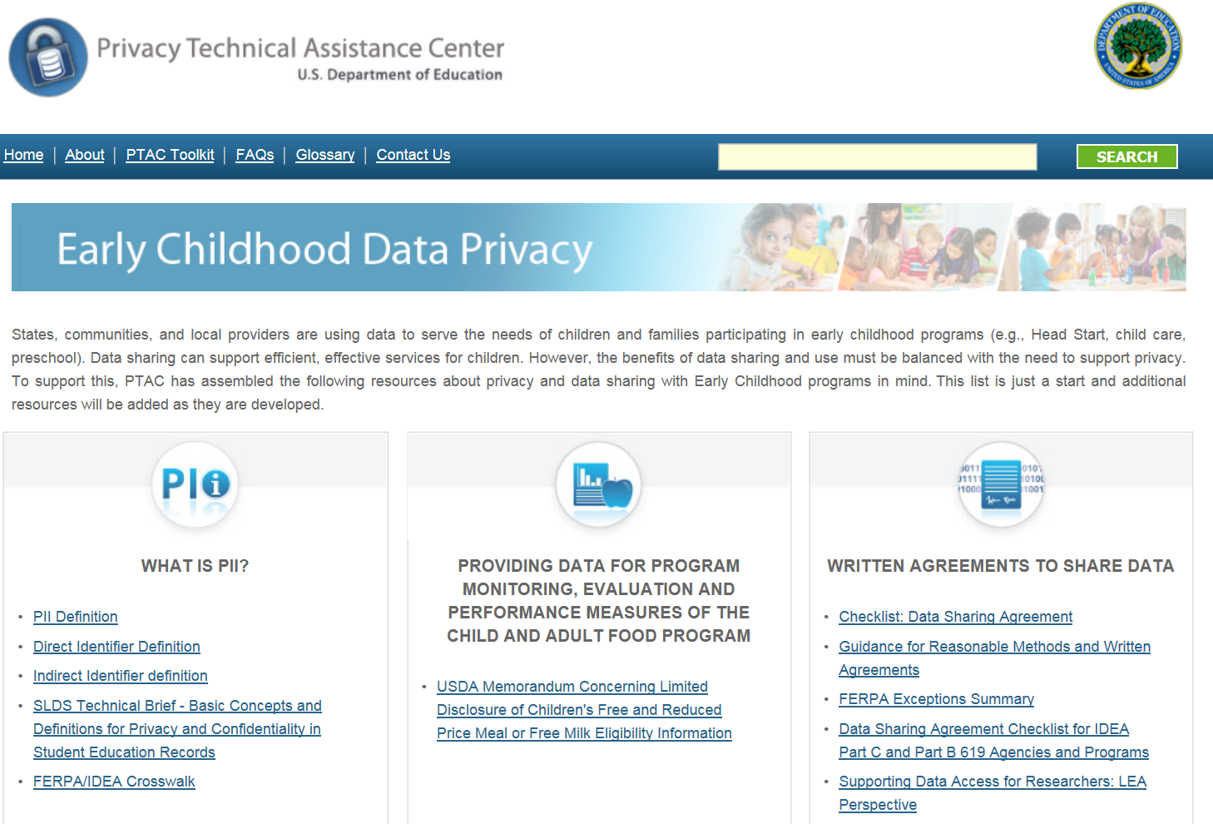
Privacy Resources

Slide 56
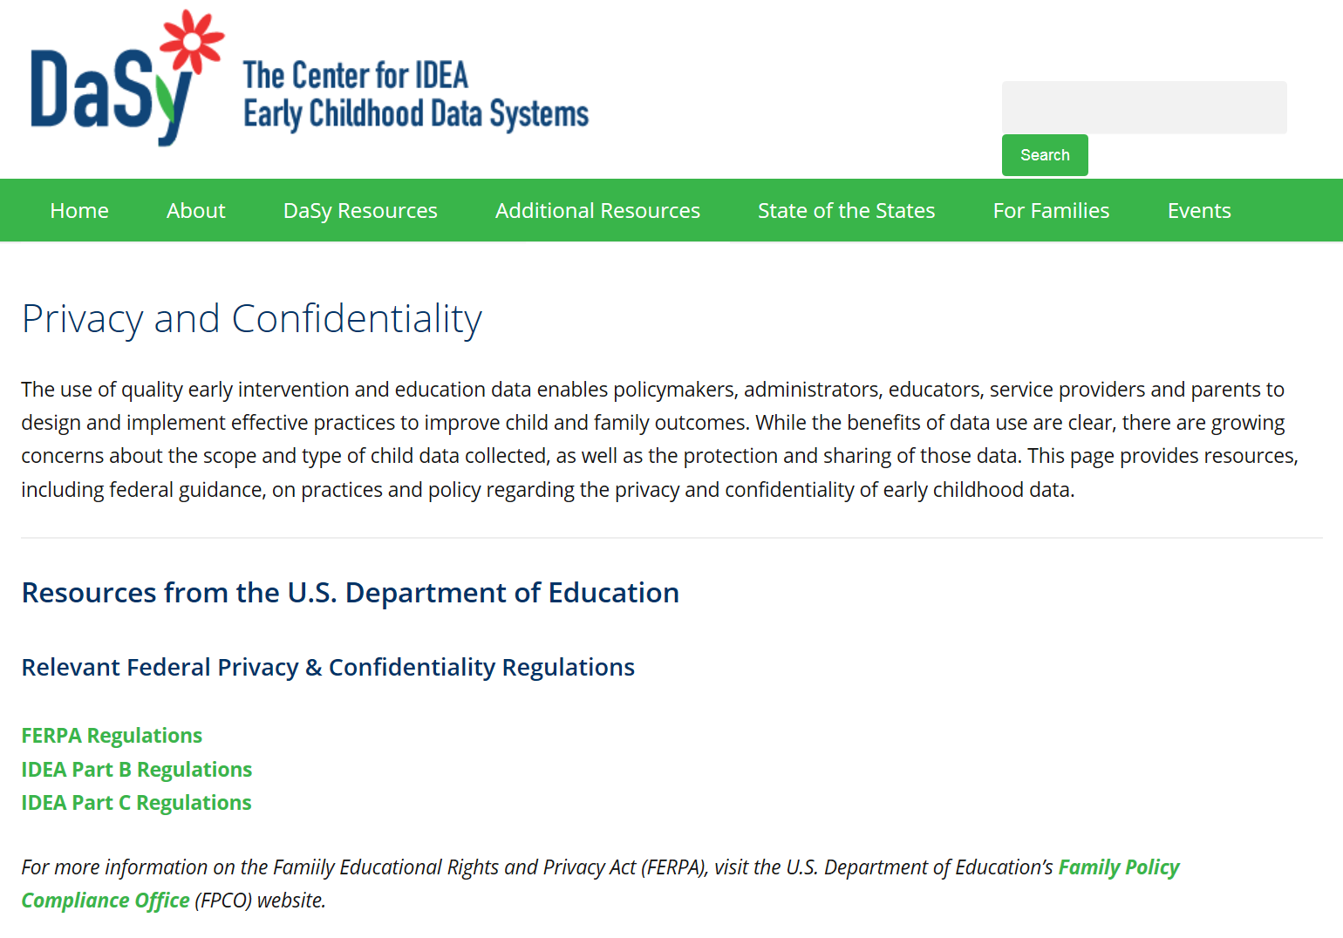
Privacy Resources

Slide 57
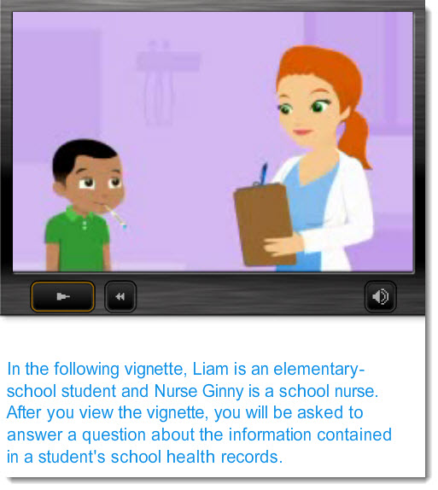


FERPA Training Videos
  Interactive quizzes, animated vignettes, and more

Slide 58
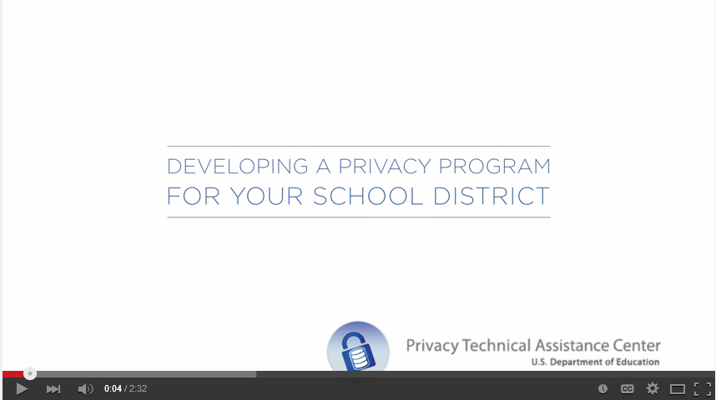


Training Videos

Slide 59
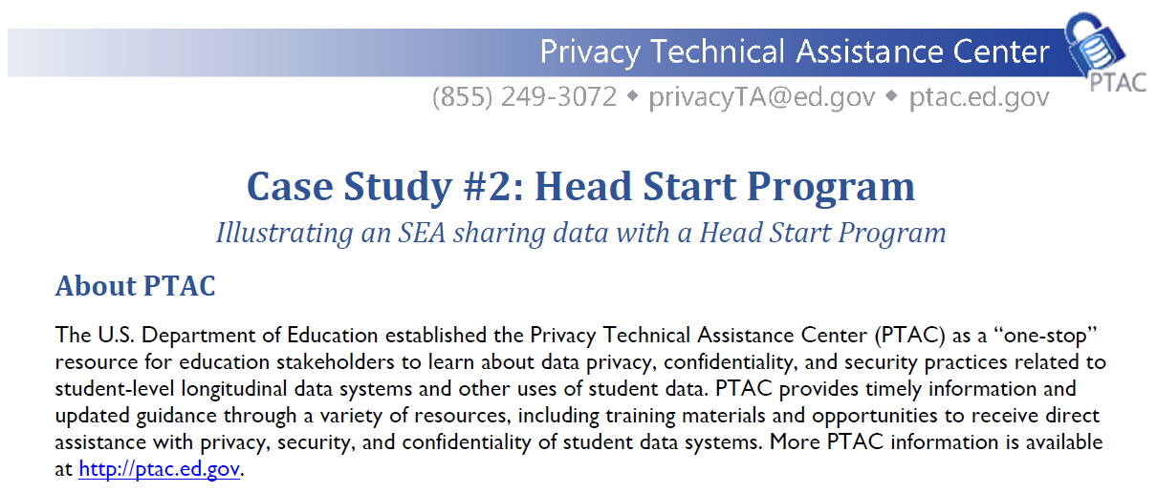
Head Start Data Sharing Case Study
http://ptac.ed.gov/sites/default/files/CaseStudy2_HeadStart.pdf

Slide 60

Questions?

Slide 61

For More Information - IDC
Visit the IDC website
http://ideadata.org/
Follow us on Twitter
https://twitter.com/ideadatacenter

Slide 62
For More Information - DaSy
Visit the DaSy website at:
http://dasycenter.org/
Like us on Facebook:
https://www.facebook.com/dasycenter
Follow us on Twitter:
@DaSyCenter

Slide 63




The contents of this presentation were developed under a grant
from the U.S. Department of Education, #H373Y130002. However,
the contents do not necessarily represent the policy of the Department
of Education, and you should not assume endorsement by the
Federal Government.
Project Officers: Richelle Davis and Meredith Miceli
Project Officers: Richelle Davis and Meredith Miceli

Slide 64
The contents of this presentation were developed under a grant from the U.S. Department of Education, # H373Z120002. However, those contents do not necessarily represent the policy of the U.S. Department of Education, and you should not assume endorsement by the Federal Government. Project Officers, Meredith Miceli and Richelle Davis.
Notes:
Instructions to presenters: This slide is to be included as the last slide in your deck but you are not expected to show it to the audience. Please be sure to delete these instructions from this slide’s notes page in your presentation.

