Slide 1
Introducing the DaSy Center
September 2013

Slide 2
What is DaSy?
A new 5-year Center funded by OSEP to assist states with improving IDEA Part C and Part B preschool data by:
Building better data systems
Coordinating data systems across early childhood programs
Connecting to longitudinal data systems
Building the capacity of states to use data

Slide 3
Center’s Goals
Provide national leadership and coordination around IDEA EC data systems
Generate new knowledge and useful products for IDEA Part C and Part B preschool state agencies regarding building integrated EC data systems with linkages to statewide longitudinal data systems
Design and implement a continuum of technical assistance strategies to improve state capacity to collect, analyze, report, and use high quality IDEA EC data

Slide 4
The time is right
Recognition of the
The importance of early childhood
Need for good data
Need for coordinated early childhood data systems
Need for longitudinal data systems
Resources for
Building coordinated EC systems (RTT-ELC)
Building state data systems (SLDS, CEDS, PTAC, RTT-ELC)
State and local programs are increasingly aware of the importance of having good data.

Slide 5
Where DaSy fits
More powerful and higher quality data about programs, personnel, services, and children and families
Policy makers, state agency staff, local program staff, and others use data to improve programs
Improve the quality of Part C and Part B Preschool services and supports
Improve outcomes for children and families
Improved capacity in states to meet IDEA reporting requirements and ask and answer policy and programmatic questions
Better data systems
as a tool
to improved programs

Slide 6
The Vision
Other EC Program
Data
Other EC Program
Data
K-12 Longitudinal Data
System
Quality
EI/ECSE
Data
Other EC Program
Data
Integrated EC Data System
Other EC Program
Data

Slide 7
Activities: Knowledge Development
Collect information from states about current and planned data systems for IDEA Part C and Part B Preschool including links to other data systems
Develop a framework for IDEA Early Childhood Data Systems
Develop documents and resources (e.g., best practices, lessons learned) to support the use of the framework to improve data systems

Slide 8
Activities: TA and Dissemination
Use framework to provide intensive TA to 10 states (phase in, years 2 and 3)
Promote critical data system requirements
Develop national TA network
Provide a continuum of general TA and dissemination activities
Maintain a website
Prepare and disseminate reports, documents, and other materials
Support states in developing data systems to address IDEA APR performance and compliance indicators

Slide 9
Activities: Leadership and Coordination
Establish and maintain stakeholder committee to guide and review the work of the center
Communicate and collaborate with relevant projects
Support communities of practice
Work with TACC on new products
Contribute products to TACC database
Coordinate with NICHY to develop a dissemination strategy

Slide 10
Some Key Collaborations
OSEP Early Childhood Technical Assistance (ECTA) Center
OSEP Early Childhood Personnel Center (ECPC)
Support team for the State Longitudinal Data System (SLDS) grants
Common Education Data Standards (CEDS)
Early Learning Challenge (ELC)TA Consortium
Privacy Technical Assistance Center (PTAC)
Center on Enhancing Early Learning Outcomes (CEELO)
Early Childhood Data Collaborative (ECDC)

Slide 11
Who are we?
SRI International
Frank Porter Graham (FPG) Child Development Institute
Applied Engineering Management (AEM)
Westat
Center for Technology in Education (CTE) at Johns Hopkins University (JHU)
Cadre of national experts

Slide 12
SRI International
Long history of work in special education and early intervention
Conducted the National Early Intervention Longitudinal Study (NEILS)
Oversee the Early Childhood Outcomes Center (ECO)
Headquarters in Menlo Park, CA with offices around the world including Arlington, VA

Slide 13
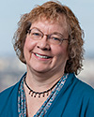
DaSy at SRI
Donna Spiker and Kathy Hebbeler
Lauren Barton
Frances Bergland
Taletha Derrington
Laura Hudson
Suzanne Raber
Cornelia Taylor
Sara Thayer
Jennifer Tschantz

Slide 14
DaSy at Frank Porter Graham (FPG)
A long history of providing technical assistance to programs serving young children with disabilities and Part C and Part B preschool state agencies
Operate the newly funded Early Childhood Technical Assistance (ECTA) Center
Located at the University of North Carolina in Chapel Hill, NC

Slide 15
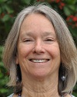
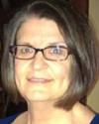
DaSy at FPG
Martha Diefendorf and Lynne Kahn
Siobhan Colgan
Kathi Gillaspy
Mary Peters

Slide 16
DaSy at Applied Engineering Management
Background in data systems development and technical assistance
Operates several important related efforts including:
Technical assistance for the State Longitudinal Data System (SLDS) grant program
Support to the development of the Common Education Data Standards (CEDS)
Privacy Technical Assistance Center (PTAC)
Technical assistance for the Race to the Top – Early Learning Challenge states
Headquarters in Chantilly, VA

Slide 17
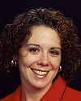
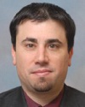
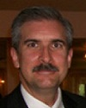
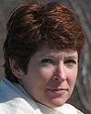
DaSy at AEM
Missy Cochenour and Denise Mauzy
Baron Rodriguez
Jeff Sellers
Beth Caron
Jim Campbell
Nancy Copa

Slide 18
DaSy at Westat
Long history of work in special education and data systems
Conducted the Preschool Elementary Longitudinal Study (PEELS)
Provided support for the collection of the IDEA 618 data for many years most recently as the Data Accountability Center (DAC)
Located in Rockville, MD

Slide 19
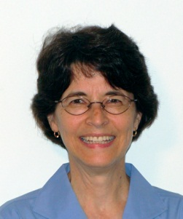
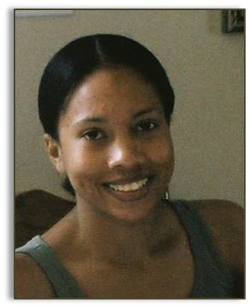
DaSy at Westat
Joy Markowitz
Haidee Bernstein
Danielle Crain

Slide 20
DaSy at the Center for Technology in Education at JHU
Expertise in data systems development and applications of technology to professional development
Developed IDEA birth to 21 longitudinal data system for Maryland
Program development including development of comprehensive assessment system for RTT-ELC grant for Maryland
Located in Columbia, MD

Slide 21
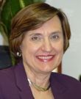
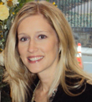
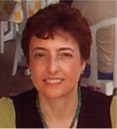
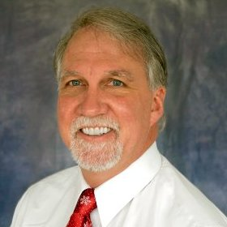
DaSy at CTE
Amy Nichols and Jackie Nunn
Chadia Abras
Rob Caples
Dave Peloff

Slide 22
Expert Consultants
Consultant | Expertise
Robin Nelson | Part C, data systems, APR, 618, use of data
Sharon Walsh | IDEA, policy, state systems, confidentiality, use of data
Mary Beth Bruder | IDEA, workforce data, personnel, service coordination
Tate Gould | State Longitudinal Data Systems, technical assistance
Maureen Greer | Part C, state systems, finance
Bruce Bull Karen Martens | IDEA, data systems, APR, 618
Jamie Kilpatrick | Part C, states systems, data systems
To be named | As other needs are identified

Slide 23
What we will do
Activity | When
On-line Needs Assessment : Compile information on state data systems and key areas where state would like help | Summary report available on website
Framework Development (7 partner states)
Solicited applications | May-June
Selected states | July
In person and conference call framework development meetings | Beginning at end of July
Framework completed (projected timeline) | March 2014

Slide 24
What we will do
Activity | When
Topical Meetings | Ongoing
National Meeting Paired with ECO, ECTA meeting for 2013 | September 15-17, 2013; in Washington DC
Resource Materials (print, online, video) | Ongoing
National webinars | Ongoing
Communities of practice | Ongoing
Intensive TA (10 states)
Select 5 states | Spring 2014
Select 5 more states | Spring 2015

Slide 25
Framework partner states
Alaska
Arkansas
Connecticut
Georgia
Idaho
Massachusetts
Pennsylvania

Slide 26
How states can request help from DaSy
Email any DaSy staffer
Email to dasycenter@sri.com
Call DaSy Center at 650-859-3881

Slide 27
Keeping up to date with DaSy
Visit DaSy web site: http://dasycenter.org/
Follow DaSy on Twitter : @DaSyCenter
Like DaSy on Facebook: DaSy Center

