Slide 1
Under the Hood with the DaSy System Design and Development Framework:
The mechanics of a high performance data system
Improving Data, Improving Outcomes Conference
New Orleans, LA ~ September 8, 2014

Slide 2

Presenters & Presentation Overview
Taletha Derrington
  The DaSy Center at SRI International
David Mills, Catherine Hancock, & Kyla Patterson
  Virginia Part C
Christy Cronheim & Rick Harris
  Idaho Part C
Emily Hackleman
  Pennsylvania Part C/Part B 619
Notes:
We have four presenter groups today. I am Taletha Derrington from the DaSy Center at SRI International, and I will introduce the DaSy System Design and Development Framework Subcomponent, and then we will hear from David Mills, supported by Catherine Hancock and Kyla Patterson of Virginia Part C, Christy Cronheim and Rick Harris of Idaho Part C, and Emily Hackleman of Pennsylvania Part C and Part B 619.
Each of our presenters has recently designed and developed a new system or a system enhancement. We have asked them to demonstrate the application of the DaSy System Design and Development Framework Subcomponent to self-evaluate their processes and resulting systems or enhancements. Although system design and development will almost always entail a great deal of work, it is our hope this DaSy framework subcomponent will be a useful tool to guide and support states so that state system design and development teams look less like the team pictured here.

Slide 3
DaSy System Design and Development Framework Subcomponent
System Design and Development (SDD) refers to both a set of functional and technical requirements for a data system, and the development and implementation of a data system based on those requirements. It is the process of defining the architecture, database, system standards and components, and the data elements. This subcomponent supports the development of new data systems and enhancements to existing data systems.
Notes:
In the DaSy Framework, the System Design/Development (SDD) Subcomponent refers to both a set of functional and technical requirements for a data system, and the development and implementation of a data system based on those requirements. It is the process of defining the architecture, database, system standards and components, and the data elements. This subcomponent supports the development of new data systems and enhancements to existing data systems.

Slide 4
DaSy System Design and Development Framework Subcomponent
The purpose of system design and development is to create and support a data system based on the Part C/619 program requirements as articulated in the purpose and vision. System design and development is the means by which the operational needs of the program staff and other users are translated into a technical infrastructure that will meet those needs.
Notes:
The purpose of system design and development is to create and support a data system based on the Part C/619 program requirements as articulated in the purpose and vision of the data system, which is covered by another subcomponent within the DaSy Framework. System design and development is the means by which the operational needs of the program staff and other users are translated into a technical infrastructure that will meet those needs.
Some examples of functional requirements are processes and tasks that the system must be able to accomplish, including processes that require action on the part of users, like data entry, and those that are not directly related to user interaction with the system, like off-hours processing or the automated exchange of information between system components.
Examples of technical requirements are:
1. accessibility needs of users,
2. whether or not the storage and handling of data must follow specific encryption regulations, and
3. whether the system will operate on internal agency hardware or will be hosted at either an internal or external data center.
Source: New York State Project Management Guidebook, Release 2., 2003: NY State Office for Technology. http://www.its.ny.gov/pmmp/guidebook2/index.htm. Section III.

Slide 5
DaSy System Design and Development Framework Subcomponent
The DaSy SDD Framework subcomponent was developed around the phases and processes of a standard System Development Life Cycle:
System initiation and requirements analysis
System design and development
System acceptance and deployment
Notes:
There are different approaches or methodologies for system development projects. There are, however, standard phases and processes that should be followed.
The DaSy SDD Framework subcomponent was developed around the phases and processes of a standard System Development Life Cycle.
We have grouped these into 3 subcomponents:
System initiation and requirements analysis
System design and development
System acceptance and deployment

Slide 6

The Mechanics of a High Performance Data System
The fundamental intent of the DaSy Framework is to help states develop more powerful and comprehensive data systems
  The 3 SDD sections lay out the mechanics of a high performance data system
Notes:
The fundamental intent of the DaSy Framework is to help states develop more powerful and comprehensive data systems.
The 3 SDD subcomponents lay out the mechanics of a high performance data system using 9 quality indicators, each with 3 or more elements of quality.

Slide 7
Test-driving the DaSy SDD Framework Subcomponent
System initiation and requirements analysis
  Virginia Part C
System design and development
  Idaho Part C
System acceptance and deployment
  Pennsylvania Part C and Part B 619
Notes:
Today’s presenters will test-drive parts of the SDD subcomponent.
The Virginia Part C team will discuss the first section, System initiation and requirements analysis.
The Idaho Part C team will present on the System design and development section.
And Emily Hacklmen from Pennsylvania Part C and Part B 619 will present on the 3rd section, system acceptance and deployment.
We will pause for a few questions in between each presentation, and we plan to leave room for more general discussion and questions for all the presenters at the end.

Slide 8

Virginia Part C
First interaction with SDD Subcomponent
Test driver for Section 1: Initiation of New System/ Enhancement and Requirements Analysis
  Applied to system enhancement currently underway
Notes:
(Taletha will introduce)

Slide 9
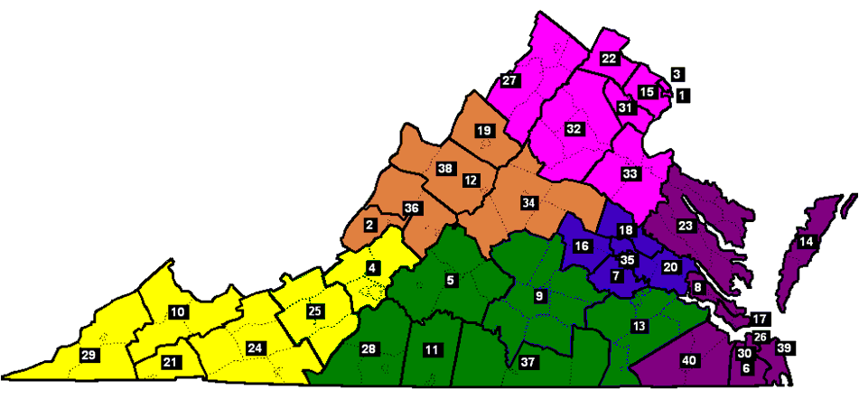
The Department of Behavioral Health and Developmental Services is the Lead agency for the Infant & Toddler Connection of Virginia. Virginia is divided into 40 local systems and six different regions.
Infant & Toddler Connection of
1 Alexandria 11 Danville-Pittsylvania 21 the Highlands 31 Prince William, Manassas and Manassas Park
2 the Alleghany Highlands 12 Staunton-Waynesboro 22 Loudoun 32 Rappahannock-Rapidan
3 Arlington 13 Crater District 23 Middle Peninsula-N Neck 33 Rappahannock Area
4 the Roanoke Valley 14 the Eastern Shore 24 Mount Rogers 34 the Blue Ridge
5 Central Virginia 15 Fairfax-Falls Church 25 the New River Valley 35 Richmond
6 Chesapeake 16 Goochland-Powhatan 26 Norfolk 36 the Rockbridge Area
7 Chesterfield 17 Hampton-Newport News 27 Shenandoah Valley 37 Southside
8 Williamsburg * James City * York * Poquouson 18 Hanover 28 the Piedmont 38 Augusta-Highland
9 the Heartland 19 Harrisonburg-Rockingham 29 DILENOWISCO 39 Virginia Beach
10 Cumberland Mountain 20 Henrico-Charles City-New Kent 30 Portsmouth 40 Western Tidewater
Notes:
The Department of Behavioral Health and Developmental Services is the Lead agency for the Infant & Toddler Connection of Virginia. Virginia is divided into 40 local systems and six different regions. Which are color coded for your reference. Though it was before my time, Virginia was providing services to Infants & Toddlers with disabilities before there was a Part H of the federal law. I understand these were issued to each of the systems to count their babies.

Slide 10

Chinese Abacus
Notes:
At the time we had the most advanced data system invented.
Virginia red clay is an efficient if cumbersome method of reporting to the state the numbers of children served.

Slide 11
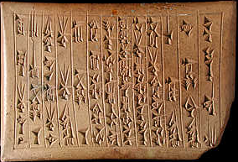
Clay tablet with Cuneiform writing
Notes:
As you can see, this region was serving 300 children at the time.

Slide 12

Stacked Papers
Notes:
When I first started working with Part H this is what we were collecting.
In 2001 we contracted, primarily to meet annual federal reporting requirements for Part C (child data), our statewide online data base called ITOTS (Infant-Toddler Online Tracking System)

Slide 13

Infant Toddler Online Tracking System (ITOTS) screen shot
Notes:
Child data is collected in ITOTS entry into the early intervention system (referral, intake, eligibility, and initial planned services) with updates to Primary Service Setting, outcome data and transition.
Not collected are changes in services or any delivered service data.
Another HUGE deficit of the system is the lack of financial data.
Originally contracted out, ITOTS was then moved in-house in 2005 to make it easier to make changes, improvements.
Between 2006 and 2010, a number of initiatives were implemented to analyze and improve ITOTS. Although data system improvements have been implemented to address data integrity and better reporting, fiscal constraints and competing data priorities within the Department led to delays in developing or purchasing a data system with the complete functionality necessary to enter and report on delivered services.

Slide 14

Report cover page
Notes:
In 2006, we completed an analysis of the need.

Slide 15

Project Overview Executive Summary
Notes:
And the documentation began.
During this documentation process, I am happy to say that for the most part, we followed the guidelines set out System Design/Development. We first eliminated all other options before developing the system in house.

Slide 16

Single Waterfall
Notes:
I didn’t know it at the time but the departments standard for a System Development Life Cycle (SDLC) was the waterfall method. Therefore we planned out the entire system. The problem with the waterfall method is that it does not take into account changes that you will invariably be needed as any unexpected consequences make them selves known. That way you will end up with a data system which is as worthwhile as the detritus at the base of this waterfall.
Time has passed and the law has been rewritten so some of this work is no longer valid but we had the bones of an excellent plan which we are implementing in components.

Slide 17

Waterfall Steps
Notes:
With the agile method releases are developed in single steps with constant testing to assure reliability

Slide 18
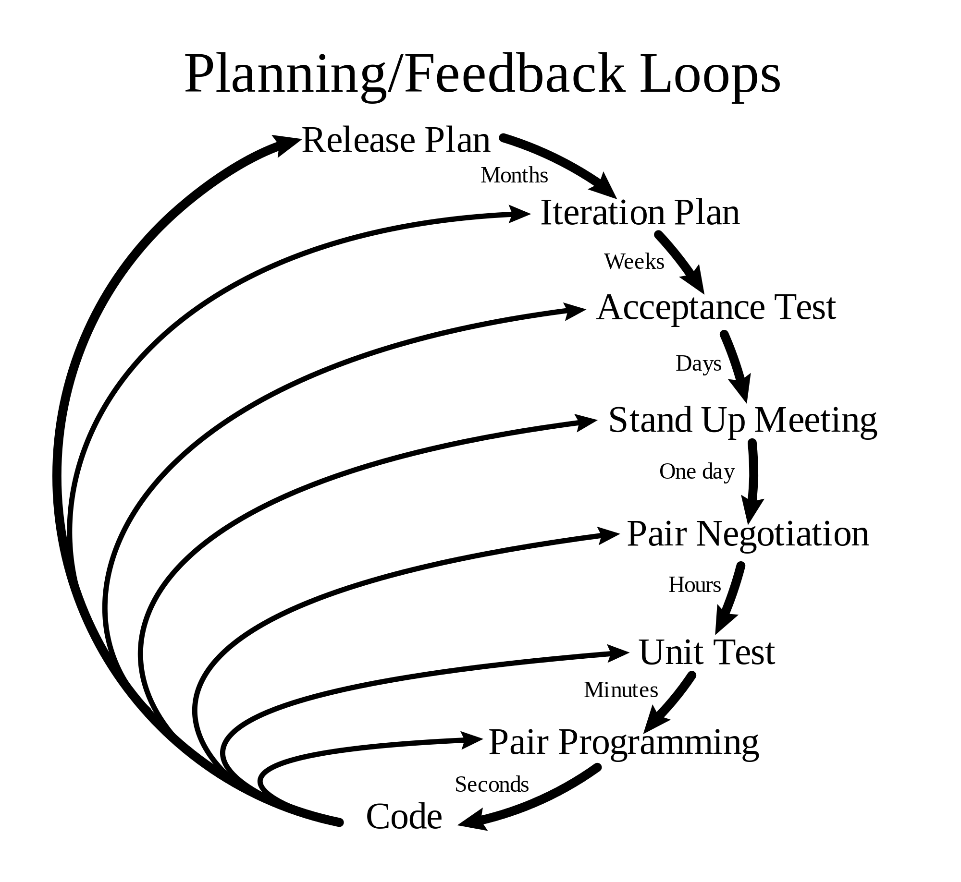
Planning/Feedback Loop Diagram
Notes:
Planning/Feedback Loop Diagram
Tries to portray that in the agile method is a repeated cycle. Different stages spanning different time frames but any number of the activities could be happening simultaneously.

Slide 19
Section 1: Initiation of New System (or Enhancement) and Requirements Analysis
Quality Indicator 1: State Part C/619 staff are actively involved in initiating the development of the new system or enhancement.
  Quality element a: State Part C/619 management provide input to determine project team roles and responsibilities and commit Part C/619 staff to the project.
Notes:
This indicator speaks to committing staff on project team roles and the project staff.
EI staff includes a full-time Data Manager (background is EI)
EI Administrator and Data Manager are primary liaisons with IT Team
Established EI staff data team (with reps from monitoring, TA and SPP/APR) that works with Data Manager to identify data/reporting needs, prioritize needs, identify timelines, develop/review business requirements, test, etc)
An ITOTS end user group reviews the business requirements then tests those requirements prior to a new release.
What has facilitated the collaborative relationship between EI and IT? (EI funding to pay for positions? Good working relationship between EI Administrator and IT Director? Etc.)
Part of the Agile method is daily stand-up meetings. These meetings are used to assess progress or update shifting priorities. Lasting about 15 minutes these meetings keep the momentum going.

Slide 20
Section 1: Initiation of New System (or Enhancement) and Requirements Analysis
Quality Indicator 1: State Part C/619 staff are actively involved in initiating the development of the new system or enhancement.
  Quality element b: State Part C/619 staff review the approved proposal for the new system or enhancement(s) to ensure that it meets existing and anticipated Part C/Part B 619 organizational goals and needs.
Notes:
Generally, State EI staff identify the needed enhancements
Example – SSIP, need for more detailed reports on child indicators (identified by staff and stakeholders).
If IT identifies need based on their work in the system, they bring it to Data Manager who keeps rest of EI staff informed and convenes EI staff data team if needed.
Example – Multiple new individual detailed reports for SSIP were going to take too long to develop, so discussed with IT, they proposed ad hoc reporting module, staff discussed and agreed this would meet need and meet desired timeline.

Slide 21
Section 1: Initiation of New System (or Enhancement) and Requirements Analysis
Quality Indicator 1: State Part C/619 staff are actively involved in initiating the development of the new system or enhancement.
  Quality element c: State Part C/619 staff provide input on who will develop the new system/enhancement (i.e., vendor/contractor, in-house staff, commercially available product) and related staffing needs.
Notes:
In-house.
Meetings between IT and EI staff (Administrator and Data Manager) to discuss program needs in terms of staffing- one issue was “revolving” IT staff. Some left or others moved to positions not tied to federal grants. Beginning to achieve stability
EI staff involved in interview process for IT staff
EI staff identify needed enhancement, IT staff identify who will work on it based on individual expertise and time
Give example of how IT assigned who would do what on a recent enhancement. Or example of what kinds of roles they play (i.e., we have one IT person whose really good at this kind of task, one who does this kind of work, etc.)
Facilitated by the fact that we fund the positions

Slide 22
Section 1: Initiation of New System (or Enhancement) and Requirements Analysis
Quality Indicator 1: State Part C/619 staff are actively involved in initiating the development of the new system or enhancement.
  Quality element d: State Part C /619 staff provide input into the plan and schedule for the detailed system requirements analysis and the overall high-level plan for the remaining system design/development phases.
Notes:
Share EI priority list with IT managers, refine list, identify time frames- discuss how much time each item will take and EI makes decisions based on program priorities and time for implementing
Plan and schedule next 2-3 sprints at a time
Challenges – IT not meeting sprint timelines.. Sometimes the releases are delayed because our office realizes a change in format or inclusion of new elements in reports will give us a better more useful product.

Slide 23
Section 1: Initiation of New System (or Enhancement) and Requirements Analysis
Quality Indicator 2: State Part C/619 staff are actively involved in the analysis of business requirements for the data system/enhancement.
  Quality element a: State Part C/619 staff are actively involved in defining, reviewing, and revising business requirements, which identify their programmatic needs expressed in the language of the Part C/619 program.
Notes:
Data Manager, in consultation with EI staff data team or individual members, helps to define, review and revise business requirements to ensure they accurately meet the need and will result in the needed data being collected and/or reported.
Stand-Up Meetings daily with IT staff to assess progress and answer questions that may arise
Example – Ad hoc reporting (if we’ve gotten far enough; otherwise, something from a recent sprint)

Slide 24
Section 1: Initiation of New System (or Enhancement) and Requirements Analysis
Quality Indicator 2: State Part C/619 staff are actively involved in the analysis of business requirements for the data system/enhancement.
  Quality element b: State Part C/619 staff are actively involved with the IT team to create work process models that reflect an understanding of the Part C/619 program, processes and language.
Notes:
We developed models for the entire process.

Slide 25
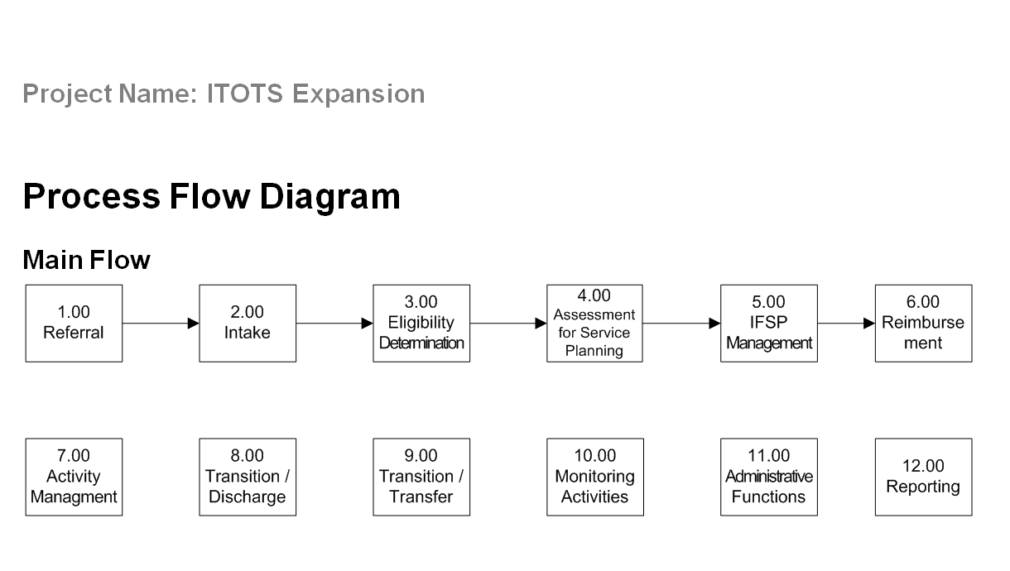
Main flow process flow diagram
Notes:
I think the language is familiar on this slide, referral, intake, eligibility determination. Each of these Main Flow activities were detailed to possible choices families can make.

Slide 26
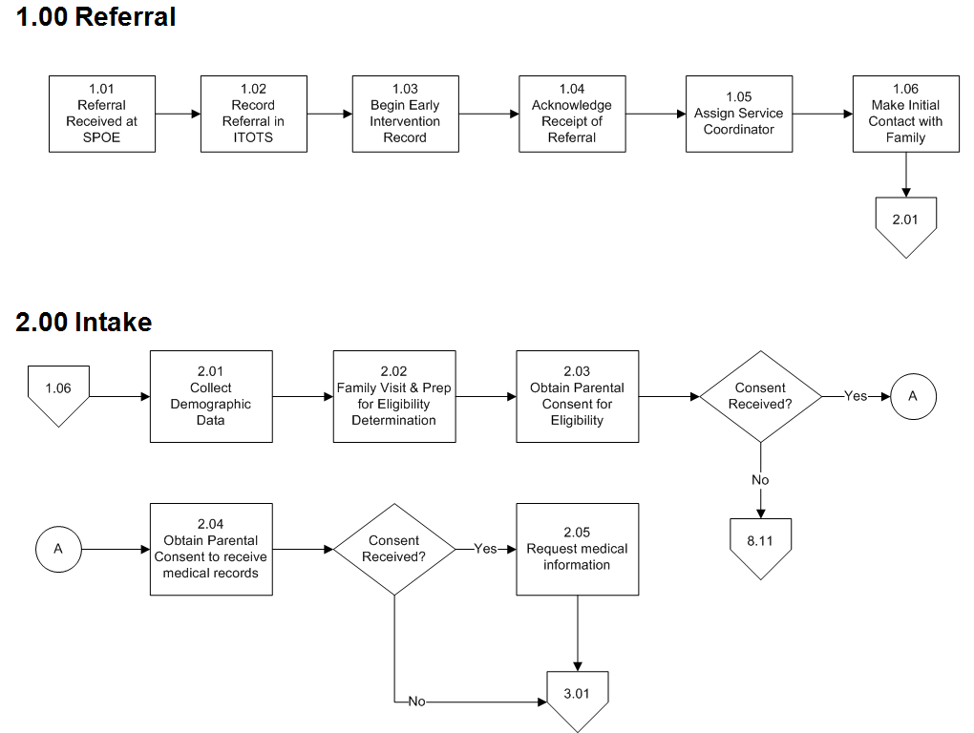
Referral and Intake Process flow diagrams
Notes:
We broke the flow at decision points in the process.
Since we directed the plan, it reflects appropriate language
Part C Staff worked directly with IT staff to develop the process flow.
Numbers in the workflow process refer users to what section to go to next.
There are more diagrams but these are some of my favorite

Slide 27
Section1: Initiation of New System (or Enhancement) and Requirements Analysis
Quality Indicator 2: State Part C/619 staff are actively involved in the analysis of business requirements for the data system/enhancement.
  Quality element c: State Part C/619 staff are actively involved with the IT team to create data models that reflect program language.
Notes:
This data model is a little hard to see but you get the idea

Slide 28
ITTOTS Data Module
Notes:
These are the tables and the data elements included. The table names and data elements reflect Part C language.

Slide 29
Section 1: Initiation of New System (or Enhancement) and Requirements Analysis
Quality Indicator 2: State Part C/619 staff are actively involved in the analysis of business requirements for the data system/enhancement.
  Quality element d: State Part C/619 staff solicit end user input on business requirements, process models and data models.
Notes:
Advisory team for implementation of new interface
Requests from LSMs
LSMs users involved in testing
Business requirements, etc. reviewed by EI Data Manager and EI Administrator.
EI staff data team and ITOTS stakeholder group – both are end-users
Evidence – meeting minutes

Slide 30
Section 1: Initiation of New System (or Enhancement) and Requirements Analysis
Quality Indicator 2: State Part C/619 staff are actively involved in the analysis of business requirements for the data system/enhancement.
  Quality element e: State Part C/619 staff are actively involved in reconciling process models and data models with business requirements, with specific consideration of budget and scope.
Notes:
Each sprint (enhancement) is very limited in scope, which helps to prevent scope creep and budget concerns. IT staff budgeted annually.
EI Data Manager actively involved – stand-up meetings, develop and review of documents.
EI staff data team or individual members involved as needed.
Agile process allows for flexibility and changing priorities.
Advisory team for implementation of new interface

Slide 31
Section 1: Initiation of New System (or Enhancement) and Requirements Analysis
Quality Indicator 2: State Part C/619 staff are actively involved in the analysis of business requirements for the data system/enhancement.
  Quality element f: The final approval of the requirements includes sign-off by a designated State Part C/619 representative.
Notes:
Sign off by Administrator and Data Manager

Slide 32
Contact Virginia Part C
Catherine Hancock - (804) 371-6592
Catherine.Hancock@dbhds.virginia.gov
Kyla Patterson - (860) 430-1160
K.Patterson@dbhds.virginia.gov
David K. Mills - (804) 371-6593
David.Mills@dbhds.virginia.gov

Slide 33

Questions?

Slide 34

Idaho Part C
SDD Subcomponent Mechanic
Test driver for Section 2: System Design and Development
  Applied to recent new system development
Notes:
(Taletha will introduce)

Slide 35
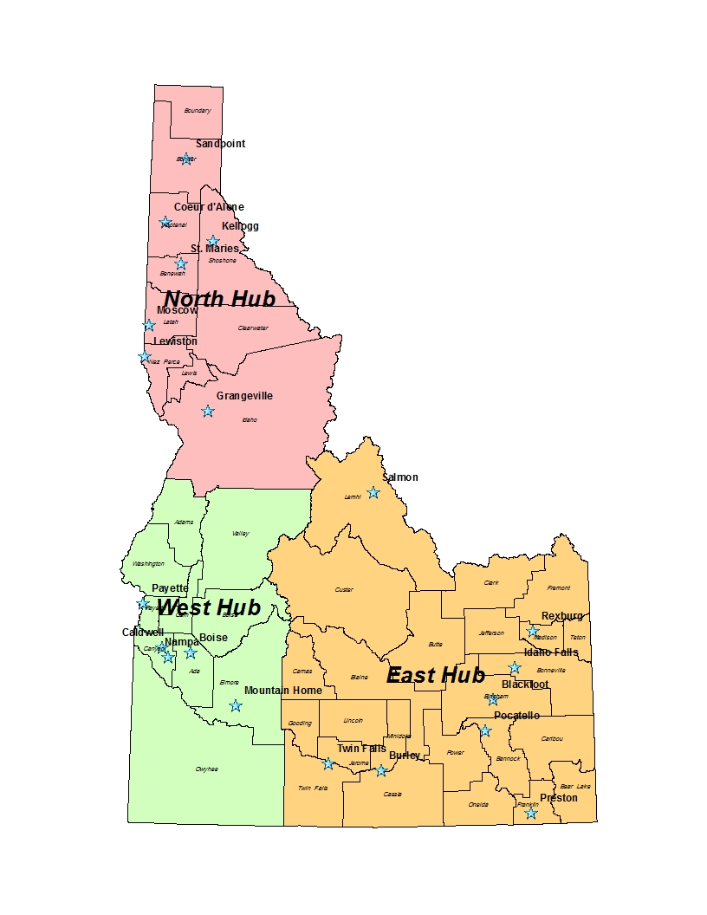

3 Hubs
7 Regions
North Hub
Regions 1 & 2
West Hub
Regions 3 & 4
East Hub
Regions 5, 6, &7
Notes:
The Department of Health and Welfare is the lead agency for the Infant Toddler Program in Idaho.
Idaho is divided into 3 hubs and 7 regions.

Slide 36

Notes:
Long, tiring, overwhelming – 5 straight years of building and testing.
2nd iteration of our Web-based system.
1990’s – Access Data Base – Data Tot
Fall of 2010 – Implemented first iteration of Web-based data system – ITP Web
Spring of 2013 – Implemented second iteration of Web-based data system with enhancements and incorporation of billing system – ITP KIDS

Slide 37
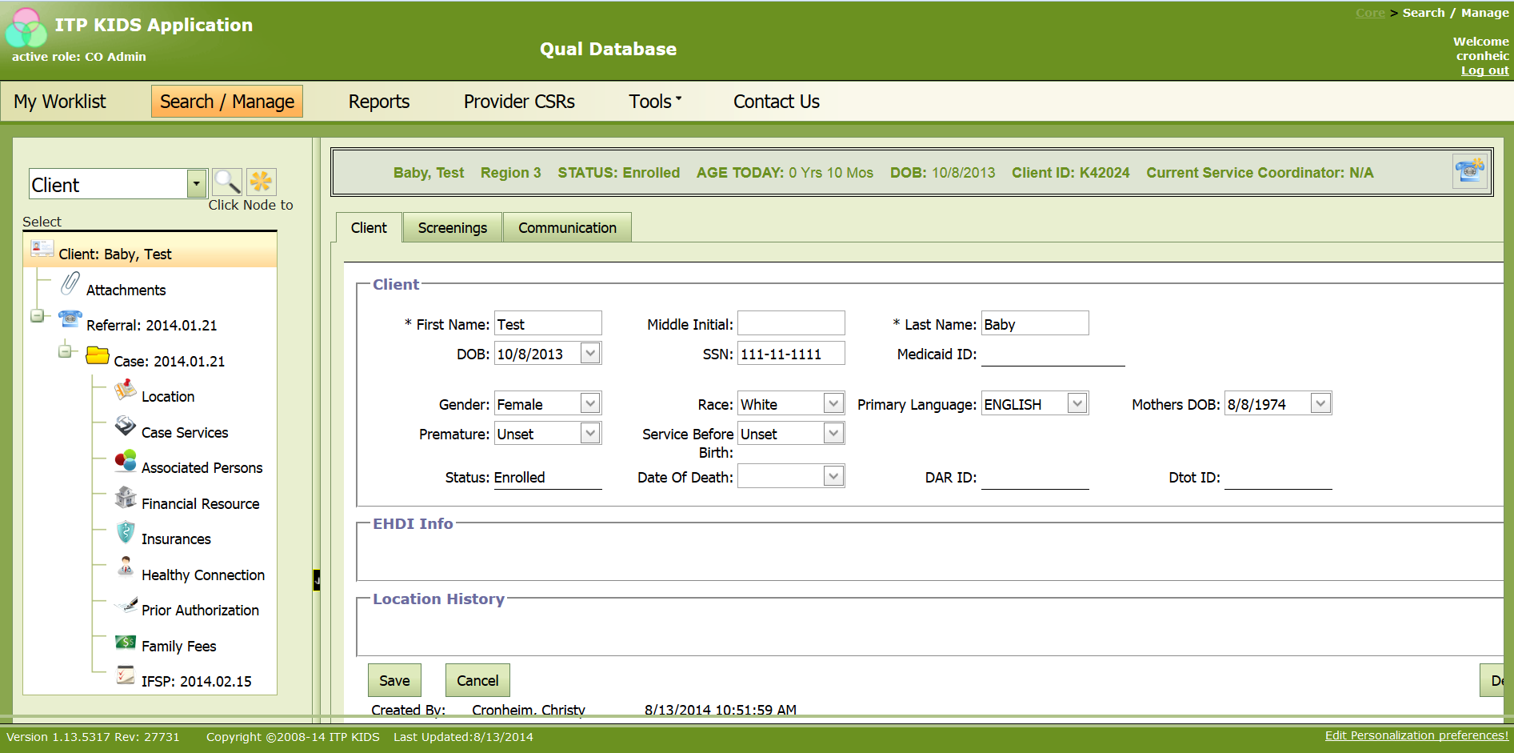
Notes:
Idaho uses a Web-based data system – ITP KIDS (Infant Toddler Program Key Information Data System)

Slide 38
Section 2: System Design and Development
Quality Indicator 6: State Part C/619 staff work with the IT team as they build and test the new system or enhancement.
  Quality element a: State Part C/619 staff are actively involved with the IT team in refining the system requirements during system construction with consideration of scope.
Notes:
Sign off by Administrator and Data Manager

Slide 39

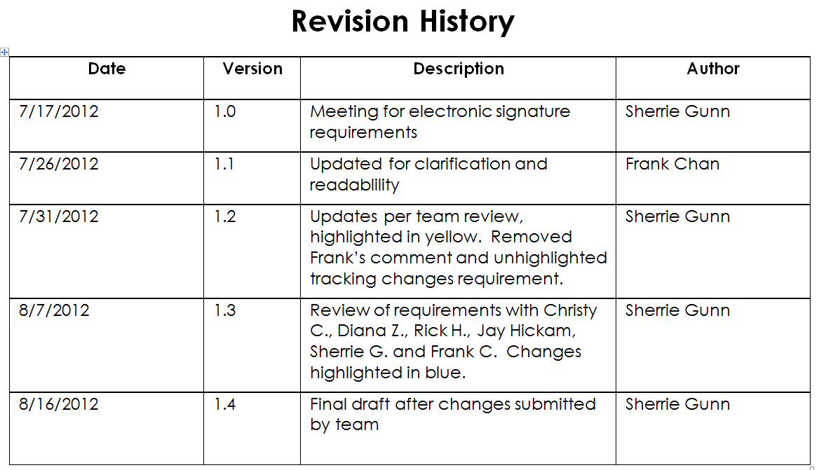
Notes:
During the refinement of the data system, we added the capacity for an electronic signature on the Continuing Service Reports. This is an example of how the IT team and State Part C team worked together to refine the system with the end result of defined business requirements.

Slide 40
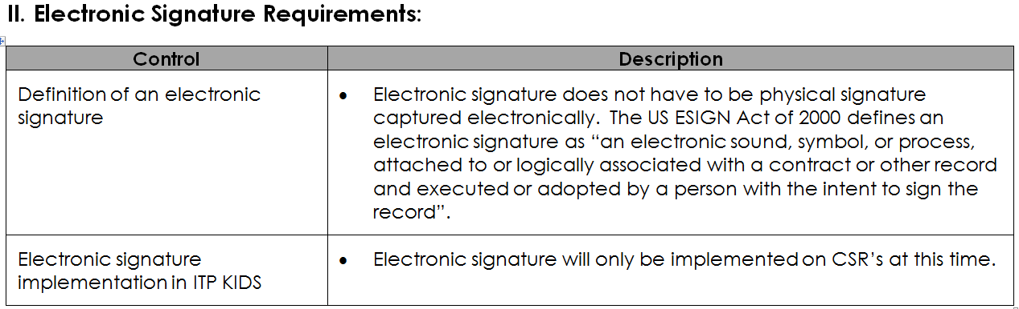
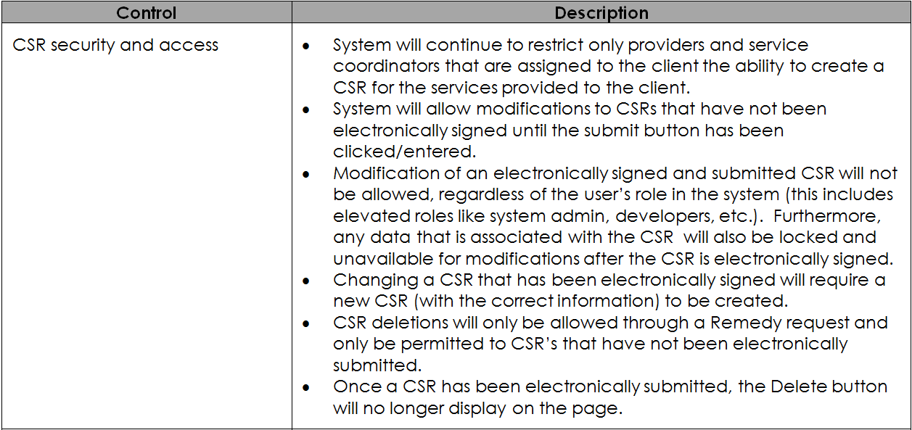
Notes:
During the refinement of the data system, we added the capacity for an electronic signature on the Continuing Service Reports. This is an example of how the IT team and State Part C team worked together to refine the system with the end result of defined business requirements.

Slide 41

Section 2: System Design and Development
Quality Indicator 6: State Part C/619 staff work with the IT team as they build and test the new system or enhancement.
  Quality element b: State Part C/619 staff test modules as they are developed until they function as intended.
Notes:
Sign off by Administrator and Data Manager

Slide 42
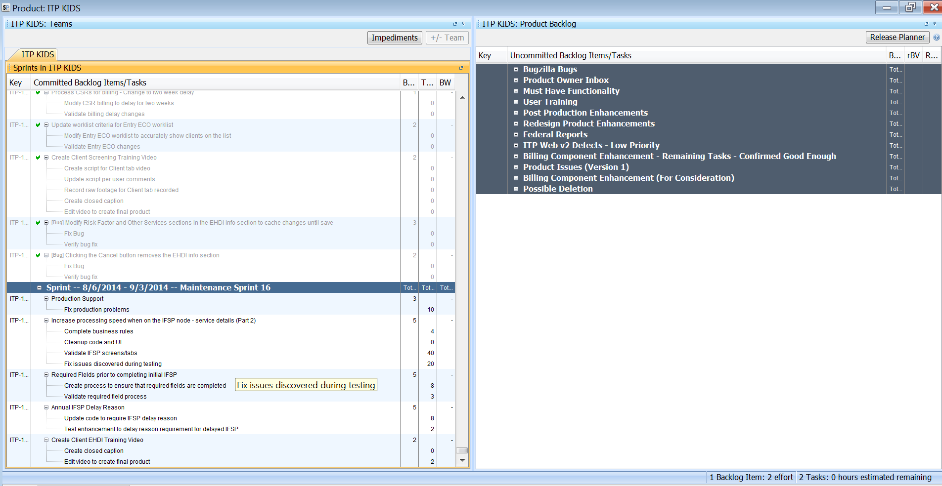
Notes:
IT team and State Part C staff use Scrumworks to track:
Documented business requirement
Completion of system design by developers
Systems testing by developers
Testing by State Part C staff
Document test results
Repeat steps 2-6 if needed
Scrum meetings provide opportunity for State Part C staff to give final approval
Deployment into production

Slide 43
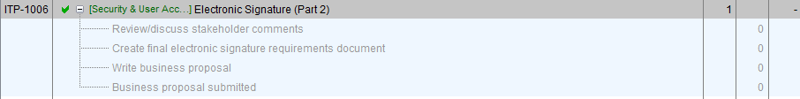
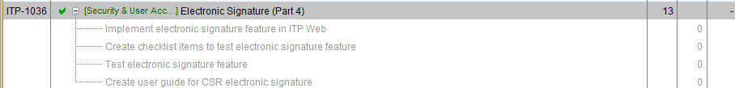

Slide 44

Section 2: System Design and Development
Quality Indicator 6: State Part C/619 staff work with the IT team as they build and test the new system or enhancement.
  Quality element c: State Part C/619 staff communicate with IT team to ensure adequate system load performance based upon anticipated system peak usage.
Notes:
Sign off by Administrator and Data Manager

Slide 45
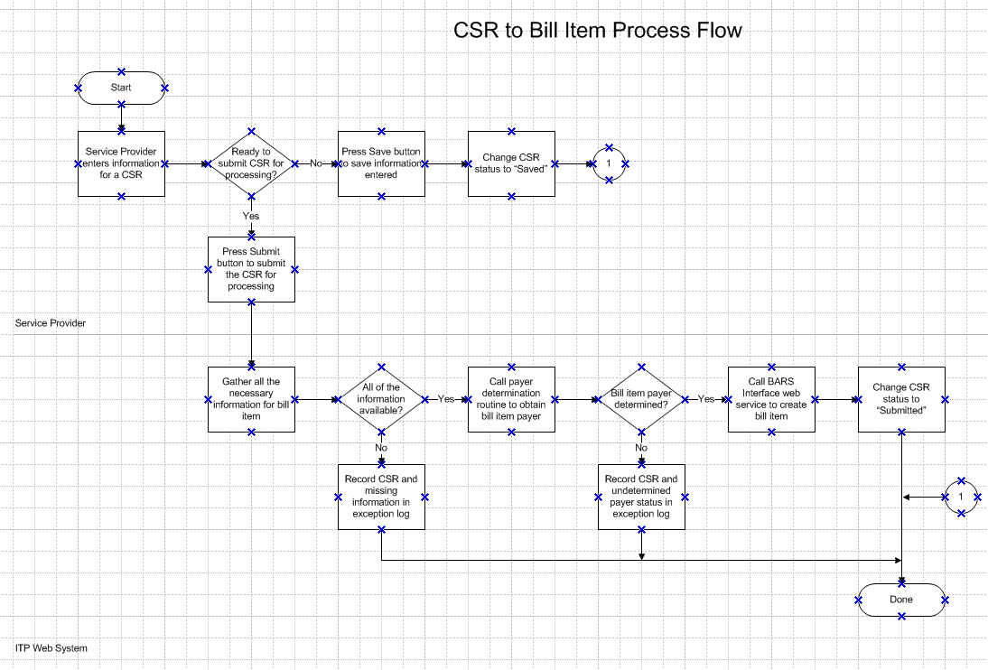
Notes:
Example of adequate system load performance based testing – Processing CSR’s
The more CSR’s that are processed, the greater the load is on the system. As a result, we modified the flow for CSR’s to be processed every hour during the day instead of nightly so there were fewer to process at one time.

Slide 46

Section 2: System Design and Development
Quality Indicator 6: State Part C/619 staff work with the IT team as they build and test the new system or enhancement.
  Quality element d: State Part C/619 staff or representatives require technical documentation, which include instructions necessary for system deployment and maintenance.
Notes:
Sign off by Administrator and Data Manager

Slide 47
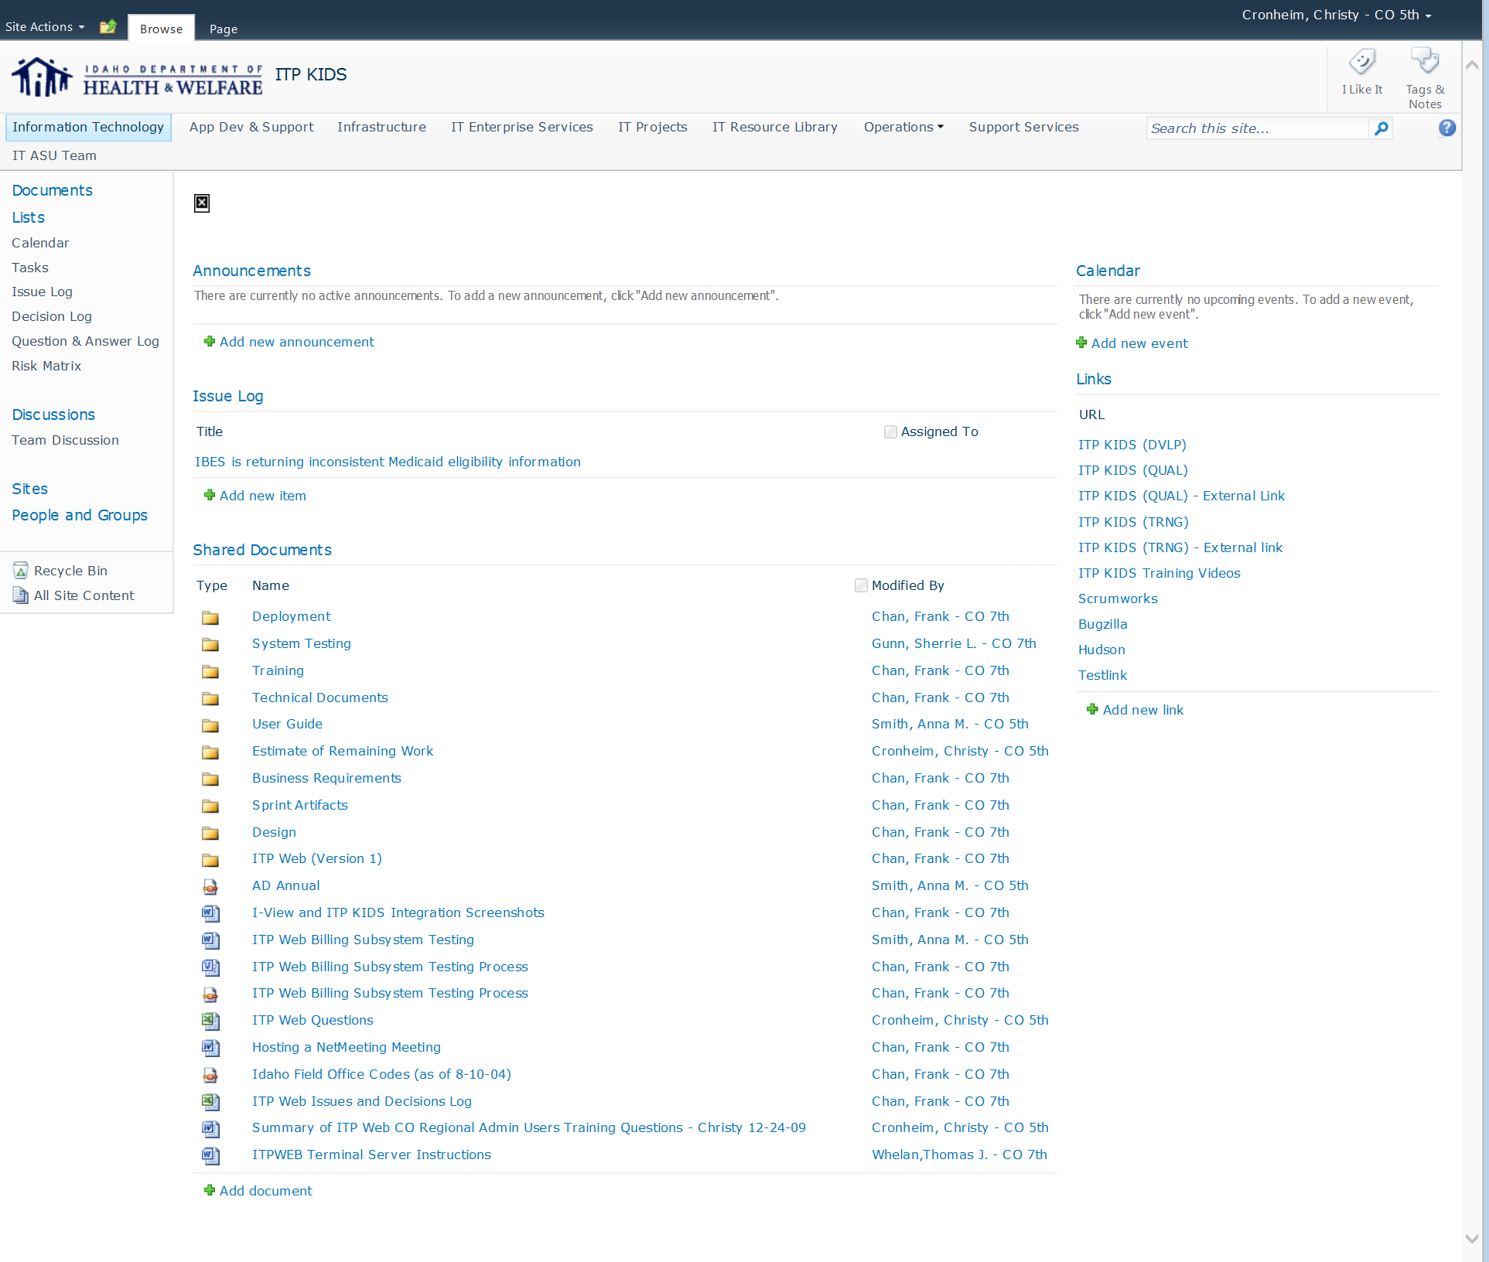
Notes:
The IT team and State Part C team require technical documentation as they build and test the system or any enhancements.
An ITP KIDS Sharepoint site was created specifically for the ITP KIDS data system. All team members have access to this repository.

Slide 48
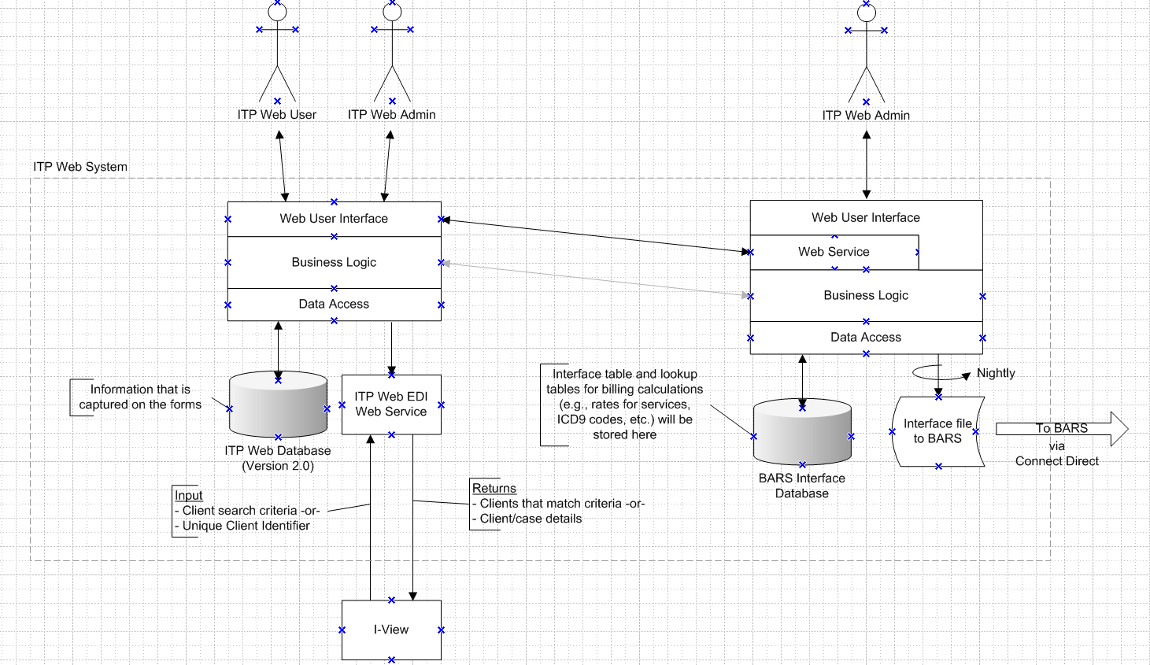
Notes:
Example of technical documentation.

Slide 49
Contact Idaho Part C
Christy Cronheim – (208) 334-5590
  cronheic@dhw.idaho.gov
Rick Harris – (208) 334-5517
  harrisr@dhw.idaho.gov

Slide 50

Questions?

Slide 51

Pennsylvania Part C & Part B 619
SDD Subcomponent Mechanic
Test driver for Section 3: System Acceptance and Deployment
  Applied to deployment of recent system enhancement
Notes:
(Taletha will introduce)
(Read slide)
Although the DaSy SDD subcomponent is laid out in an ordered fashion, it does not need to be used in that specific order, and sometimes one effort can cover more than one quality element. Emily’s presentation will provide an example of that.

Slide 52

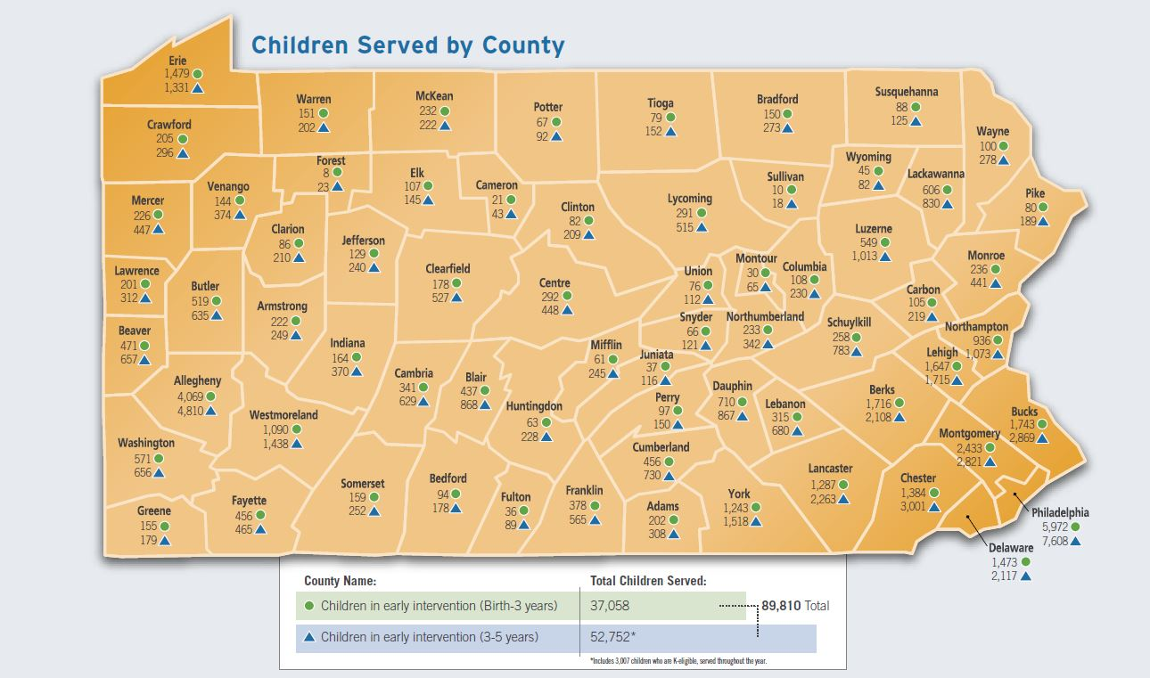
Notes:
This slide is to give context to our geographical size, the children served and linkage to the volume of professionals we reach for deployment of data systems.

Slide 53

Pennsylvania’s Enterprise to Link Information for Children Across Networks Early Intervention system is an information management system used to manage the records of children receiving Early Intervention (EI) services in Pennsylvania.
2008/09 – Part C Training Roll Out: Case Management
2009/10 – Part C Training Roll Out: Financial Management
2011/12 – 619 Training Roll Out: Case Management
Notes:
This is our data system and some of the major roll-outs we have managed. We do incremental changes on a quarterly basis and some other smaller projects, but this flow charts helps to identify some major statewide initiatives.

Slide 54
PELICAN-EI User Structure
State Staff
Early Intervention Training & Technical Asisstance
County/Joinder Leadership (Part C)
Preschool Leadership (619)
Local Program Leads
Local Service Coordination
Service Provider Community
Service Provider Community

Slide 55
Section 3: System Acceptance & Deployment
Quality Indicator 8: State Part C/619 staff create, review, and/or revise supporting materials.
  Quality element a: State Part C/619 staff ensure data dictionary is updated, as needed.
  Quality element b: State Part C/619 staff participate in creating/updating system materials (e.g., user manuals, online tutorials, webinars, etc.) as needed.
  Quality element c: State Part C/619 staff ensure applicable changes are communicated to help desk support.
  Quality element d: State Part C/619 staff revise updated materials based on testers’ review and feedback.
Notes:
I’ll be talking about our PA Implementation Team structure, the roles and responsibilities of this team (which include Help Desk support) and how they support the development of materials. This will be looped back into how our user structure impacts the way in which we plan for deployment (talking back to slide 54 (PELICAN-EI User Structure)).

Slide 56
Section 3: System Acceptance & Deployment
Quality Indicator 9: State Part C/619 staff communicate and work with the IT team to deploy the new system/enhancement.
  Quality element a: State Part C/619 staff collaborate with the IT team to create a deployment plan, including guidelines for transition, schedule, and roles and responsibilities.
  Quality element b: State Part C/619 staff communicate the deployment plan to all necessary parties, including state and local staff.
Notes:
Section 3/Quality Indicator 9/Quality Element C & D and Section 3/Quality Indicator 8/Quality Element A & B

Slide 57

Section 3: System Acceptance & Deployment
In-person Program Trainings
Learning Management System
(on-line)
Ad Hoc Training Teams
Live Webinar Sessions

Slide 58
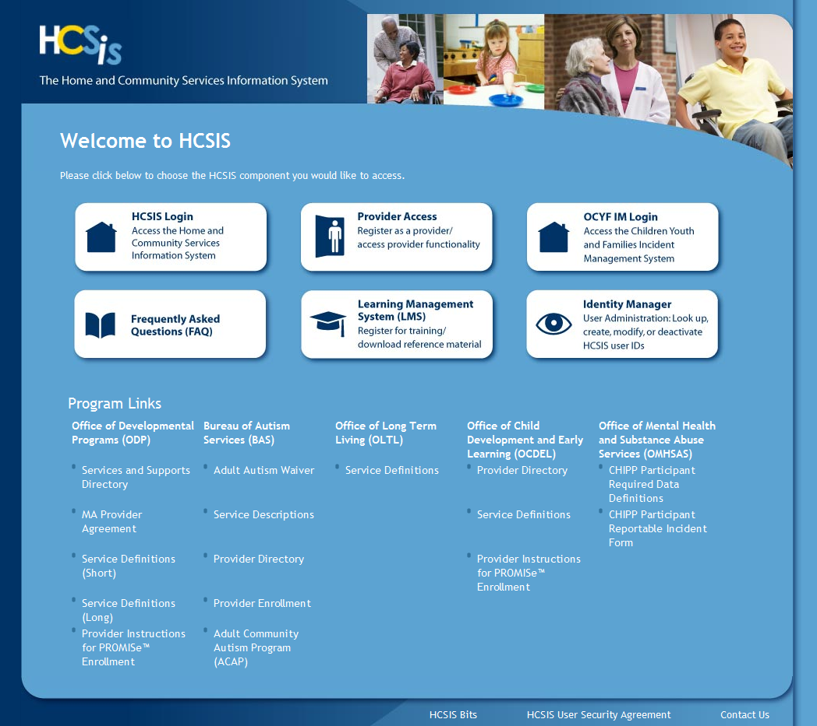
Learning Management System (LMS)

Slide 59
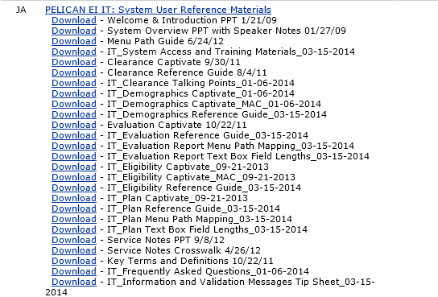
LMS Course Options
Captivate
Reference Guides
Menu Path Mapping
Field Definitions
Unique Process Tip Sheets
Policy Crosswalks

Slide 60
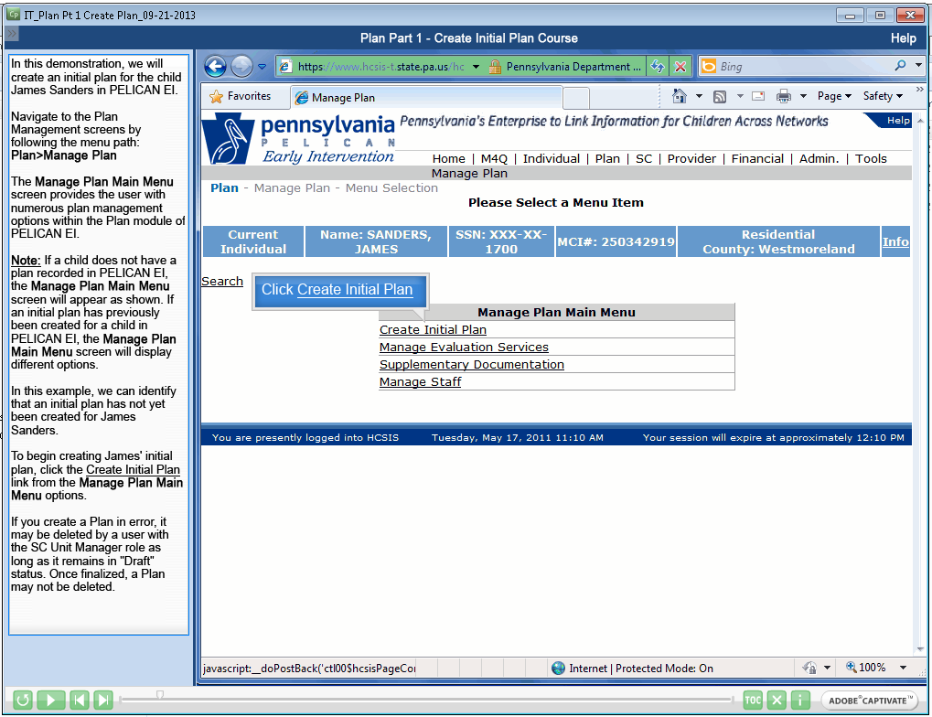

Slide 61
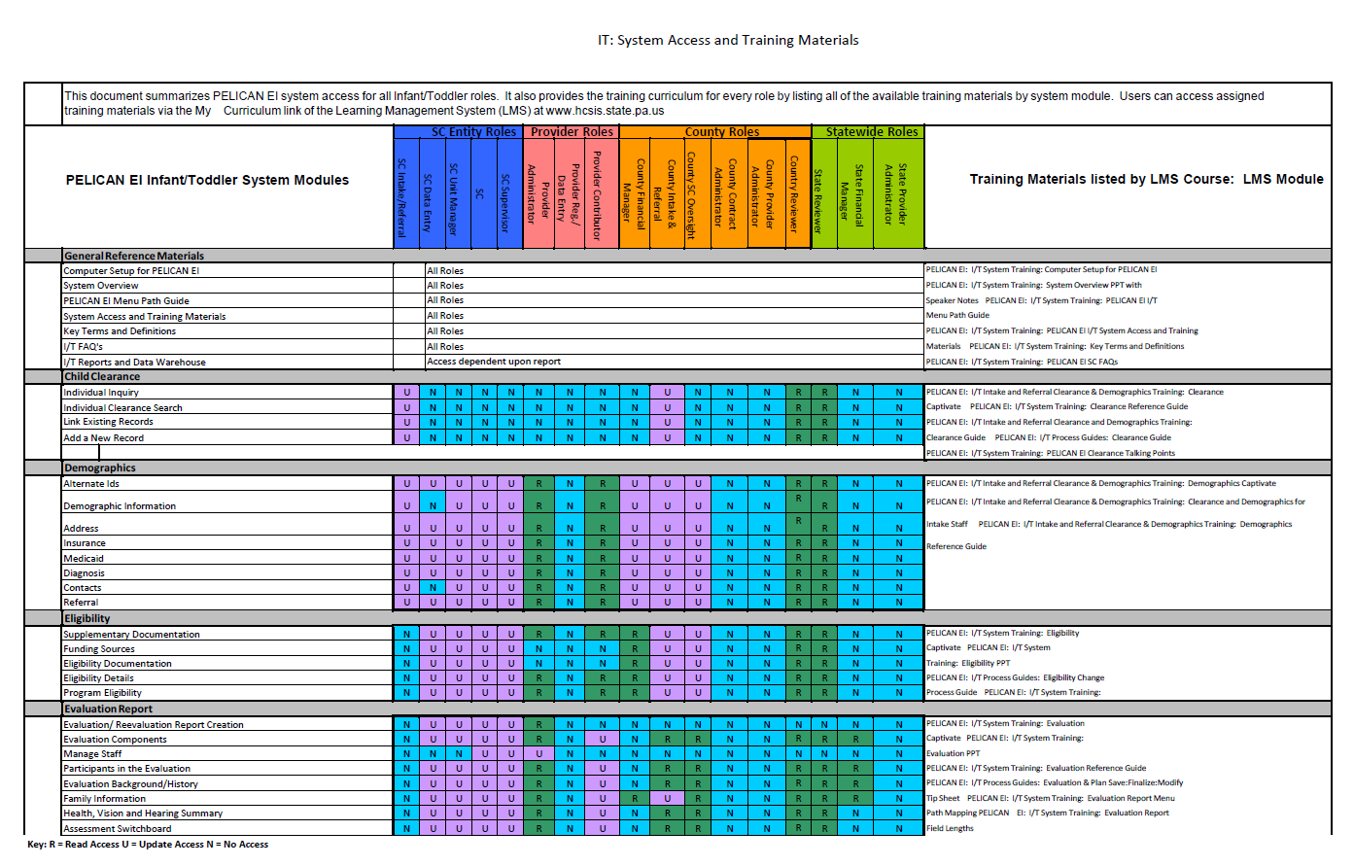

Slide 62
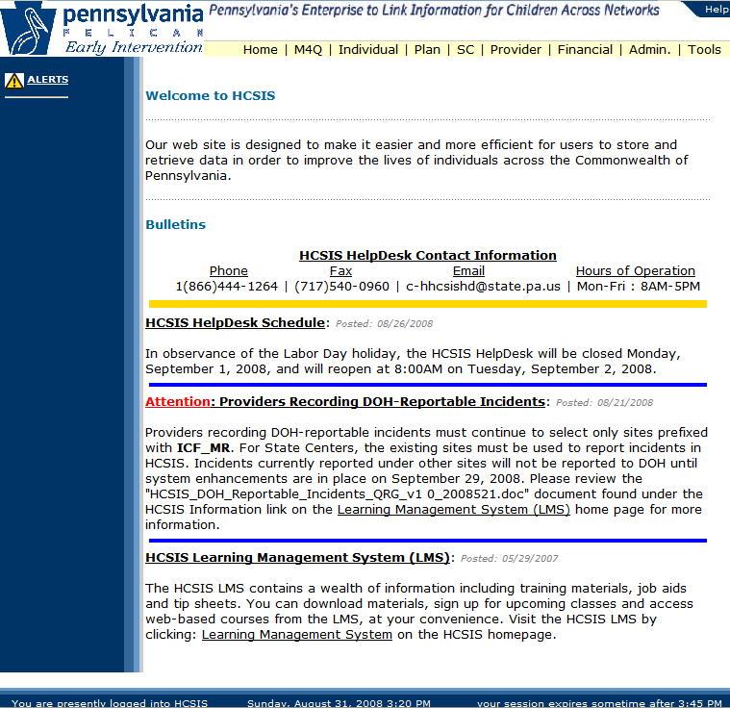

Online Help
Important Links
Online Help
  Screen description and field definitions
Important Announcements
Link to the LMS

Slide 63
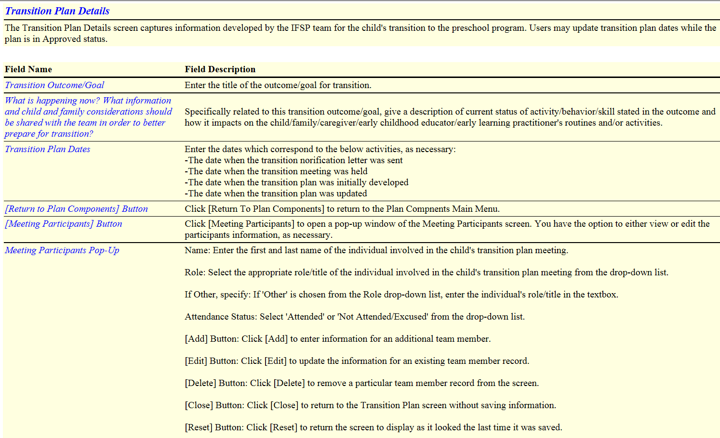

Slide 64
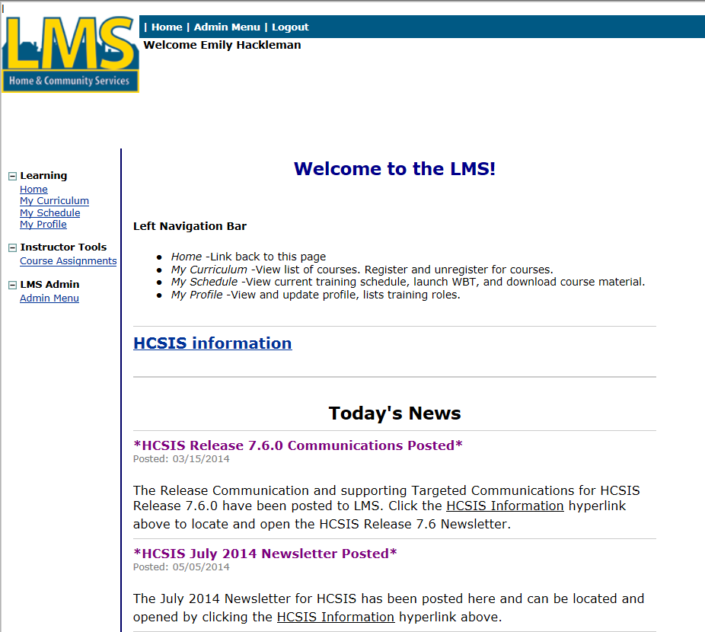
Communications

Slide 65
Contact Pennsylvania Part C/619
Emily Hackleman | Division Chief & Data Manager
Office of Child Development and Early Learning
Bureau of Early Intervention Services
Departments of Education and Public Welfare
333 Market Street, 6th Fl | Harrisburg, PA 17126
Office: 717.783.3636 | Mobile: 717.370.1206 | Fax: 717.265.8220
www.dpw.state.pa.us | www.pde.state.pa.us

Slide 66

Questions?

Slide 67
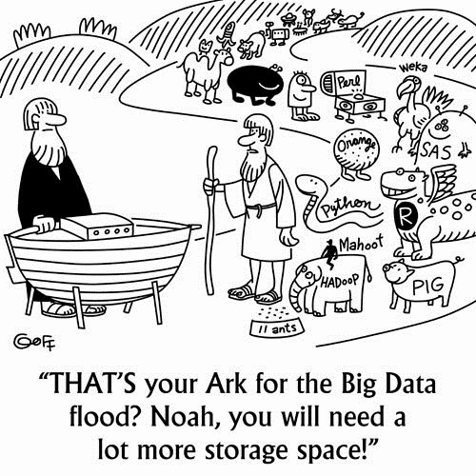
Discussion

Slide 68



The contents of portions of this presentation were developed under a grant from the U.S. Department of Education, #H373Z120002. However, those contents do not necessarily represent the policy of the U.S. Department of Education, and you should not assume endorsement by the Federal Government. Project Officers, Meredith Miceli and Richelle Davis.

