Slide 1
Alaska Part C
Linking Outcomes and CAPTA
Ken Smith, Analyst Programmer
Notes:
More programmer than analyst. Also, other contacts at end of this session who can answer questions about the meaning of data.

Slide 2
Presentation:
Alaska Part C Overview
Part C / CAPTA Collaboration
Linking CAPTA & Outcomes
Issues & Next Steps
Notes:
During this presentation, we’ll give a brief overview of the Alaska EI program (ILP) …

Slide 3
Alaska Department of Health and Social Services
Office of Children’s Services
Part C
(ILP)
Adoptions
Child Protective Svcs
Foster Care
Indian Child Welfare Act
Children’s Trust
Early Childhood Comprehensive Systems
Children’s Justice Act
Notes:
Unique co-location within OCS with Child Protective Services (CW program)
Disadvantages – Community Stigma – state agency that takes children away
CPS referrals to ILP are mandated / EI services are voluntary
Advantages – Funding for Mental Health workforce development, scholarships for mental health training,
AK Gov: priority for family violence reduction – so some state funding with related CAPTA

Slide 4
Alaska ILP Eligibility Criteria Part C 50% Delay in 1 or more domains Diagnosed condition resulting in 50% Delay Clinical Opinion (expected delay) Non-Part C (per State funding availability) <49% Delay in 1 or more domains, or at-risk for developing delays
Notes:
As for eligibility requirements: AK’s are stricter than many states: 50% delay … DX or Clinical Opinion
EI agencies are encouraged to enroll CAPTA children based on clinical opinion, and to screen with ASQ-SE, Greenspan Social Emotional Growth Scale tools

Slide 5
5-Year Enrollment Trend Part C & Total
Notes:
Small increases in enrollment
5% increase in total enrollment (1,832 – 1,923)
15% increase in Part C enrollment (1,481 – 1,706)

Slide 6
Part C / CAPTA Collaboration
Notes:
EI collaboration with our child welfare agency, CPS

Slide 7
Alaska Part C and Child Protection Collaboration
2006 – 2008
ILP CAPTA Impact Pilot
2012
Automated CPS Referrals
2013 Workforce Training
Part C • Dept Health and Social Services • Office of Children’s Services • University of Alaska • Child Welfare Academy • Alaska Association for Education of Young Children • Alaska Family Violence Prevention
Notes:
CAPTA Impact Pilot – 3 largest EI grantees participated in evaluating and enrolling as many CAPTA as possible to Assess the impact on the system. Tried to refer and enroll as many CAPTA children as possibl
CAPTA Automated Referrals – Developed automated CAPTA referral system from CPS. It took a lot of tweaking: siblings, automatically Part C, substantiations taking longer than 45 days from report of harm.
Workforce Training – Scholarships offered to build a “Train the Trainer” on Early Childhood Mental Health issues; Early Childhood Mental Health focus of annual Alaska Association for Education of Young Children; UAA Welfare Academy facilitated statewide collaborative meetings between local EIS; and CPS staff also offered specific Part C training to all new Social Workers and students.

Slide 8
CAPTA Outcomes Pilot: FY06-FY08
Goals:
Increase collaboration between CPS and ILP
Increase CAPTA referrals
Increase developmental screenings for children referred through CAPTA
Evaluate impact of CAPTA referrals on ILP System
Notes:
A number of tweaks to address issues encountered along the way.
Auto Part C, Siblings, Unable to contact, late substantiation

Slide 9
Disposition of CAPTA Referrals
548 CPS Referrals
3 (largest) Agencies
Notes:
It was determined that many CAPTA children don’t immediately qualify, but show up later with MH issues before age 3

Slide 10
Notes:
136% increase in CAPTA enrollments over 5 year period, since implementing CAPTA strategies statewide

Slide 11
Linking CAPTA & Outcomes
Notes:
Alaska EI/ILP among first state agencies to do a pilot study of CAPTA referrals on Child Outcomes.

Slide 12
How CPS Referred Children Qualified (n=599)
Notes:
Of children referred, 11% Part C with delays > 50% …
Orange bars represent Part C eligible
599 children CPS referred

Slide 13
COS Distribution at Exit
Notes:
For the CAPTA pilot project: High level of confidence - children in COS category D made functional gains as result of receiving EI services.
Number of Children with Pilot Entry and Exit Rating

Slide 14
FY13 CAPTA COS Distribution at Exit
Notes:
e Maintained functioning as same age peers
d Improved functioning to same age peers (38-41%)
c improved functioning to near same age peers
b Improved functioning but not sufficiently to same age peers
a Did not improve functioning (0%)

Slide 15
FY 13 CAPTA Summary Statements
Notes:
HERE ARE MOST RECENT RESULTS FOR 3 OUTCOME AREAS OF Child Outcome Summaries:
Of children who entered below age expectations: 71% with functional gains to same-age peers at exit
Of those entering at age expectations, maintained at level of same-age peers

Slide 16
Issues & Next Steps

Slide 17
Financial
Alaska State budget increment for domestic violence prevention - Outcomes data supports funding continuation
Medicaid, EPSDT, ASQ On-line, Family Co-Pay
Updating Prevalence Study to Include CAPTA Report Data - which may increase evidence of need
CAPTA
- Unfunded mandate
Seeking additional resources
Notes:
Financial: AK did receive a budget increment for domestic violence prevention – our outcomes support continuinuation
Alaska EI working on Medicaid project FY14 to incorporate new billing sources for Dev. Therapists.
Increased outreach to providers on billing strategies, concentrated efforts on ASQ screenings
Discussing a new Family Co-pay system FY14

Slide 18
Cross-system buy-in – paradigm shift for both systems (ILP/CPS)
Active dialog to improve timely CAPTA family contact data
Automated CAPTA referrals
Quarterly Data Reports to OCS Administration tracking referral trends and quality (valid/invalid referrals)
CPS training on timely substantiation/data entry
Part C increased MH workforce development
University Part C training incorporated into Social Work program
Notes:
Working on cross-system buy-in (EI / CPS)
One of the issues is the difference in cultures and perspectives between the programs.
Same state division, different cultures/perspectives

Slide 19
EI System Capacity Building
Early childhood mental health conference trainings (including CEUs), Scholarships to Infant-Parent Mental Health Post-Graduate Certificate Program, Reflective Supervision Teleconferences
New Part C Credential includes Early Childhood Mental Health Module
Newly created Alaska Association for Infant Mental Health which has established competency standards
Trainings
Notes:
EI program has been working to build capacity with training and other vehicles, including …

Slide 20
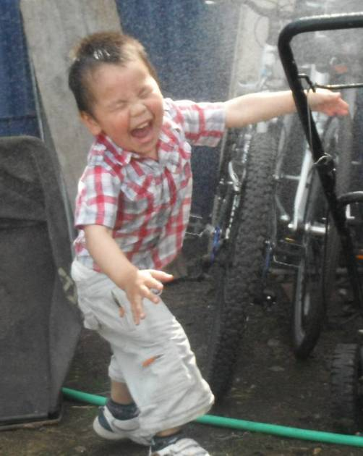
Contacts Alaska Part C
Alaska Dept. of Health and Social Services
Ken Smith, Analyst Programmer kenneth.smith@alaska.gov Shirley Pittz, ECCS/ILP Manager shirley.pittz@alaska .gov Lisa Balivet, Public Health Specialist II lisa.balivet@alaska.gov
Notes:
Alaska EI contacts. Lisa and Shirley would be better to help know what data means.

