Slide 1
CEDS: Common Data Elements and Definitions for Part C and 619 Programs
Meredith Miceli, OSEP
Missy Cochenour, Applied Engineering Management
Suzanne Raber, SRI International
Lisa Backer, Minnesota Dept. of Education
IDEA Leadership Conference
July 29-31, 2013
Washington, DC

Slide 2
Session Description
Discuss the benefits and challenges of developing data systems across Part C and Part B/619 programs with common data elements and definitions.
Share tools developed by the CEDS initiative to illustrate the power of shared data dictionaries, shared evaluation and research questions, and shared analytic strategies to answer important program and policy questions.

Slide 3
Agenda
Topic | Purpose/CEDS Tool | Facilitators
CEDS Overview | To introduce CEDS | Missy
Program & Policy Questions | To demonstrate Connect | Suzanne & Lisa
Data Dictionaries | To demonstrate Align | Missy & Lisa
Data Elements | To solicit Feedback for Version 4 | Meredith & Lisa
Wrap Up: DaSy | To determine TA needs | Suzanne

Slide 4
CEDS Overview
What are the Common Education Data Standards?
How have they been developed?
Who developed CEDS, specifically in early learning?
Why is CEDS an initiative worth caring about?

Slide 5
Getting to know the audience
Are you working in your state to develop a common data vocabulary?
Are you currently using
CEDS?

Slide 6
Does CEDS relate to Part C and 619?
Common Education Data Standards
Education - Sounds like it doesn’t include Head Start, Child Care, and Part C non-Education lead agencies
Standards - Sounds like it refers to benchmarks or criteria that data would have to meet
Common (mis) Conclusions:
CEDS does not include or relate to Part C and Section 619.
OR
If CEDS does include Part C and 619, it means more requirements coming down from U.S. Department of Education.

Slide 7
What is CEDS?
A vocabulary including standard definitions, option sets, and technical specifications to streamline sharing and comparing information
A national collaborative effort to develop voluntary, common data standards for a key set of education data elements
Voluntary Common Vocabulary

Slide 8
Why
CEDS in EC?

Slide 9
Imagine...
A child from
Early Learning Program A also enrolls in Early Intervention Part C services that use a different education data standard.

Slide 10
Here’s a
child:
Matthe
SmithIII
Race = Guamanian
Gender = M
Did you mean:
Matthew ?
Smith ?
Suffix = III ?
Race = NHOPI ?
Sex = M ?
Early Head Start
Early Intervention

Slide 11
CEDS Tools

Slide 12
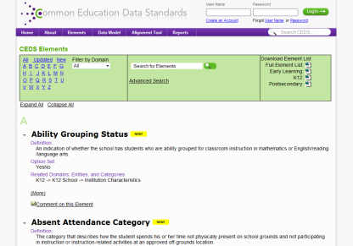
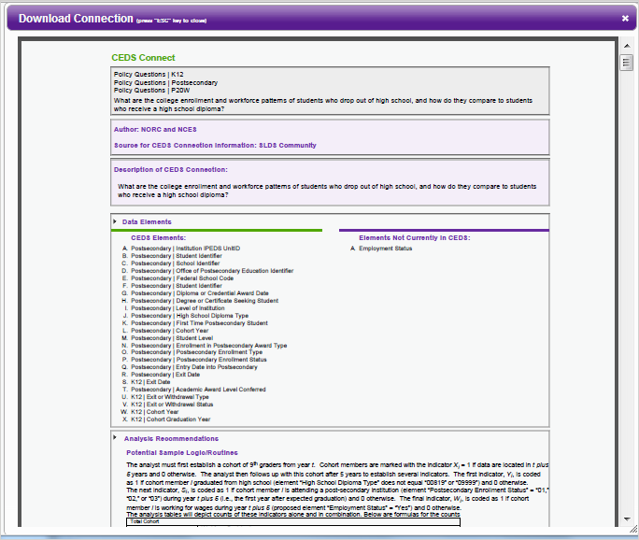
CEDS Tools
A Robust & Expanding Common, Voluntary Vocabulary drawn from existing sources
Powerful Stakeholder Tools & Models
Connect
Logical Data Model
Align

Slide 13
Using CONNECT

Slide 14
Connect
Stakeholders from various types of educational organizations can use the tool to
Answer program and policy questions
Calculate metrics and indicators
Address reporting requirements

Slide 15
Using CEDS to Answer Program & Policy Questions: Part C/619 Example
What percentage of children with an IFSP or IEP are currently enrolled in each early learning program setting?
To answer such a program question, you need
Data, possibly from multiple data systems
Data elements and their definitions
A plan to analyze the data . . .
You need the CEDS Connect tool.

Slide 16
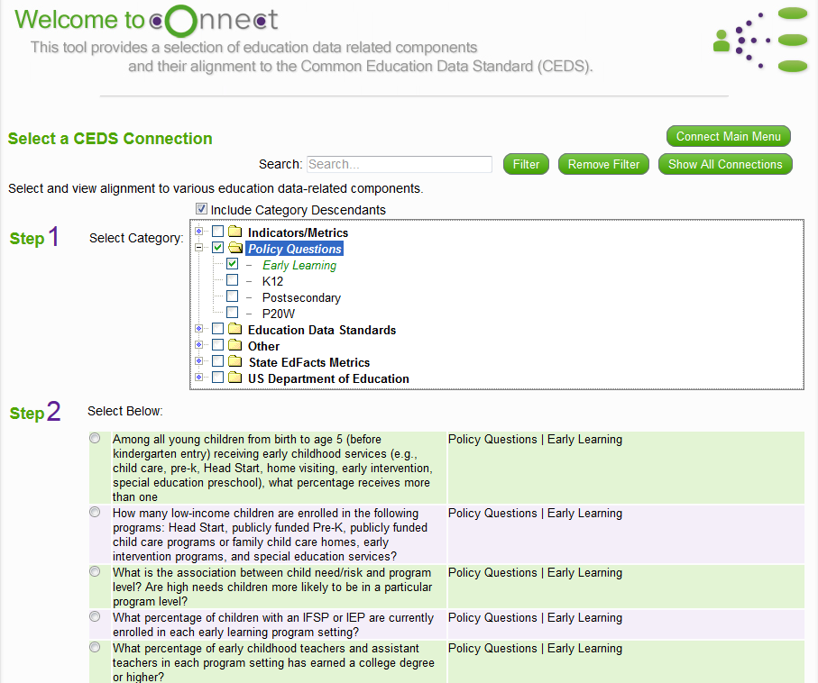
Available Connections

Slide 17
myConnect

Slide 18
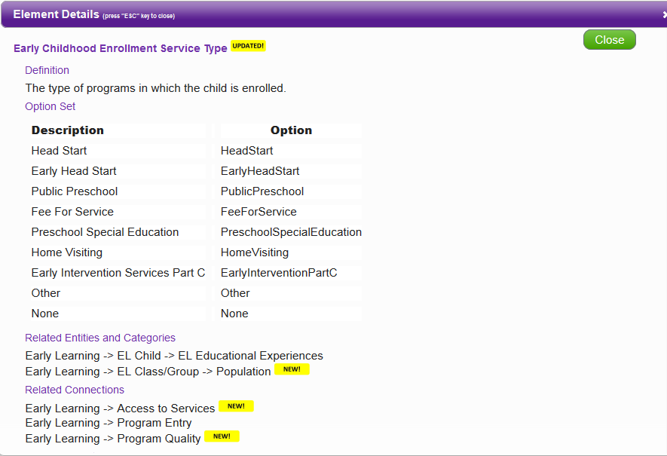
Data Element Details

Slide 19
myConnect

Slide 20
State Example: Connect Tool
State serves young children under Part C and Part B/619.
State has developed a tiered quality rating and improvement system (QRIS).
Policymakers want to know if children with disabilities who participate in a highly rated program experience better outcomes. They have posed this question to the Part C and 619 Coordinators.
Where to start?

Slide 21
Go to CEDS Connect
Options
Search for an existing Connection
Create your own Connection
Suggest a Connection
Data Elements
Multiple elements to identify an individual child across data sets or systems
Multiple elements to identify program participation
QRIS score of provider programs
Early Childhood Enrollment Service Type
Entry/exit scores for outcomes 1-3 (V. 4)
Progress in outcome area at exit (V. 4)

Slide 22
Potential Analysis Recommendations
What percentage of young children who received early intervention or special education preschool and who participated in a highly rated early learning program substantially increased their rate of growth on Outcomes 1-3?
Determine N, the unduplicated number of children receiving EI or ECSE services.
Select those who participated in another program type.
Remove children who participated in unrated or low rated programs.
Remove children without exit ratings.
Calculate progress category (a-e) for remaining children.
Apply OSEP formula (c+d)/(a+b+c+d).

Slide 23
Facilitated Discussion Question
What are benefits of using the CEDS Connect Tool?
_____________________________
_____________________________
_____________________________
_____________________________

Slide 24
Facilitated Discussion Question
What are challenges of using the CEDS Connect tool?
_____________________________
_____________________________
_____________________________
_____________________________

Slide 25
Using Align

Slide 26
Align
Web-based tool that allows users to
Import or input their data dictionaries
Align their current data to CEDS
Compare their data dictionaries
Analyze their data in relation to various other CEDS-aligned efforts

Slide 27
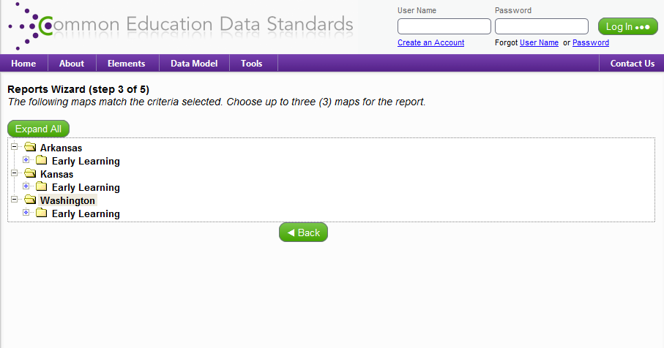
States with Early Learning Maps

Slide 28
Aligning to CEDS

Slide 29
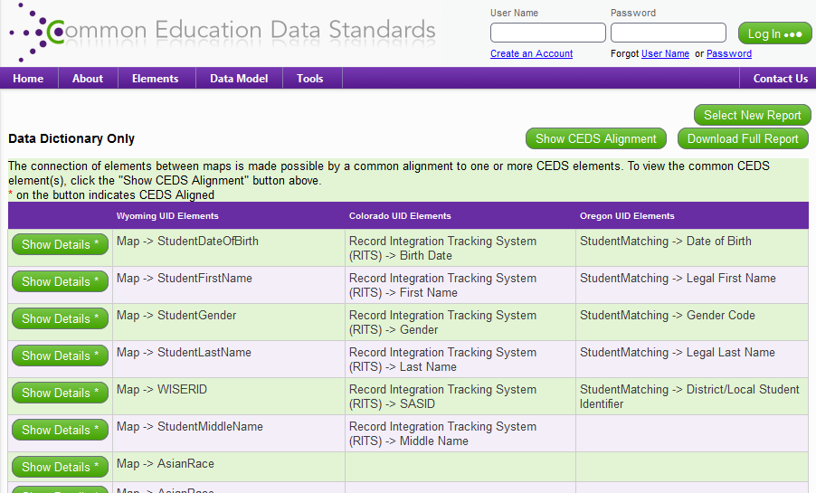
Aligning to Others

Slide 30
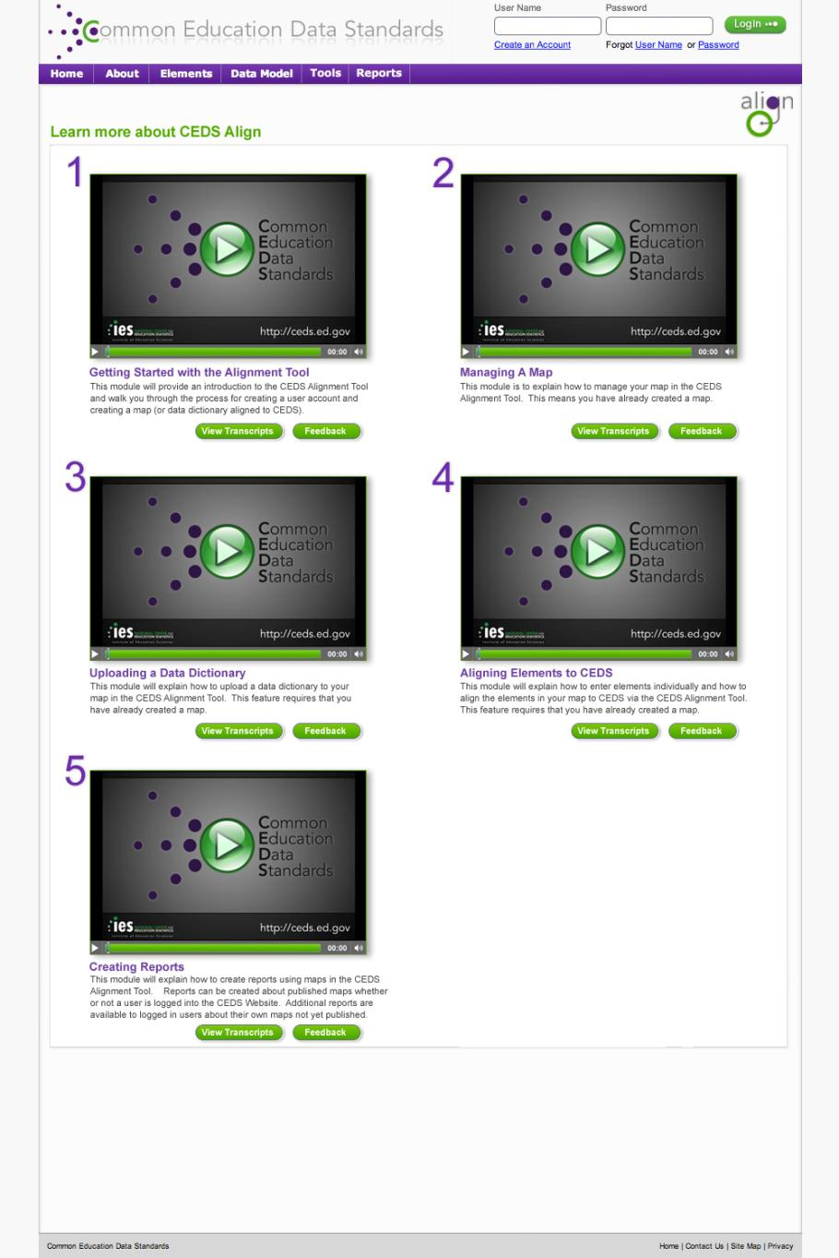

Slide 31
State Example: Align Tool
State plans to link data collected by Early Hearing Detection & Intervention (EHDI) with Part C data to guide program improvement and for CDC reporting.
Each agency can create a map using the Align tool to simplify the process of linking data sets.

Slide 32
Facilitated Discussion Question
What are benefits of aligning data elements across programs?
_____________________________
_____________________________
_____________________________
_____________________________

Slide 33
Facilitated Discussion Question
What are challenges of aligning data elements across programs?
_____________________________
_____________________________
_____________________________
_____________________________

Slide 34
CEDS Anatomy: The Basics

Slide 35
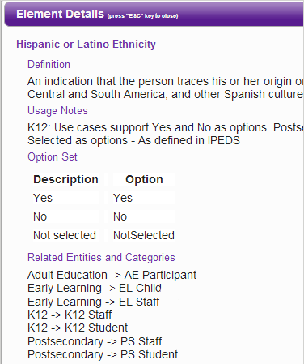
Standard Information: The Basics
Element
Definition
Hispanic
or Latino
Ethnicity
Option set
Yes
No
NotSelected
Domain
K12
Entity
K12 Student

Slide 36
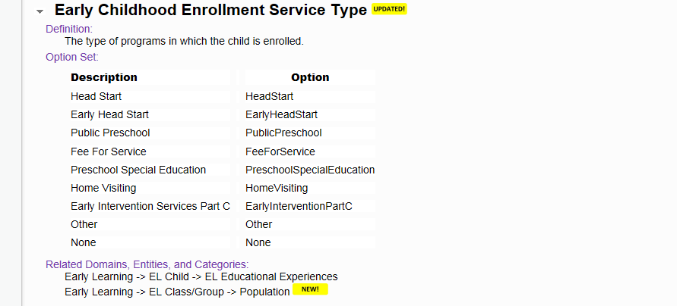
Early Childhood Enrollment Service Type

Slide 37
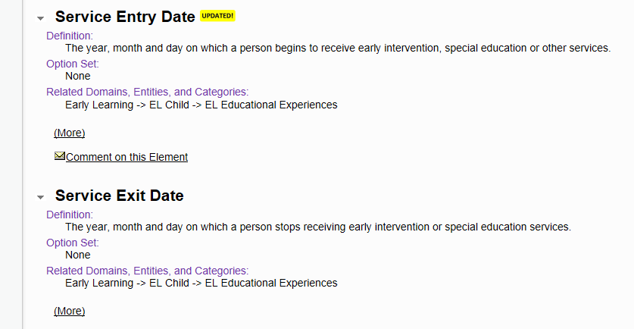
Service Entry and Exit Dates

Slide 38
Prior Early Childhood Experience

Slide 39
Program Type

Slide 40
Personnel Qualification Status

Slide 41
Potential New Data Elements for Version 4
Service Description
Service Frequency
Service Intensity
Service Setting

Slide 42
State Example: Data Elements
Building new data system
OR
Expanding or revising existing data system
CEDS provides a “jump start”

Slide 43
Facilitated Discussion Question
What additional data elements would you like to see in CEDS Version 4?
_____________________________
_____________________________
_____________________________
_____________________________

Slide 44
Wrap-Up
Do you better understand the benefits of CEDS?
What is DaSy?
Why is DaSy talking about CEDS at this conference?
What are your TA needs in relation to CEDS?

Slide 45
What is DaSy?
A 5-year TA center (Dec 2012 – Nov 2017) funded by OSEP to assist states with improving Part C and Part B preschool data by:
Building better data systems
Coordinating data systems across early childhood programs
Building longitudinal data systems
Building the capacity of states to use data

Slide 46
Why is DaSy talking about CEDS?
DaSy Goal: To develop and enhance statewide early childhood coordinated and longitudinal data systems to improve state capacity to collect, analyze, and report high quality data required under IDEA
ALIGN: Addresses reporting high quality data by providing common data dictionaries (elements, option sets, and technical specifications)
CONNECT: Facilitates data analysis by recommending analytic approaches (logic and formulas) to address program and policy questions as well as Federal reporting requirements (indicators)
Enhances capacity for coordinated and longitudinal analysis by including data elements in different domains across the P-20W continuum

Slide 47
Facilitated Discussion Questions
What are your current
resources to support
this work?
What technical
assistance might you need to use CEDS?

Slide 48
Engage with CEDS
http://ceds.ed.gov

